Slide 1

Mobility-as-a-Service
Dr. Amudhan Valavan
TECHSACS,India
Mrs.Priya Ajit
Lyko, France

Slide 2


Knowledge removes the darkness of ignorance in life

Slide 3
DIFFERENCE - MOBILITY & TRANSPORT
“Transport relates to the modes themselves and how we use them to move goods and services. Mobility is much more about people, space and movement.” – by Transport Studies Unit, Oxford University,UK
TRANSPORT | MOBILITY
Movement of people and goods between physical places/locations | Physical movement
Means and modes of conveying people and goods | Potential or ability to move
 | Meaning of movement
 | Practice and experience of moving

Slide 4
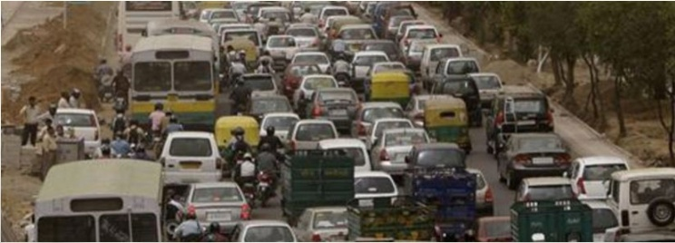
URBAN MOBILITY
Urban Mobility is an increasingly critical issues in most cities around the world.

Slide 5
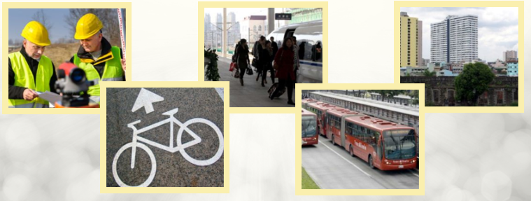
URBAN MOBILITY
Growing Demand for Travel Needs to be faced in a way that is equitable, sustainable and affordable

Slide 6
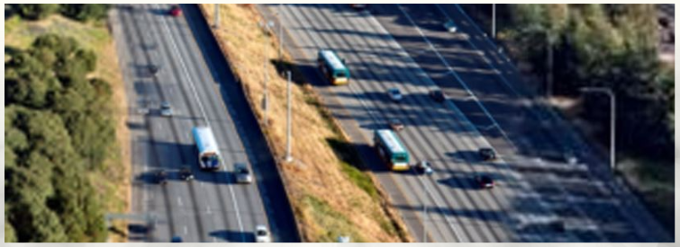
URBAN MOBILITY
Urban Transport Solutions need to be Multi dimensional , Comprehensive and Holistic. Supply side and Demand side measures to be needed.

Slide 7

URBAN MOBILITY
Policy Makers who understand and champion are comprehensive and Sustainable approaches to Urban Mobility are needed .

Slide 8
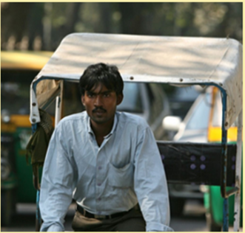
URBAN MOBILITY
The Growing Problems in Urban Transport Specifically in the developing world and the necessity of a paradigm shift in transport planning are high lighted.

Slide 9
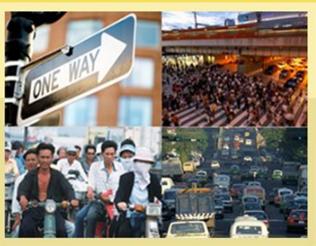
GROWING PROBLEMS OF URBAN TRANSPORT
As Developing Countries urbanize & increasing Income levels add to the Vehicle Population , certain Urban Transport Problems continue to grow and listed below :
Increasing Congestion
Traffic Accidents
Safety
Urban Air Pollution
  1. Air Quality
  2. Carbon Dioxide Emissions

Slide 10
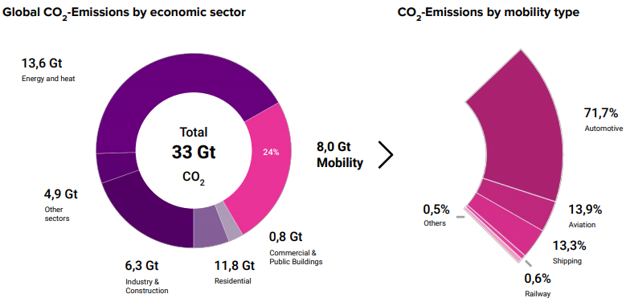
TRANSPORT IS LARGEST EMITTERS OF CO2 - EMISSIONS

Slide 11
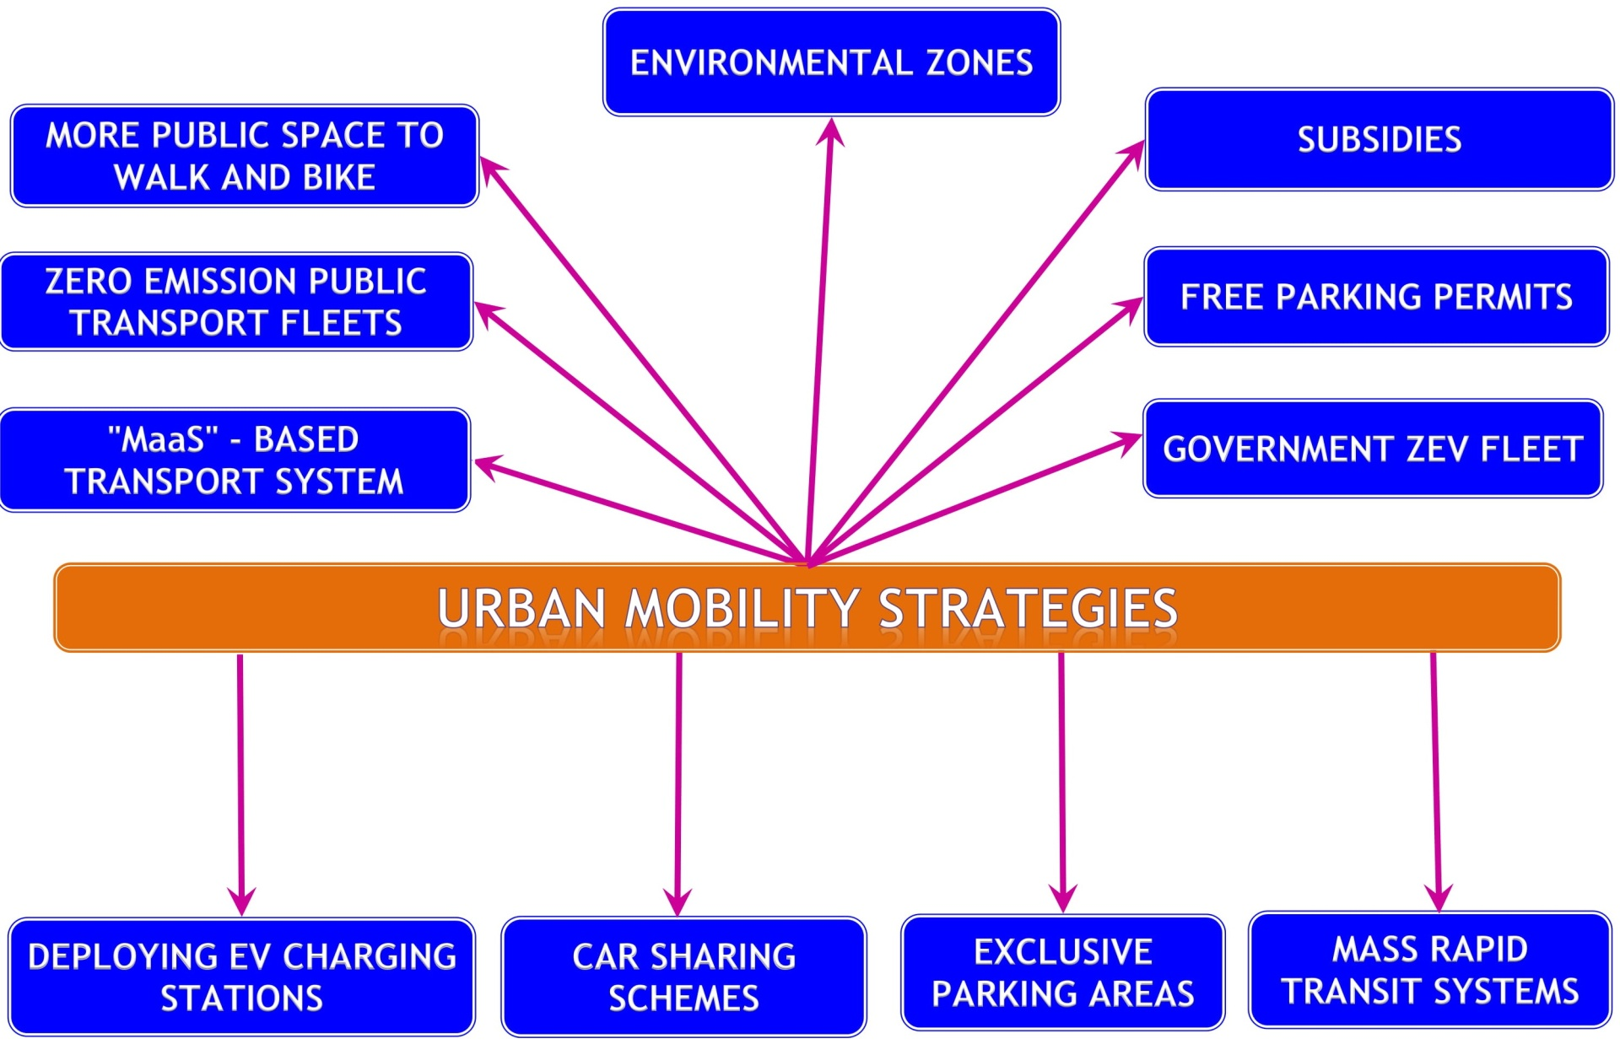

Slide 12
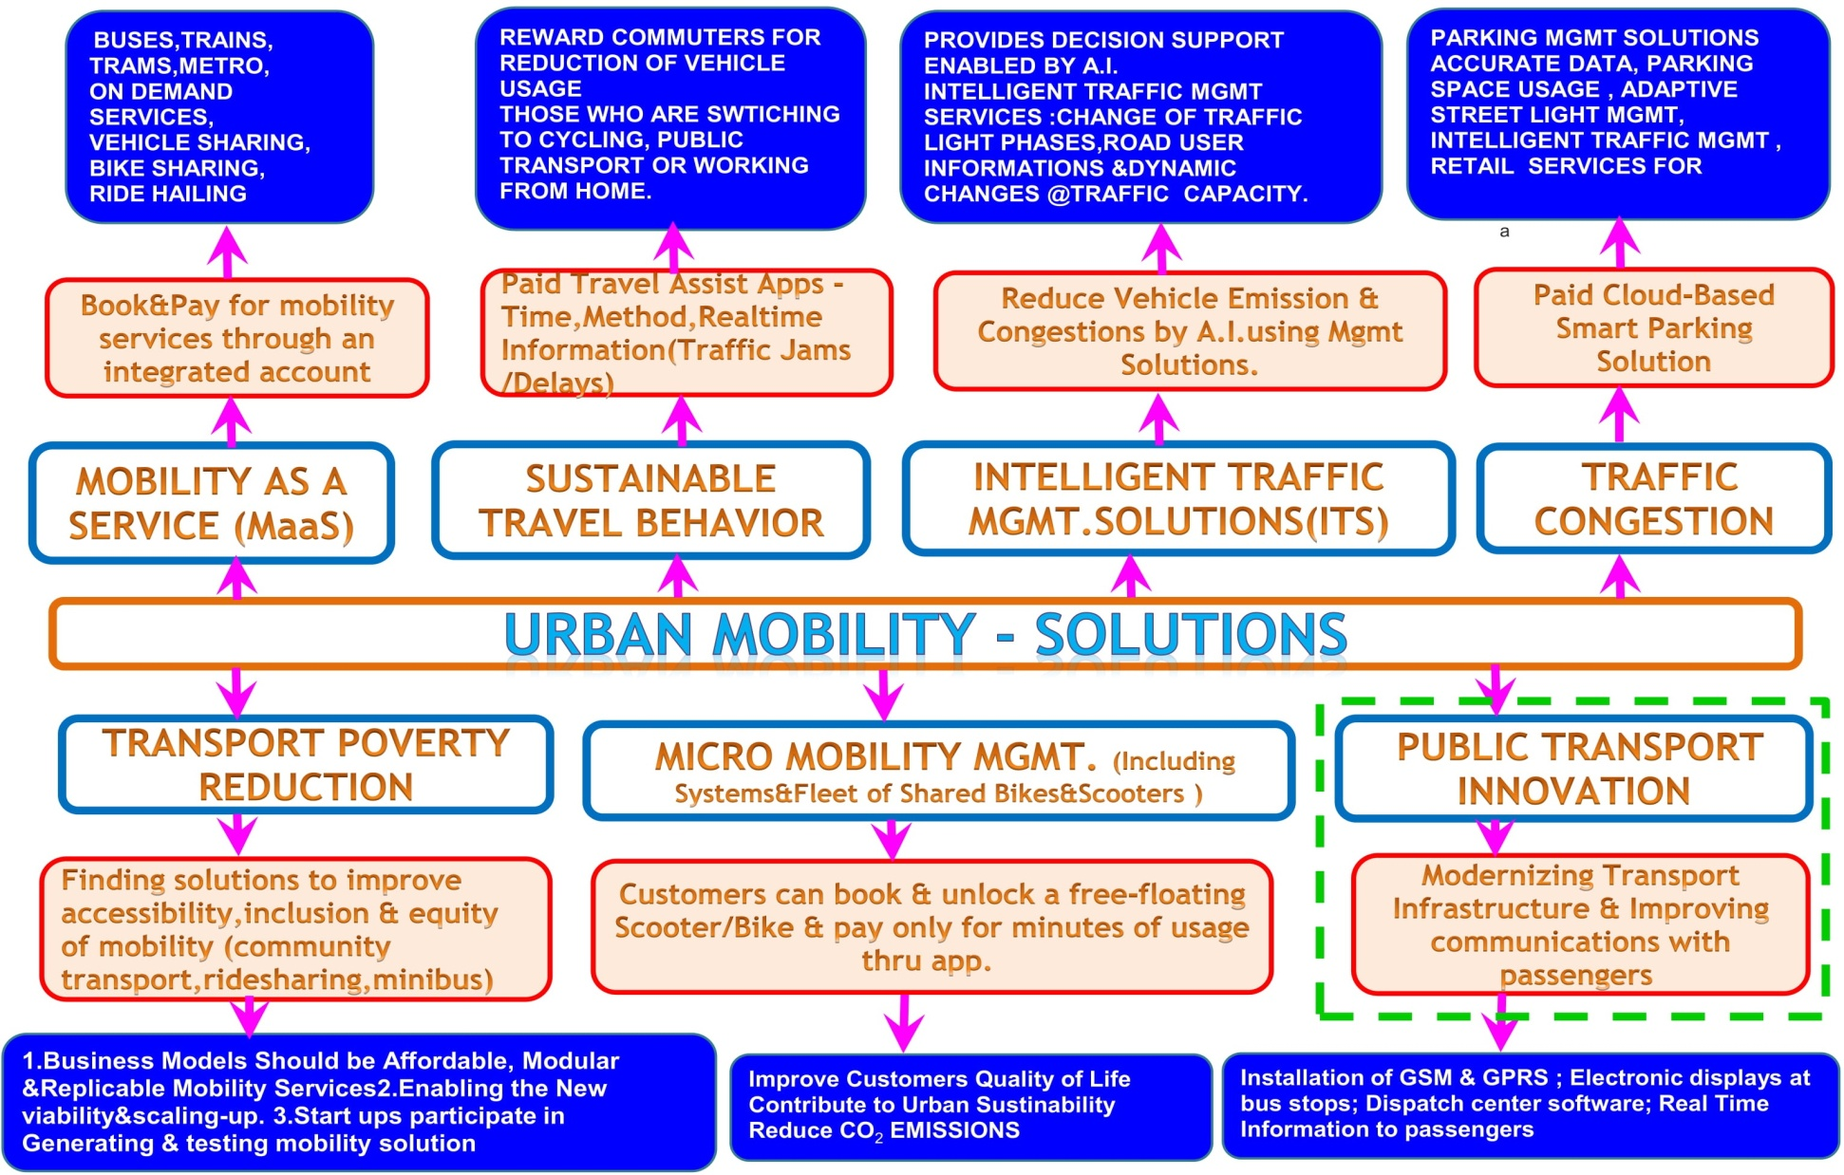

Slide 13
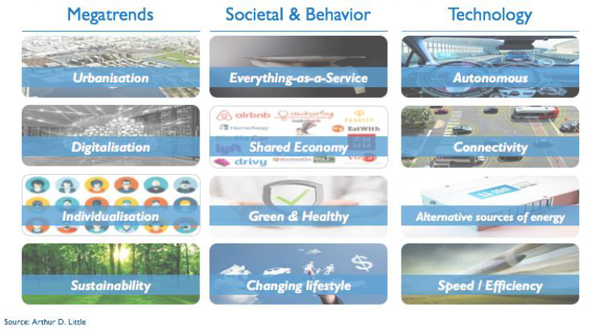
CONFLUENCE OF GLOBAL TRENDS IS RESHAPING MOBILITY SYSTEMS

Slide 14
DEFINITION –“MaaS”(Mobility as a Service)
“ Maas Definition

Slide 15
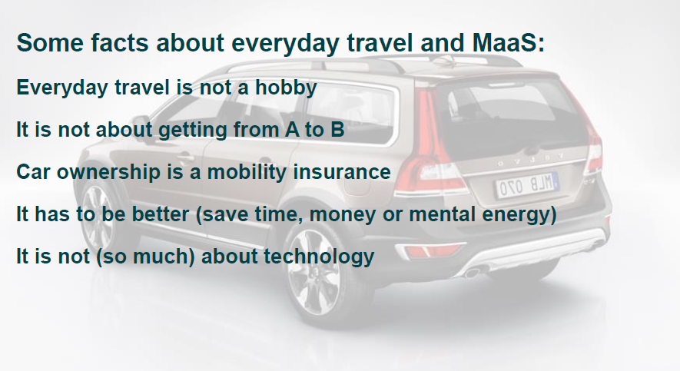
“MaaS” SIGNIFICANCE IN DAILY ACTIVITIES

Slide 16
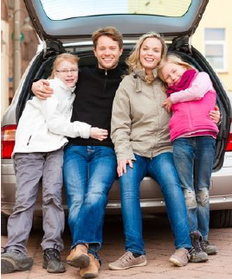
CUSTOMERS SEGMENT : CAR OWNERS
Why ?
• Good customers
• Good societal effects
How ?
• Households
• A → B - > Mornings to evenings etc
• A big promise - comprehensive
• Concept: Flexible subscription on mobility
• Close partnerships
• Geographical, not demographic

Slide 17

WHY IS “MaaS” IMPORTANT?
Cities and regions are fighting with:
● Emissions
● Life Spent in Traffic Jams
● Shortage of space
● Traffic fatalities

Slide 18

WHAT ARE THE CHALLENGES TO MAKE “MaaS” THE ALTERNATIVE TO INDIVIDUAL CARS?
Examples
● Sufficient Supply
● User experience
● Incentive
● Regulation
● Legal framework and standards
● Stakeholder management

Slide 19

ADVANTAGES OF “MaaS”
It has become easier to pay for the travel
The service has given them better control of their travel expenditures
The service has given them access to more modes of travel

Slide 20
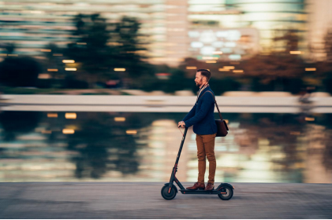
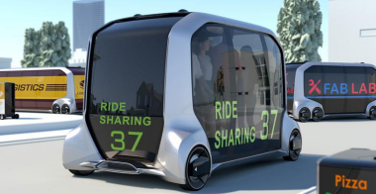
UNDERLYING TRENDS
New mobility services
• DRT/Micro transit
• Ride Hailing/
Ride Sharing/ Carpooling
• Micro Mobility
• Car sharing

Slide 21
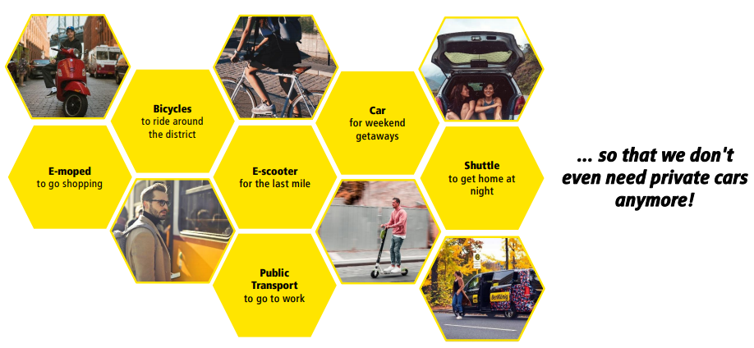
“MaaS”- ALWAYS RIGHT MODE OF TRAVEL

Slide 22
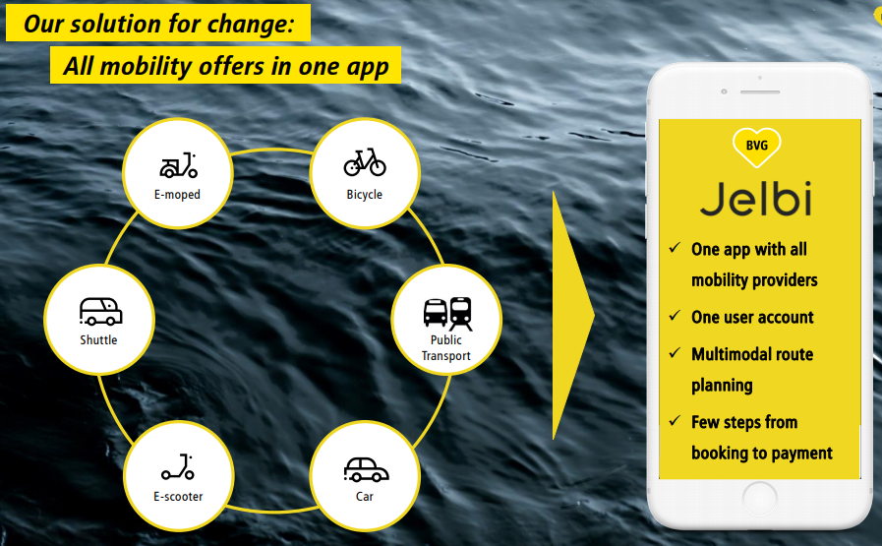
“MaaS”- ALL IN ONE
MaaS

Slide 23
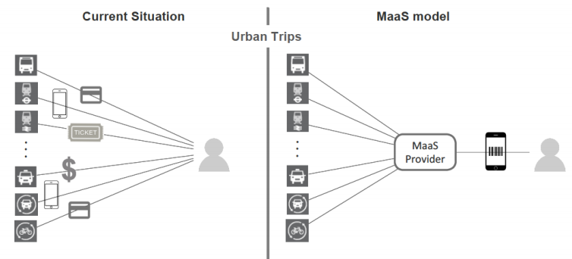
“MaaS”- MODEL

Slide 24
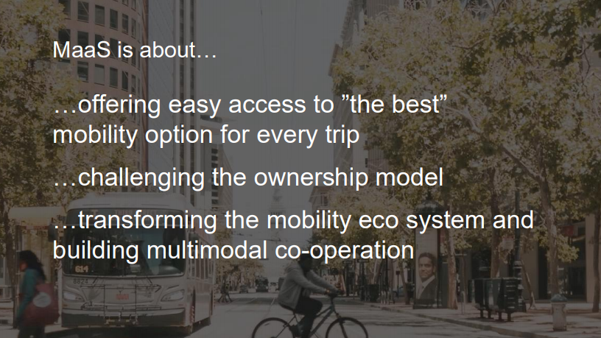
“MaaS”IS ABOUT

Slide 25
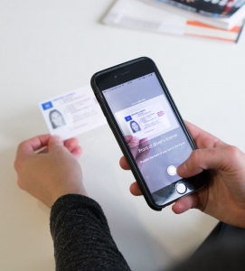
LEGAL FRAMEWORK AND STANDARDS ARE STILL IN DEVELOPMENT STAGE
● Still few standards for public transport and private mobility providers
● For “MaaS” the current data standards are not sufficient
  ○ Seamless payment
  ○ Driving license verification
  ○ T&C including liability
  ○ Privacy standards

Slide 26
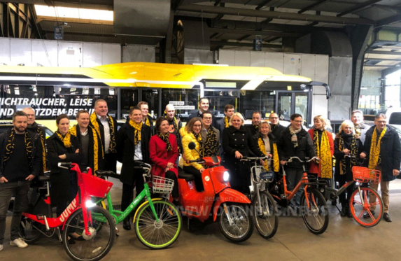
VERY COMPLEX STAKEHOLDER MANAGEMENT
● Convince the partners
● Business and benefit case
● Drafting of contracts
● Data related topics

Slide 27
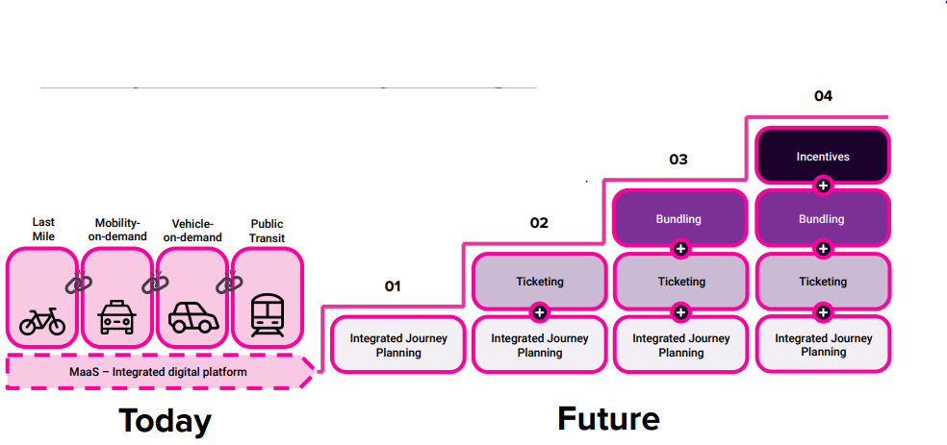
“MaaS” –MANY ADVANTAGES THEORITICALLY BUT,REALITY STILL MANY CHALLENGES

Slide 28
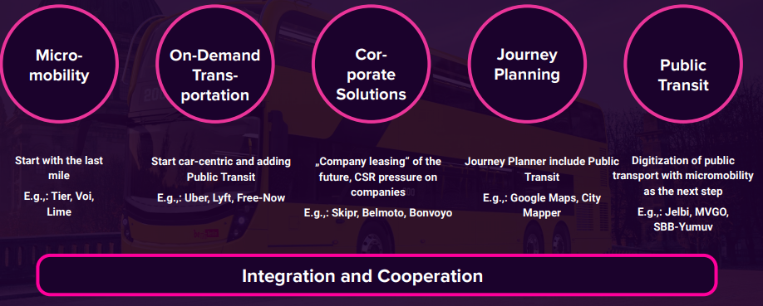
DIFFERENT APPROACHES IN THE MARKET

Slide 29
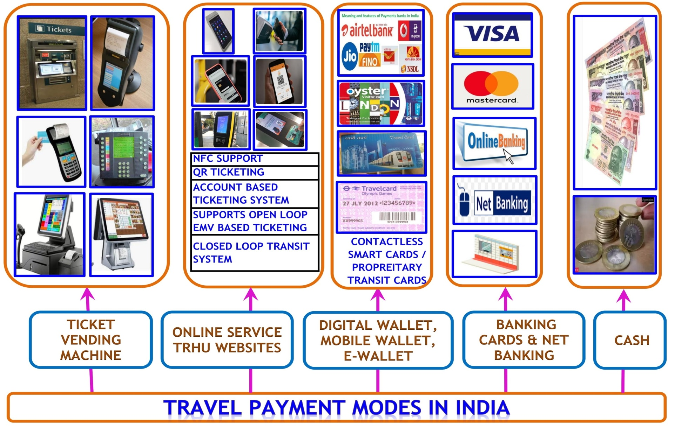
TRAVEL PAYMENTS IN INDIA

Slide 30
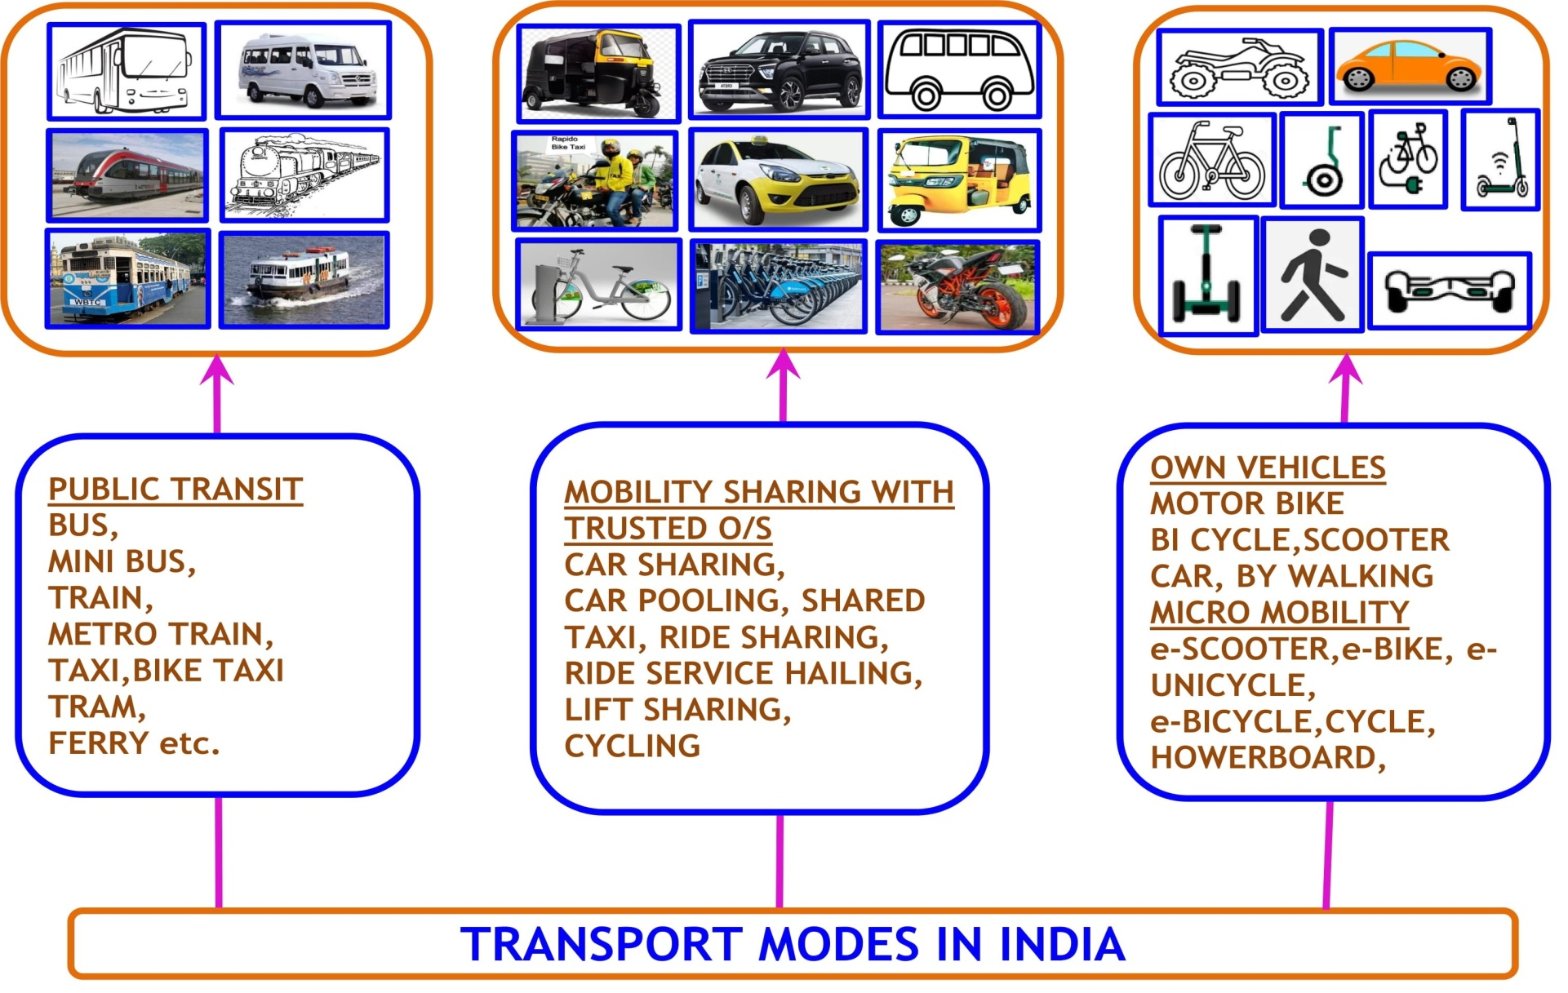
TRANSPORT PAYMENTS IN INDIA

Slide 31
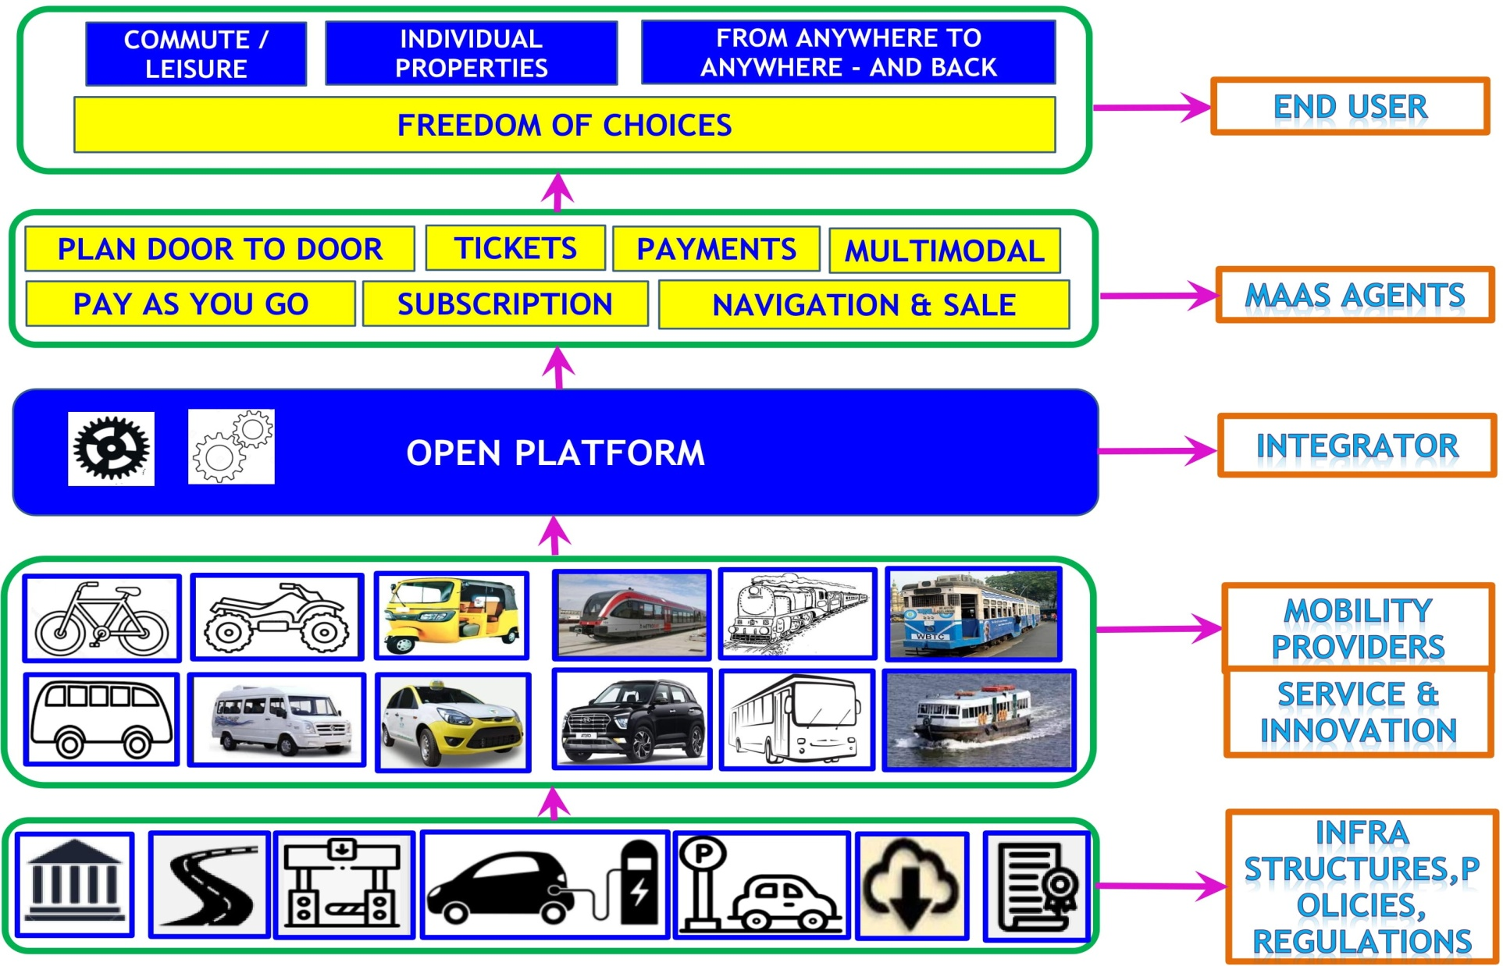
“MaaS” – AN OPEN ECO MOBILITY ECOSYSTEM

Slide 32
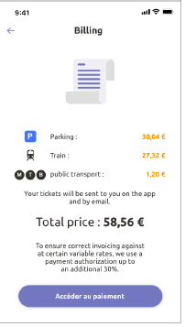
Mobility as a Service ( MaaS)
One app
Intermodal
Reservation
Payment

Slide 33
Roles of MaaS Stakeholders

Slide 34
MaaS : feature highlights
Open API Integration
Ticket & Payment Integrations
Mobility Packages
Integration of other transport related services
Data sharing and data privacy
Data analytics
Technology & Innovation
MaaS provider could either be the transport authority (or an equivalent public body) or a private firm.

Slide 35
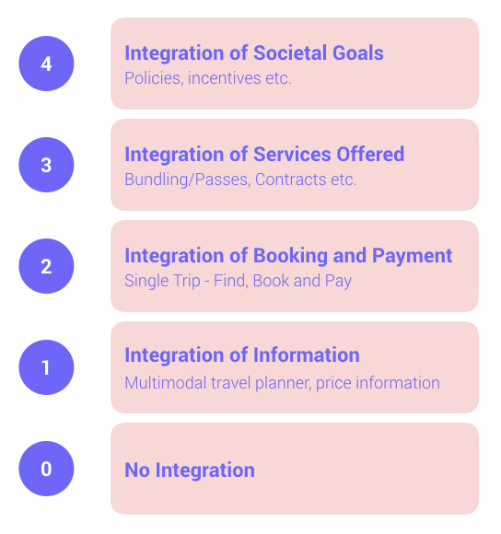











MaaS Typology

Slide 36
MaaS platforms in Europe
Project | Description | Operator | Technology Provider | City | Integration Level
Tuup | Multiple modes in one platform Intermodal journey planning |  | Kyyti | Oulu,Tampere, Turuku, Finland | Level 2
Hannovermobil | Multiple modes in one platform Intermodal journey planning | Üstra & Greater Hannover Transport Association (GVH) | Cantamen Gmbh | Hanover, Germany | Level 3
Jelbi | Multiple modes in one platform Intermodal journey planning | BVG | Trafi | Berlin, Germany | Level 2
Movizy | Multiple modes in one platform Intermodal journey planning Real time traffic updates Booking + Payment Parking | Saint Etienne Metropole | Cityway (Transdev) | Saint Etienne, France | Level 3
WienMobil | Multiple modes in one platform Intermodal journey planning Reservation and payment | Wiener Linien |  | Vienna, Austria | Level 3

Slide 37
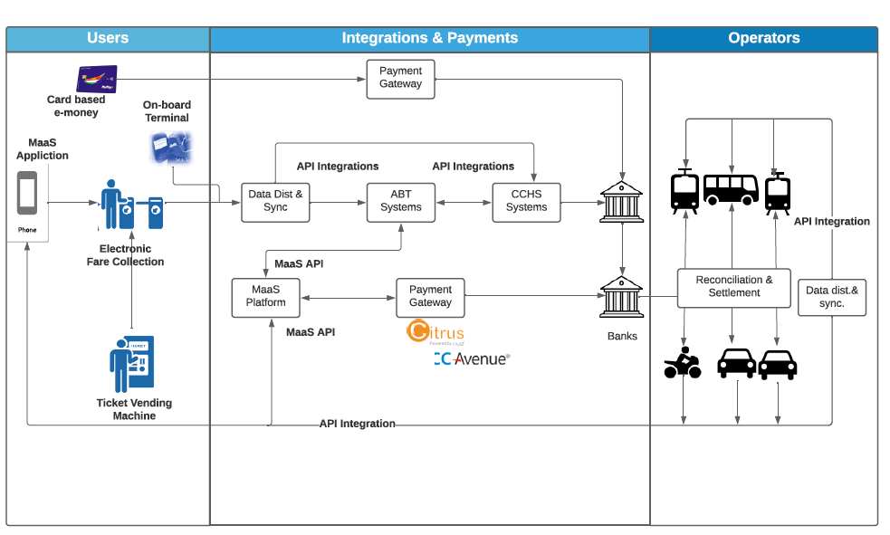
MaaS Functional Flow

Slide 38
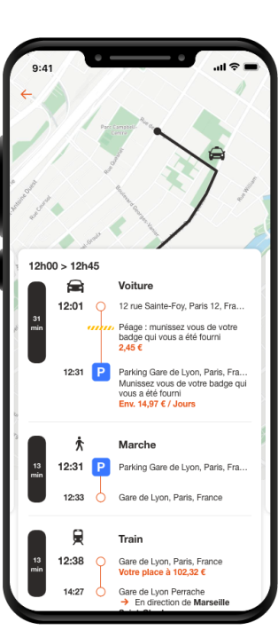
Usecase – SEAT France
Objectives of SEAT France
(Volkswagen Group Company)
Seat has developed an application that calculates the simplest multimodal route (car, motor scooter, by foot) to move from a starting point to a final point on the whole France territory
Simplifiy the multimodal calculation (with an easy-to-use app)
Integrate the appropriate multimodal operators
Integrate parking operators
Integrate modern consumption model : subscription, sharing

