Slide 1

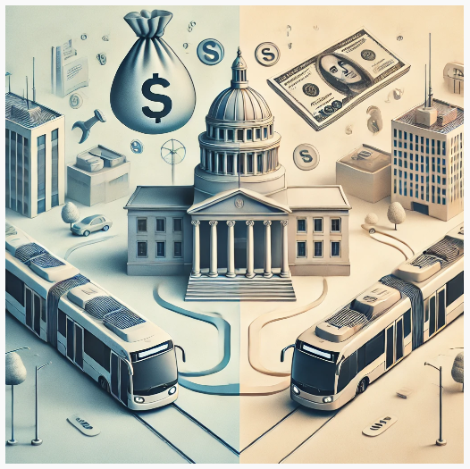
Evaluating the Impact & Innovation of Government Subsidies in Public Transit.
Govt. Subsidies - Shaping Public transit & Urban Mobility.
Global Public Transport Expert
1/974,NSC Bose Street,
Bavaani Nagar, Redhills,
Chennai-600 052.
Mail id : adroit.amudhan@gmail.com Phone : +91-9789959270

Slide 2

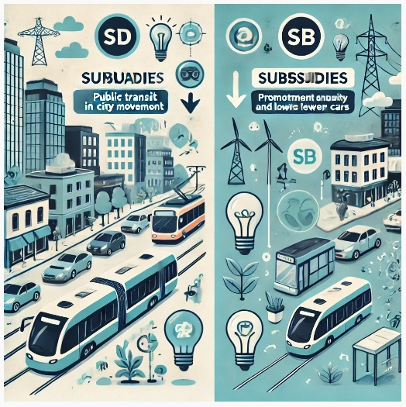
Evaluating the Impact & Innovation of Government Subsidies in Public Transit.
Introduction to the Role of Public Transit Subsidies
Government subsidies play a critical role in shaping public transit and urban mobility.
Public transport systems reduce traffic congestion, lower emissions, and offer an efficient alternative to private vehicles.
Subsidies ensure public transit remains affordable and accessible, particularly for low-income and vulnerable communities.
Subsidies promote sustainability by encouraging public transport use, reducing car dependence, and supporting green technologies.
Global innovations in subsidy allocation include data-driven approaches, dynamic pricing, and integrated funding strategies.
Public transport subsidies are the foundation of modern, inclusive, and sustainable cities.
PUBLIC TRANSIT IN CITY MOVEMENT
PROMOTE EQUITY & LOWER EMISSIONS

Slide 3




Evaluating the Impact & Innovation of Government Subsidies in Public Transit.
Key Objectives of Government Subsidies
Affordability: Ensuring public transport is accessible for all socio-economic groups
Sustainability: Supporting eco-friendly transport options
Infrastructure Development: Building and expanding transport networks
Operational Efficiency: Maintaining reliable and frequent services
1.Affordability
2. Sustainability
3. Infrastructure Development
4. Operational Efficiency

Slide 4




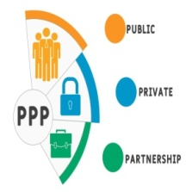

Evaluating the Impact & Innovation of Government Subsidies in Public Transit.
Types of Government Subsidies
Operational Subsidies: Cover day-to-day expenses like fuel, maintenance, and staff salaries.
Capital Investment Subsidies: Fund infrastructure projects such as metro lines, BRT systems, and rail networks.
Targeted Fare Subsidies: Make transport more affordable for specific groups (students, elderly, low-income, disabled).
Environmental & Sustainability Subsidies: Support eco-friendly solutions like electric buses and green infrastructure.
Public-Private Partnership (PPP) Subsidies: Foster collaboration between governments and the private sector for transport improvements.
Research & Development (R&D) Subsidies: Fund innovations in public transport, such as automated systems and smart ticketing.
1.Direct Subsidies
2. Capital Subsidies
3. Targeted Subsidies
4. Social Subsidies
5. PPP Subsidies
6. R&D Subsidies

Slide 5
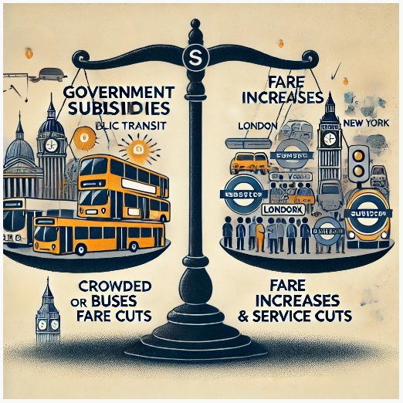
Evaluating the Impact & Innovation of Government Subsidies in Public Transit.
Challenges of Government Subsidies in Public Transit:
Balancing financial sustainability and long-term benefits is difficult, as subsidies can strain public budgets.
Over-reliance on subsidies may reduce operational efficiency, with less incentive to optimize services.
Examples: London and New York face budget shortfalls despite subsidies, leading to fare increases and service cuts, highlighting the complexity of sustainable funding.

Slide 6
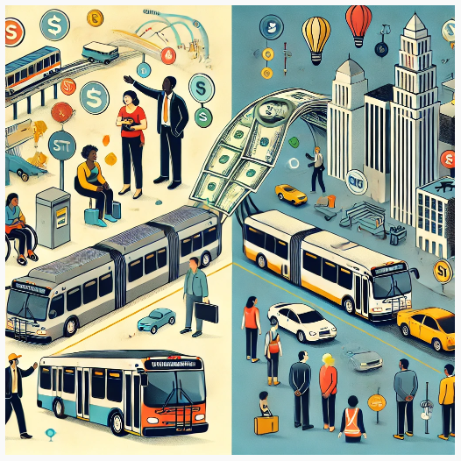
Evaluating the Impact & Innovation of Government Subsidies in Public Transit.
Importance of Government Subsidies
Subsidies keep transit affordable and accessible, particularly for low-income communities.
They allow lower fares, promoting social inclusion and equitable access to transportation.
Financial support helps maintain, expand, and modernize transit infrastructure, ensuring long-term sustainability and efficiency.

Slide 7
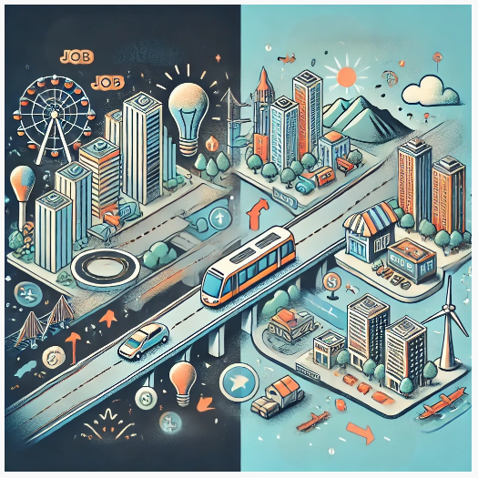
Evaluating the Impact & Innovation of Government Subsidies in Public Transit.
Economic Impact of Subsidies in Public Transit:
SUBSIDIES
JOBS
Subsidies boost local economies through job creation in transit operations and maintenance.
Affordable transit enhances mobility, allowing easier access to job opportunities and increasing economic productivity.
Encourages real estate development around transit hubs, driving urban growth, higher property values, and new businesses.
Examples include Hong Kong and Chicago, where transit systems support economic development and local commerce.

Slide 8
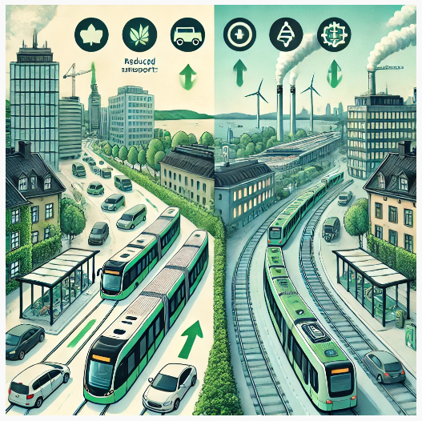
Evaluating the Impact & Innovation of Government Subsidies in Public Transit.
Environmental Impact of Subsidies in Public Transit:
Subsidies reduce greenhouse gas emissions by encouraging public transit use over private vehicles, lowering traffic congestion and carbon emissions.
They enable cities to invest in green technologies like electric buses and energy-efficient trains, promoting eco-friendly transit systems.
Example: Stockholm, where subsidies have led to high transit use, green technologies, and significant reductions in emissions, improving urban air quality.

Slide 9
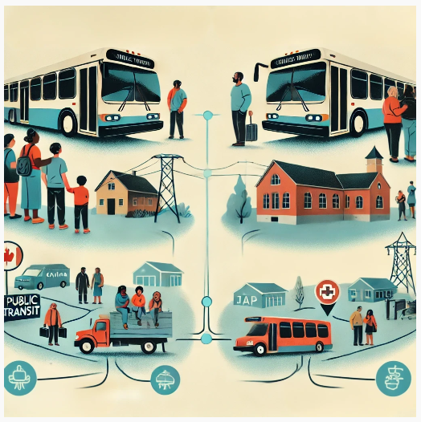
Evaluating the Impact & Innovation of Government Subsidies in Public Transit.
Social Impact of Subsidies in Public Transit:
Subsidies make transit more affordable, promoting equity and inclusion, particularly for low-income and underserved communities.
They improve access to essential services like education, healthcare, and employment, enhancing opportunities for marginalized or rural areas.
Examples include rural public transit initiatives in Canada and Japan, where subsidies bridge the gap between urban and rural areas, ensuring access to critical services.

Slide 10
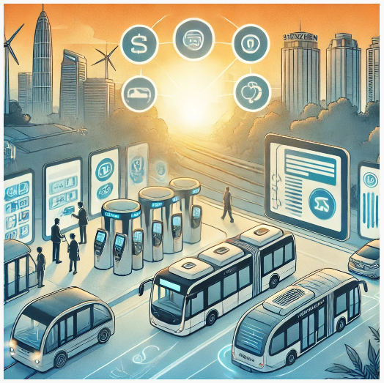
Evaluating the Impact & Innovation of Government Subsidies in Public Transit.
Innovation Driven by Subsidies in Public Transit:
Subsidies drive technological innovation, enabling smart ticketing, real-time tracking, and contactless payments, enhancing convenience and efficiency.
They support the adoption of electric and autonomous vehicles, reducing environmental impact and improving operational efficiency and safety.
Example: Shenzhen, with a fully electric bus fleet, has become a global leader in sustainable and advanced transit systems, thanks to government support.

Slide 11
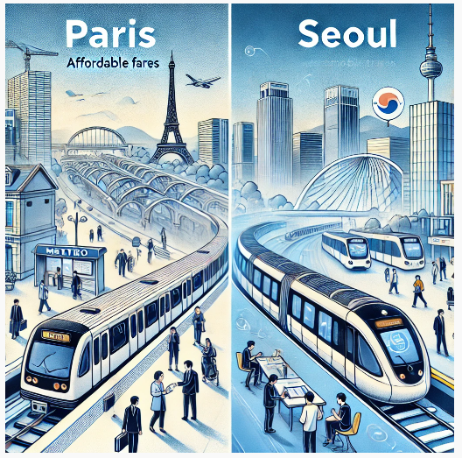
Evaluating the Impact & Innovation of Government Subsidies in Public Transit.
Global Case Study: Success implementation of Subsidies @PT:
Paris: Subsidies have enabled a vast, affordable metro network, reducing traffic congestion and providing accessible transit for millions.
Seoul: Government investments created a tech-enabled, multimodal system, integrating high-speed trains and smart buses for efficiency and sustainability.
These examples highlight how strategic subsidies and planning drive innovation and create efficient, accessible, and future-proof transit systems.

Slide 12
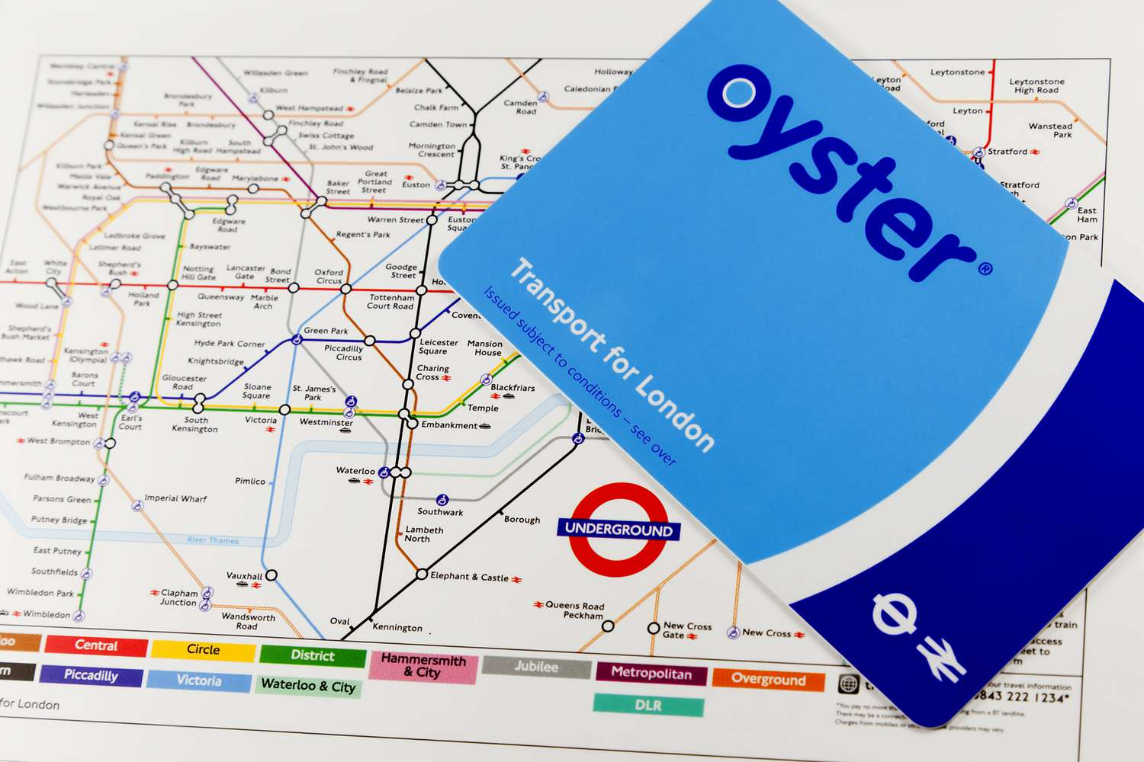
Evaluating the Impact & Innovation of Government Subsidies in Public Transit.
Global Case Study : London’s Integrated Ticketing - Revolutionized Public Transit.
Oyster Card: Simplifies fare payments across buses, trains, and the Underground.
Increased Ridership: Convenience and accessibility boosted public transit use.
Efficient Subsidy Allocation: Supports operational improvements & high service standards.
Technology-Driven Success: Enhances user experience and operational efficiency.

Slide 13
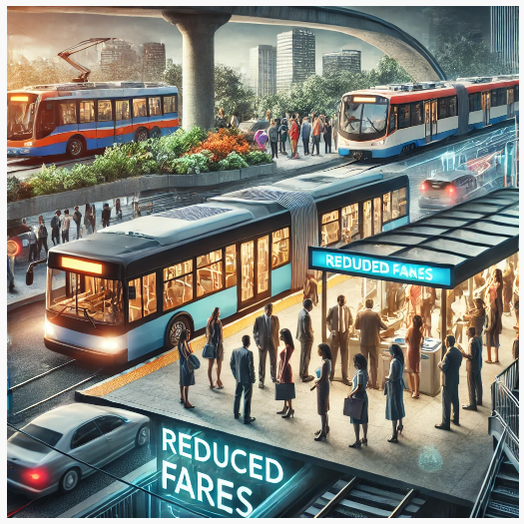
Evaluating the Impact & Innovation of Government Subsidies in Public Transit.
Best Practices for Effective Subsidy Use in Public Transit :
Targeted Subsidies: Focus on vehicle purchases and infrastructure development.
Public-Private Partnerships (PPP): Leverage private sector expertise to improve efficiency.
Revenue Generation: Through fares and property development around transit stations, reducing the need for government funding.
Balance of Benefits: Ensures high-quality services while balancing public benefit with private sector investment.
Hong Kong’s PPP Model: Hong Kong's Public-Private Partnership (PPP) model in public transport is a successful example of leveraging private sector expertise and investment to enhance the efficiency and sustainability of the system.
Under this model, private companies operate services like the MTR (Mass Transit Railway) without direct operational subsidies from the government. Instead, they generate revenue through a combination of fares and property development around transit stations. This approach reduces the need for government subsidies while ensuring high-quality, efficient, and well-maintained public transport services. It effectively balances public benefit with private sector investment.

Slide 14
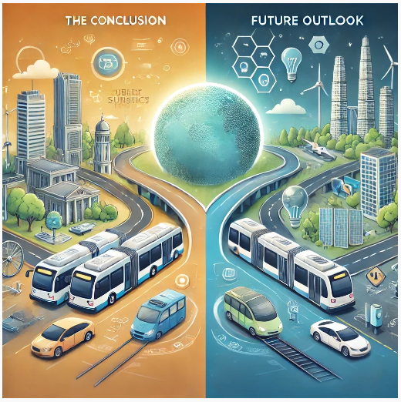
Evaluating the Impact & Innovation of Government Subsidies in Public Transit.
Conclusion & Future Outlook:
Government subsidies have made public transit more affordable, accessible, and environmentally friendly while driving innovation and promoting social equity.
Continuous innovation and re-evaluation of subsidy programs are necessary to ensure efficiency and sustainability.
The future of public transit will be shaped by public-private partnerships and emerging technologies like electric vehicles and smart infrastructure, creating sustainable, advanced transit systems for tomorrow’s cities.

Slide 15
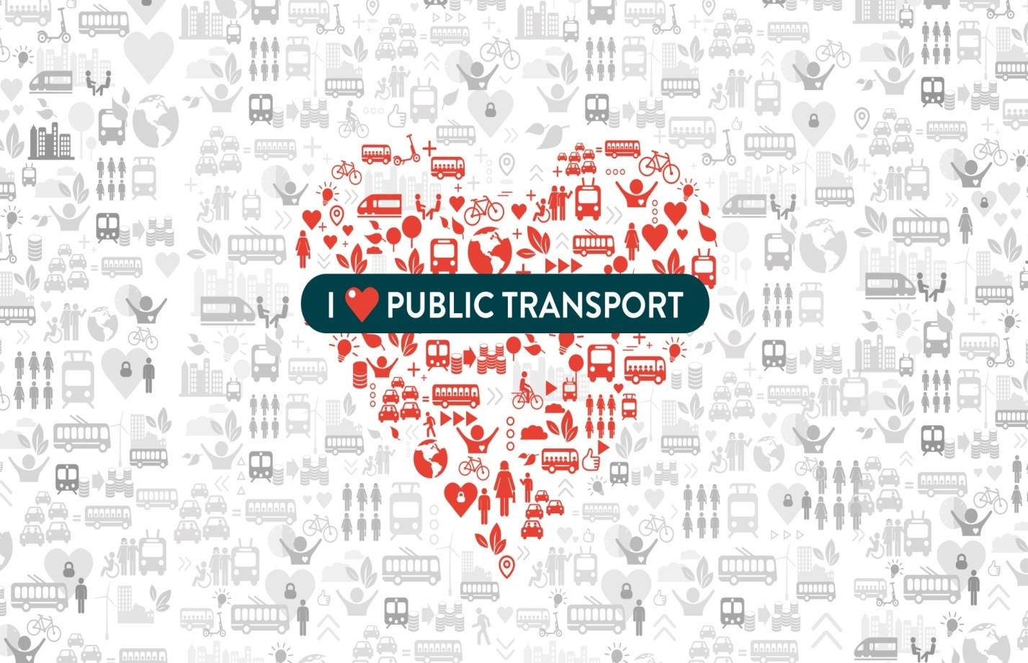
Evaluating the Impact & Innovation of Government Subsidies in Public Transit.
DO YOU LOVE PUBLIC TRANSIT ?
Notes:
Government subsidies are essential for the success of public transport, which plays a crucial role in achieving the 17 Sustainable Development Goals (SDGs). Public transport directly impacts poverty reduction, clean energy, economic growth, and climate action, helping build a more sustainable and equitable future. Subsidies keep fares affordable, improve infrastructure, and drive innovation, making transit systems more efficient, accessible, and eco-friendly.
If we want sustainable cities and communities, we must prioritize subsidies for public transit. Just as oxygen is essential for human life, subsidies are the oxygen for public transport. Without them, the system cannot thrive. I love public transport because it’s key to a better greener world. Do you love public transport? Please, love public the foundation which is safer, and a more sustainable future for all.

Slide 16

Evaluating the Impact & Innovation of Government Subsidies in Public Transit.

