Slide 1

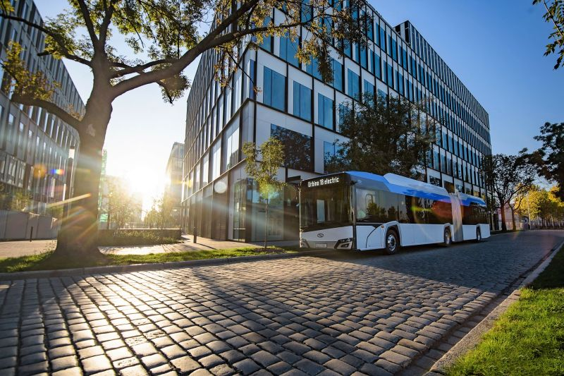
Global Pathways to Modernising Public Transport
PUBLIC TRANSIT = SUSTAINABLE FUTURE
Rethinking transit today to move the world better tomorrow.
Global Public Transport Expert
1/974,NSC Bose Street,
Bavani Nagar, Red hills,
Chennai-600 052.
Mail id : adroit.amudhan@gmail.com Phone : +91-9789959270

Slide 2



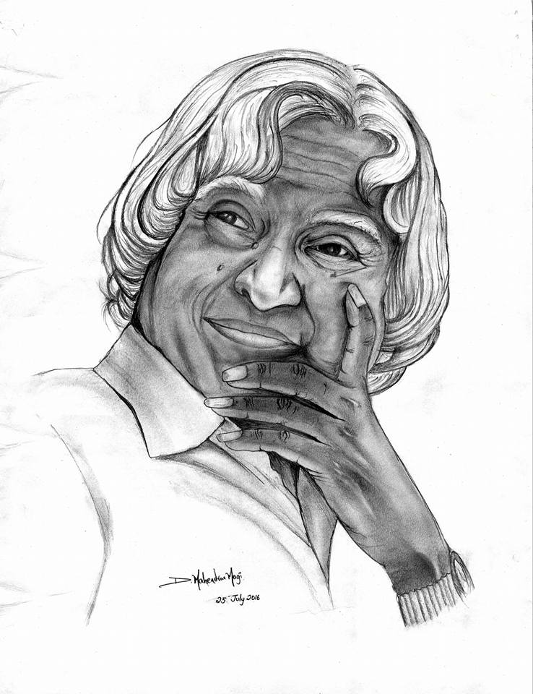
Global Pathways to Modernising Public Transport
CONCEPTS ABOUT CHANGE, FUTURE & INVESTMENT
Never See what has been done.
Only see what remains to be done
Be the Change that you want to see in the world.
Keep investing
One day you will get fantastic result
- Gautama Buddha
- Mahatma Gandhi
- Abdul Kalam
Change the way we move begins with the Changing the way we think, design and finance our mobility Systems.

Slide 3
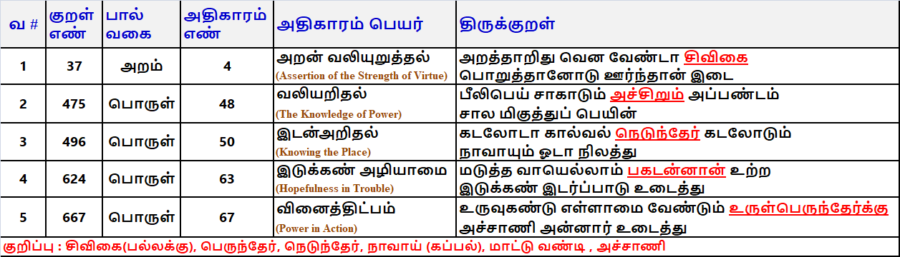
Global Pathways to Modernising Public Transport
THIRUKURAL : MENTIONED ABOUT TRANSPORT
Notes:
பல்லக்கை சுமப்பவனிடம் அதன்மேல் உட்கார்ந்து செல்லுபவன் அறத்தின் பயன் இஃது என்று கூறவேண்டாம்.
மயிலிறகை கூட அளவுக்கு அதிகமாக வண்டியில் ஏற்றினால் அளவு தாங்காமல் அச்சு முறிந்துவிடும்
வலிய சக்கரங்களையுடைய பெரியத் தேர்கள் கடலில் ஓடமுடியாது, கடலில் ஓடுகின்ற கப்பல்களும் நிலத்தில் ஓடமுடியாது.
கரடுமுரடான பாதையில் வண்டியை இழுத்துச் செல்லும் எருதுபோல் விடாமுயற்சி உடையவனிடம் வந்த துன்பமே துன்பப்படும்.
உருளும் பெரிய தேர்க்கு அச்சாணி போன்றவர்கள் உலகத்தில் உள்ளனர், அவர்களுடைய உருவத்தை கொண்டு இகழக் கூடாது.

Slide 4
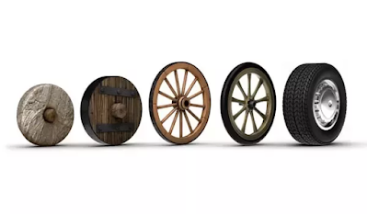
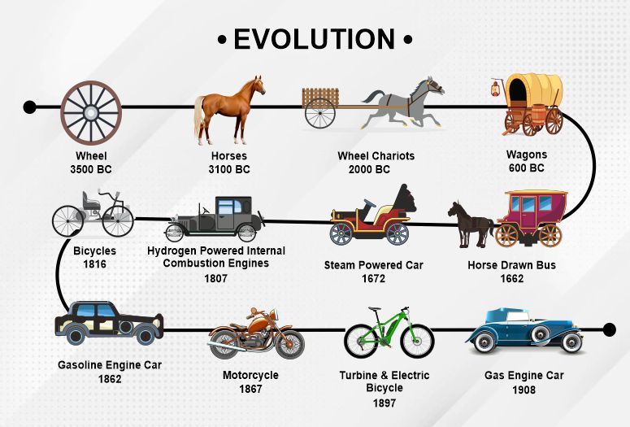
Global Pathways to Modernising Public Transport
EVOLUTION OF PUBLIC TRANSIT
Sumerians invented and used the Wheels @ Mesopotamia around 3500 BC.
John Boyd Dunlop invented the Tyre @Belfast, Ireland
Étienne Lenoir (Belgium) invented first commercially produced internal combustion engine @1860
Nicolaus Otto (Germany) developed a four-stroke internal combustion engine @1876
Rudolf Diesel(German) invented the diesel engine @ 1897

Slide 5








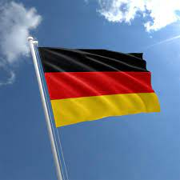
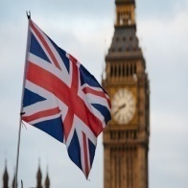
Global Pathways to Modernising Public Transport
BEST PUBLIC TRANSIT SYSTEMS IN THE WORLD
1
2
3
4
5
HONG KONG
CHINA
JURICH
SWITZERLAND
STOCKHOLM
SWEDEN
SINGAPORE
HELISINKI
FINLAND
6
7
8
9
10
OSLO
NORWAY
TOKYO
JAPAN
PARIS
FRANCE
BERLIN
GERMANY
LONDON
UK
SOURCE : WORLD ECONOMIC FORUM , Dec 21, 2022
https://www.weforum.org/agenda/2022/12/top-10-cities-with-best-public-transport/

Slide 6
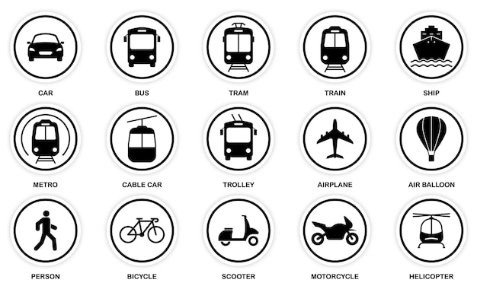













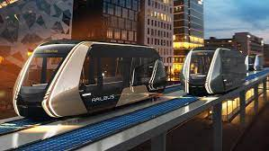

Global Pathways to Modernising Public Transport
VARIOUS PUBLIC TRANSIT MODES
CAR
BUS
TRAM
TRAIN
SHIP
FUNICULAR
CHAIR LIFT
MINI BUS
BUS RAPID TRANSIT
AUTOMATED GUIDED TRANSIT
AUTO RICKSHAWS
SCOOTER SHARING
SUBWAY / MASS RAPID TRANSIT(MRTS)
METRO
CABLE CAR
TROLLEY
TAXI
CYCLE SHARING
CAR SHARING
MONO RAIL
HELICOPTER
AUTONOMOUS TAXI
MAXI CAB
JEEP
FERRY
MAGLEV
(MAGNETIC LEVITATION)
SUSPENSION RAILWAY
WATER TAXI
CABLE FERRY
UNDER GROUND
RAILBUS
AIR BALLOON

Slide 7
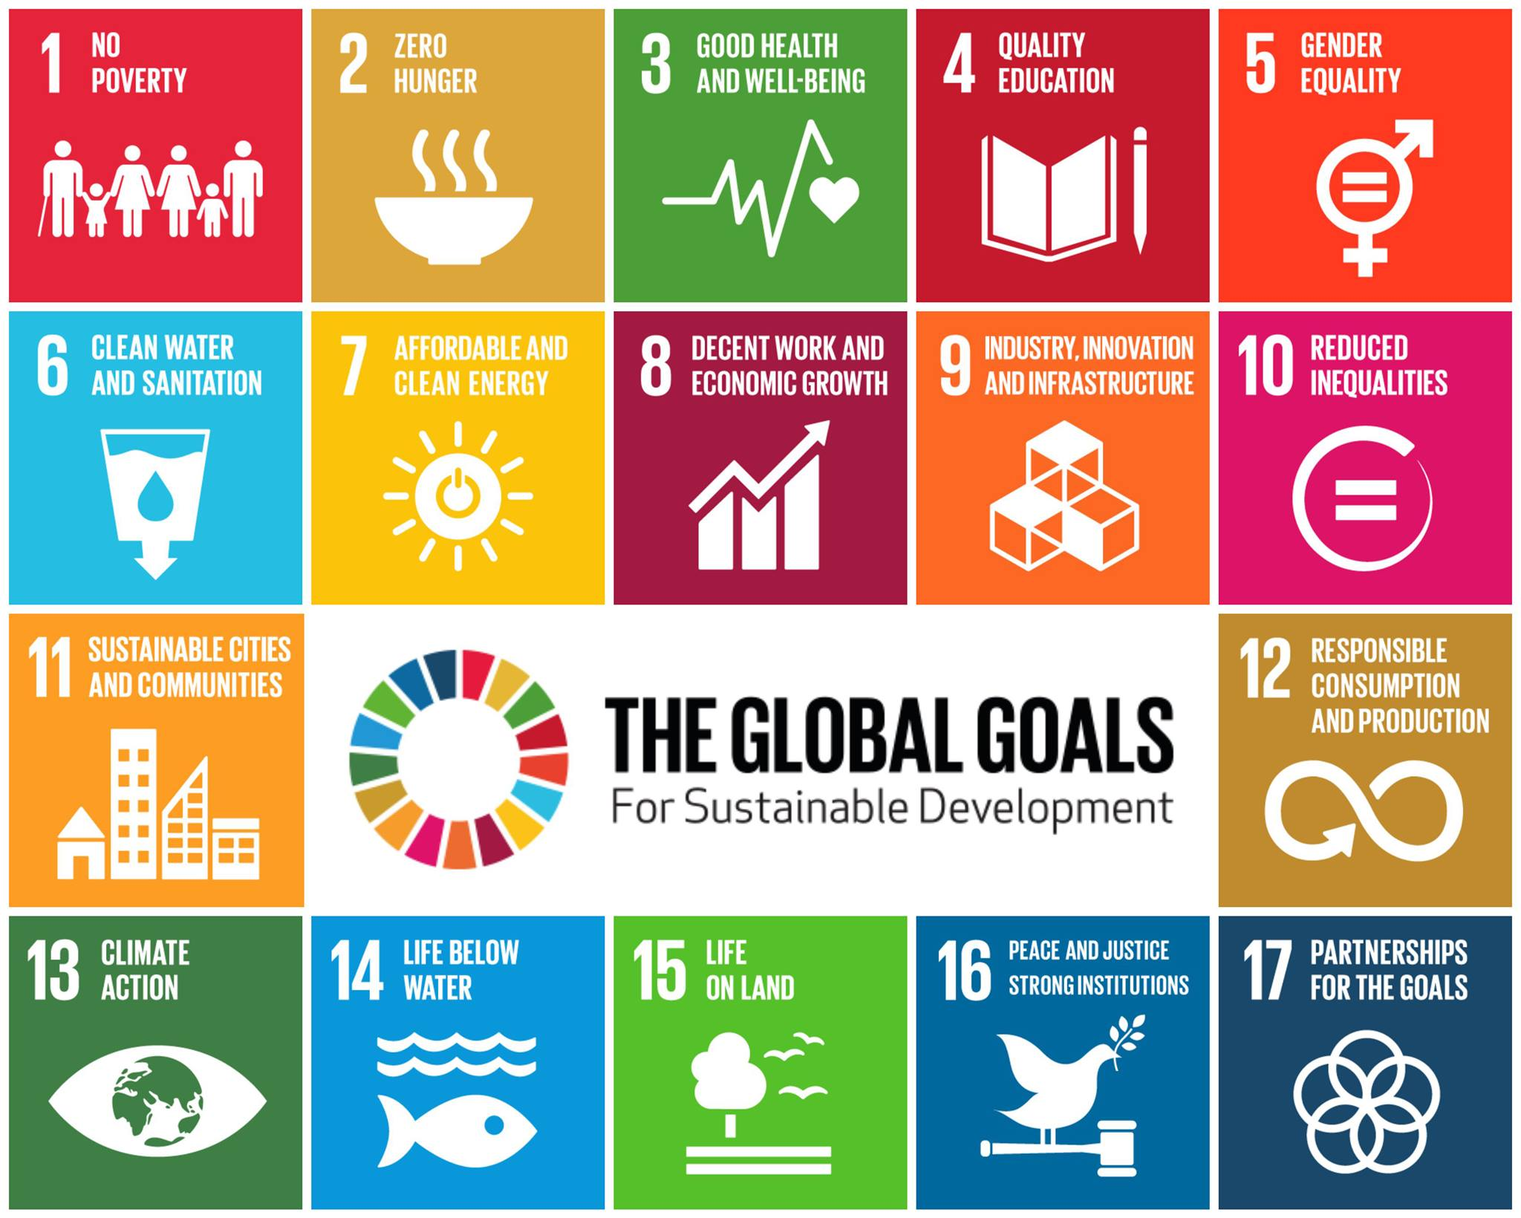
Global Pathways to Modernising Public Transport
U.N.’s SUSTAINABLE DEVELOPMENT GOALS

Slide 8
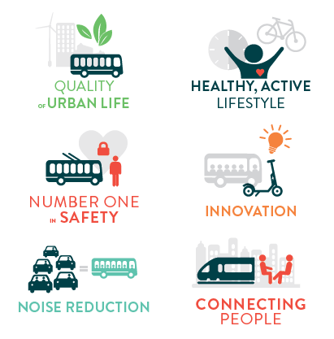
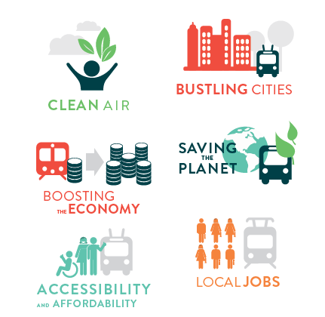
Global Pathways to Modernising Public Transport
PUBLIC TRANSIT 12 TANGIBLE BENEFITS

Slide 9



Global Pathways to Modernising Public Transport
PUBLIC TRANSIT BENEFITS
Clean air
Saving the planet
Quality of urban life
Noise reduction
PUBLIC TRANSPORT
PLANET
PEOPLE
Accessibility & affordability
Healthy, active lifestyle
Connecting people
Number one in safety
Innovation
Boosting the economy
Local jobs
Bustling cities
PROGRESS

Slide 10
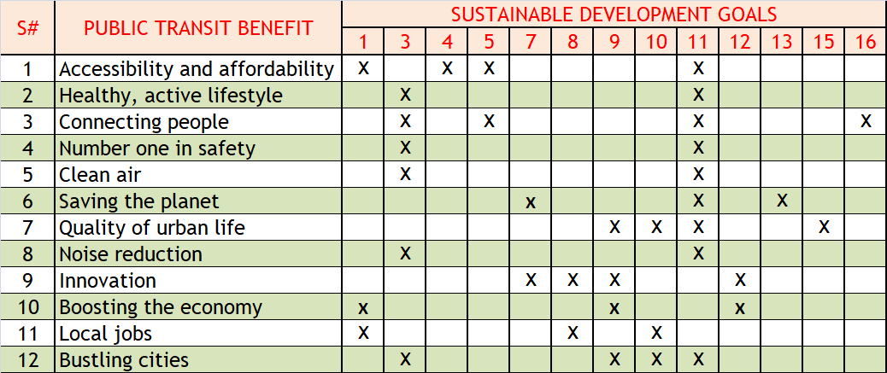
Global Pathways to Modernising Public Transport
MOST SDGS LINK TO MULTIPLE BENEFITS

Slide 11
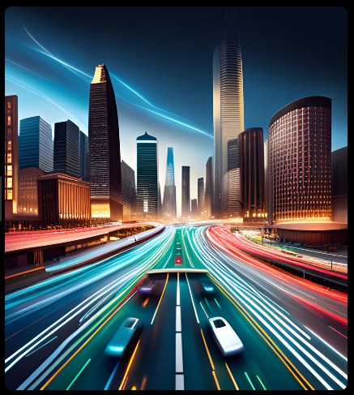
Global Pathways to Modernising Public Transport
MODERNISING P.T. : A NECESSITY, NOT A CHOICE
Rising Urbanisation = Crushed cities
Climate crisis knocking on our doors
Personal Vehicle Addiction = Congestion, Inequity
Need for Inclusive, Tech-driven, Resilient Mobility
Negative Economic & Social Impacts
🔔 Public Transit is not a backup plan, it’s THE PLAN.

Slide 12
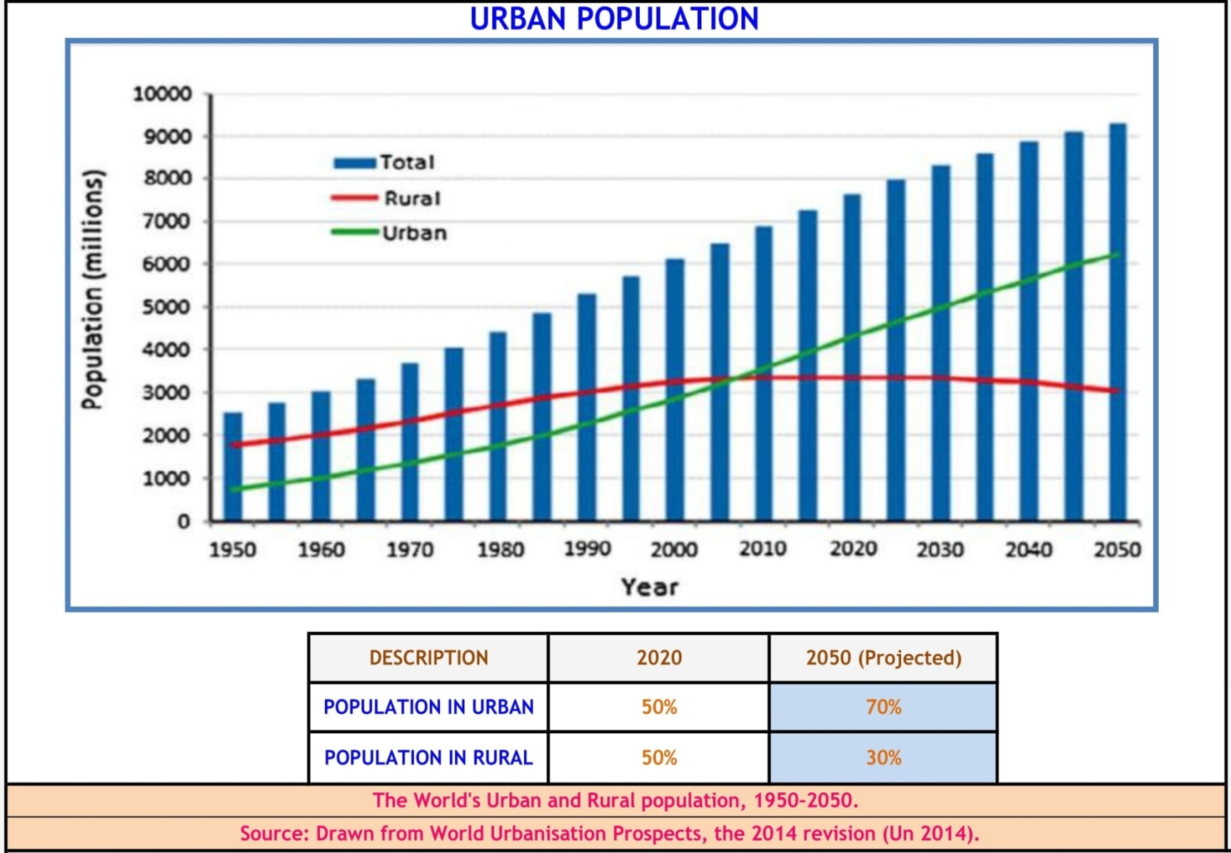
Global Pathways to Modernising Public Transport
URBAN POPULATION RISE

Slide 13
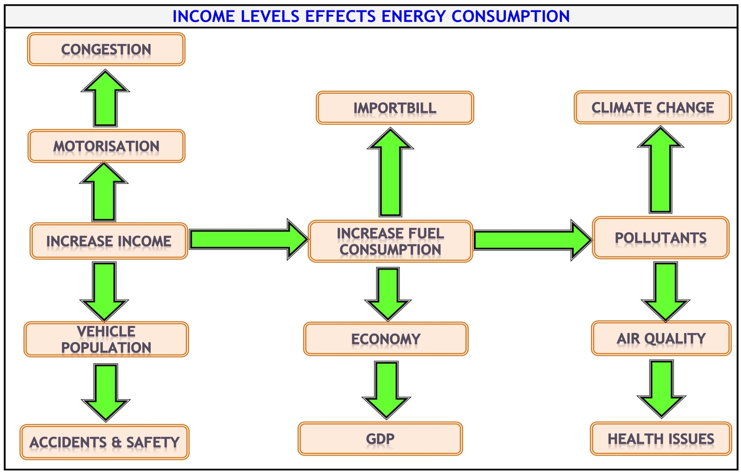
Global Pathways to Modernising Public Transport

Slide 14
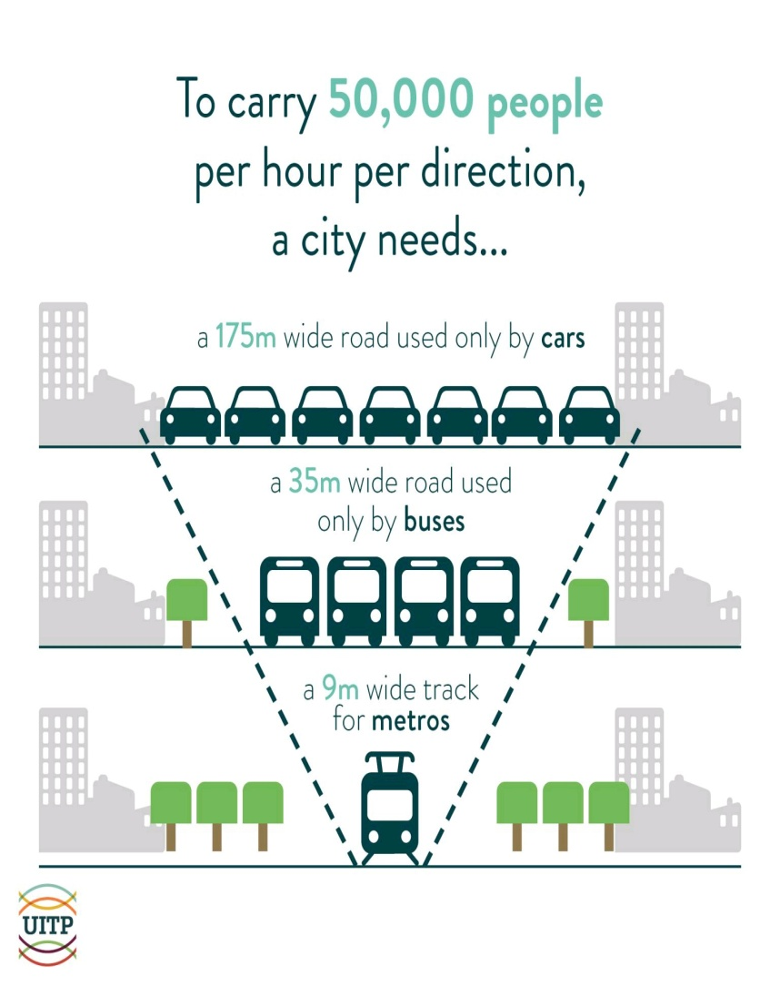
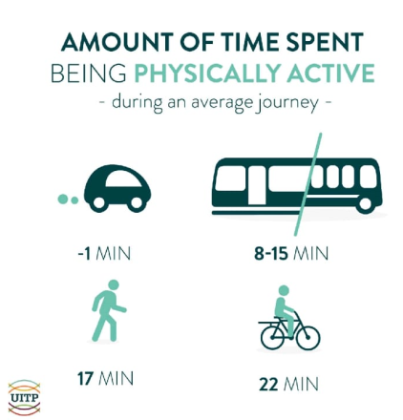
Global Pathways to Modernising Public Transport
RISING URBANISATION = CRUSHED CITIES
Crowded Cities, Crumbling Systems

Slide 15
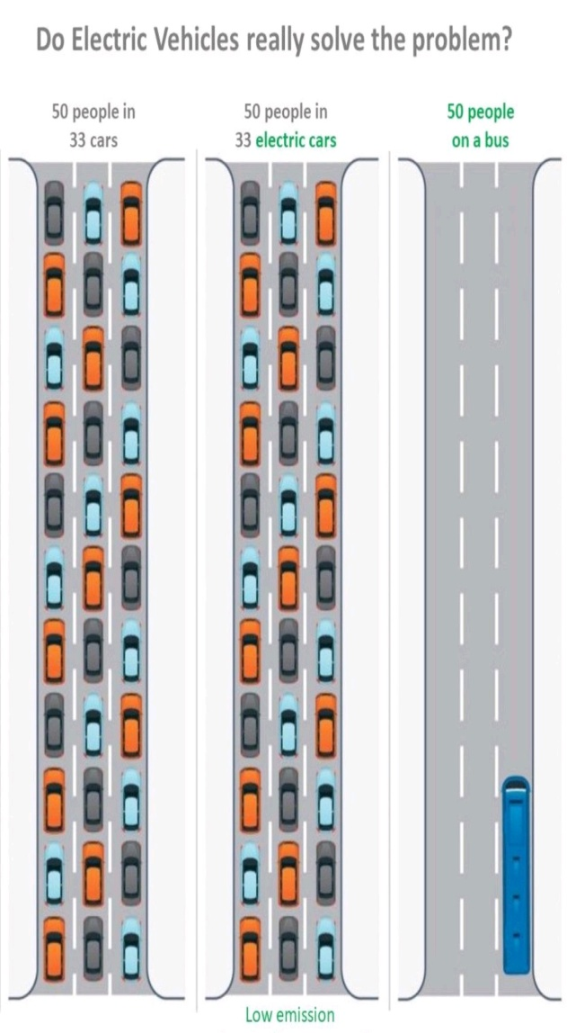
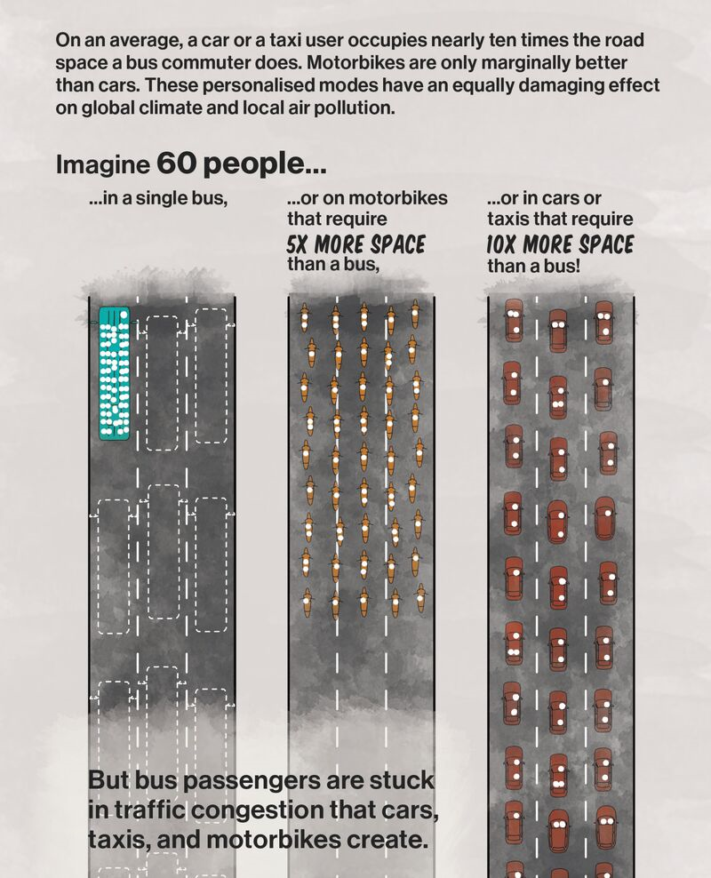
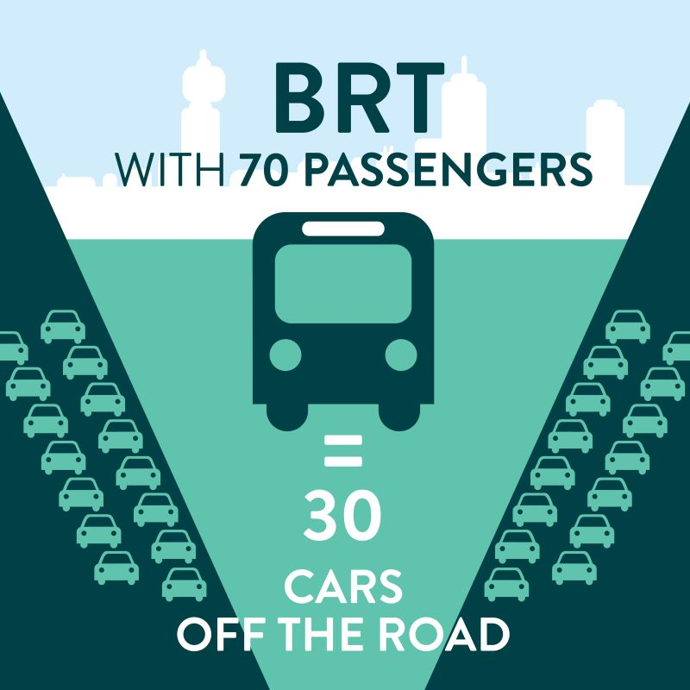
Global Pathways to Modernising Public Transport
RISING URBANISATION = CRUSHED CITIES

Slide 16
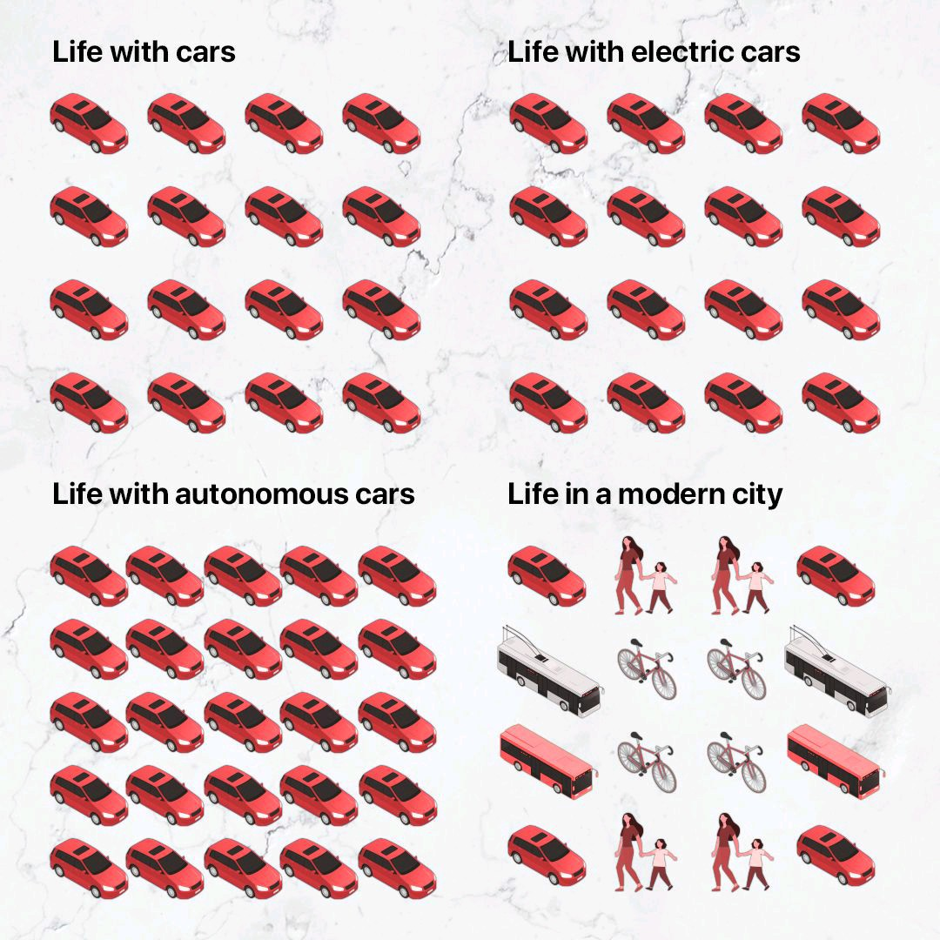
Global Pathways to Modernising Public Transport
RISING URBANISATION = CRUSHED CITIES

Slide 17
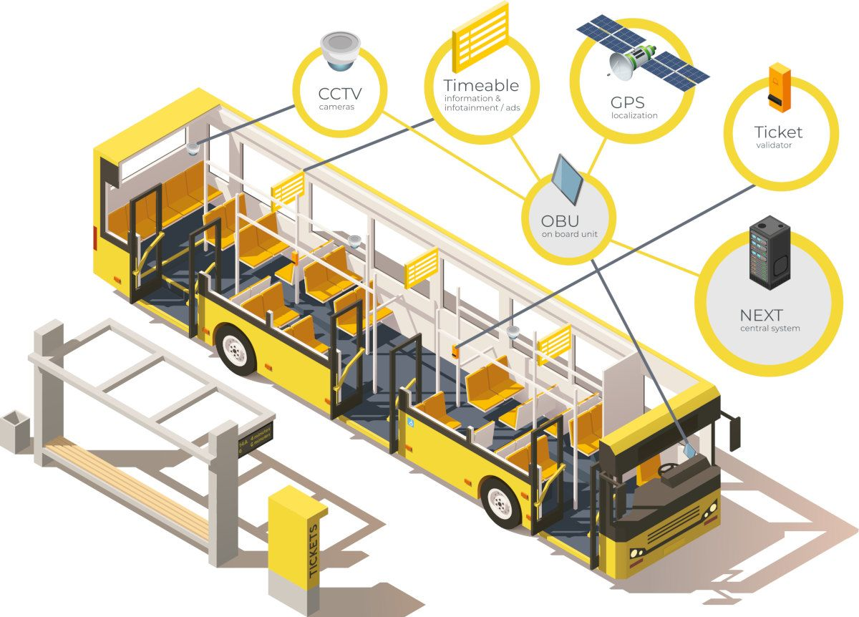
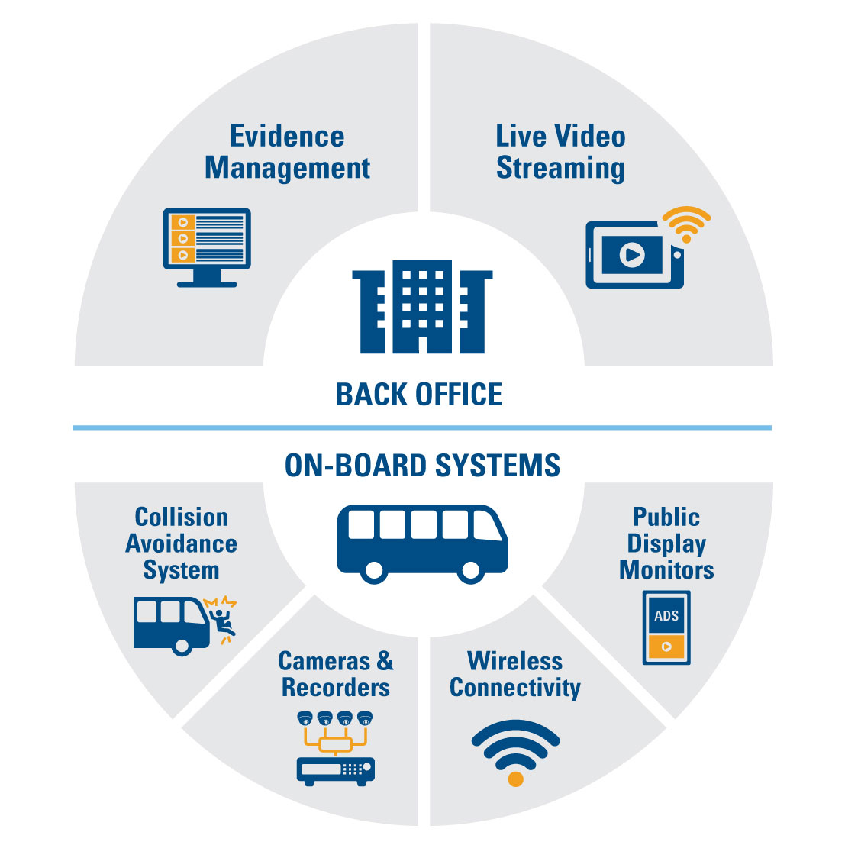
Global Pathways to Modernising Public Transport
TECHNOLOGY DRIVEN

Slide 18
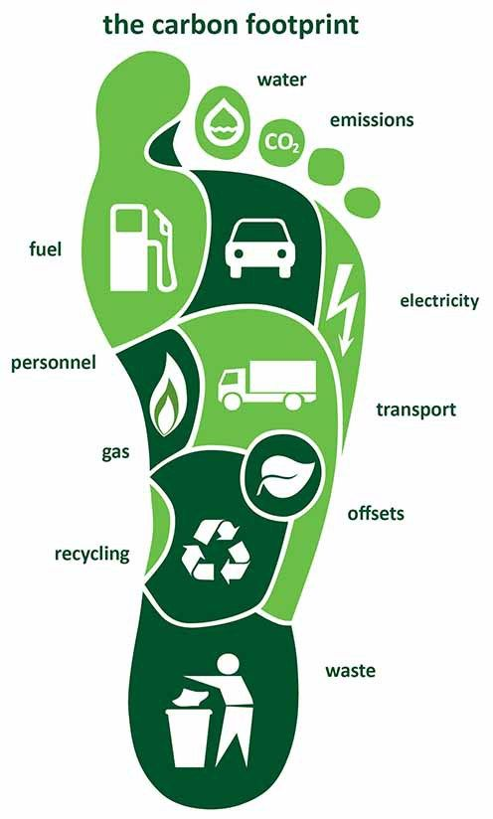
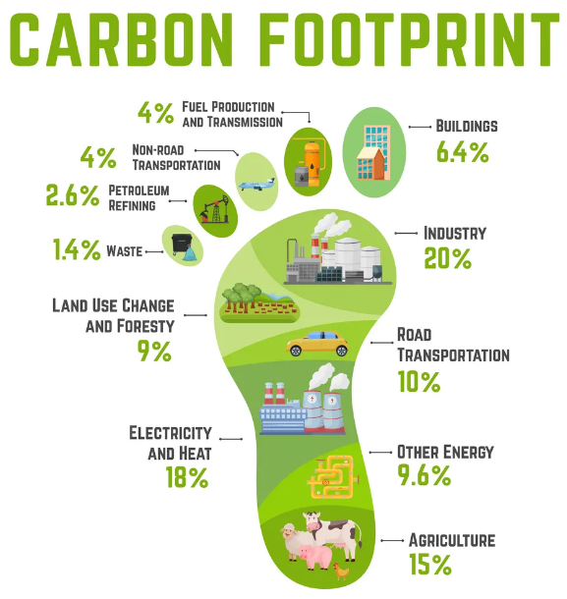
Global Pathways to Modernising Public Transport
CARBON FOOT PRINT & SHARE

Slide 19
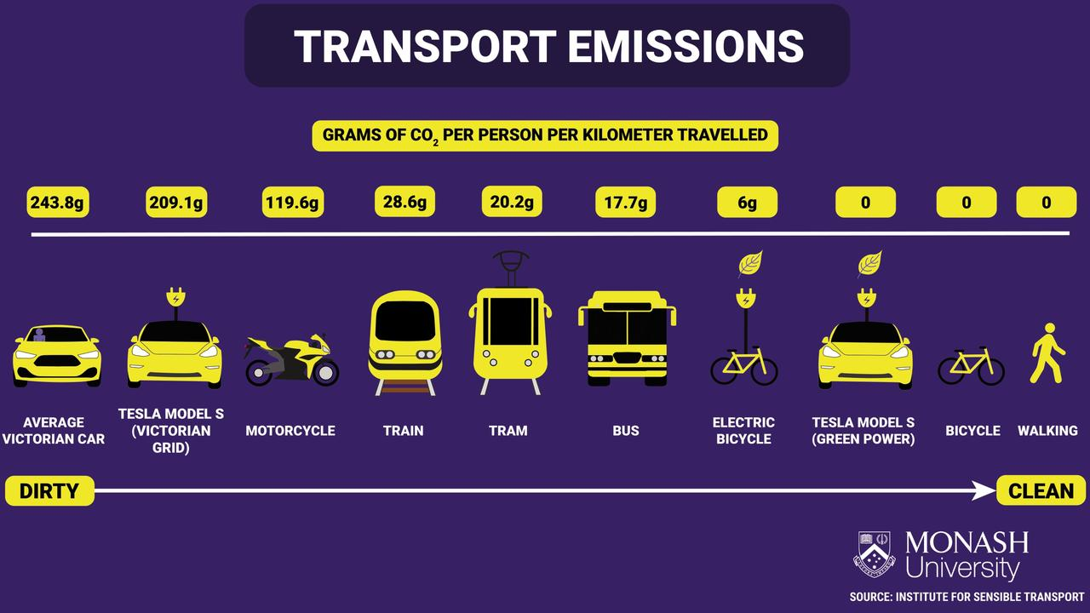
Global Pathways to Modernising Public Transport
TRANSPORT EMISSIONS
VARIOUS VEHICLE TYPES

Slide 20
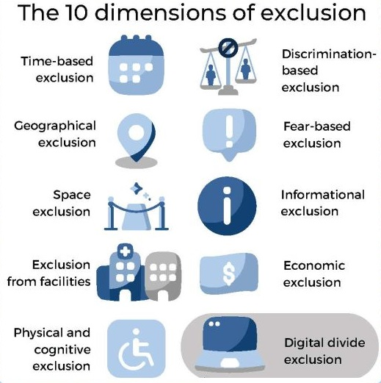

Global Pathways to Modernising Public Transport
WIDER IMPACTS OF PUBLIC TRANSPORT
EFFECTIVE MOBILITY
EFFICIENT CITY
5XE
EQUITY
ECONOMY
ENVIRONMENT

Slide 21
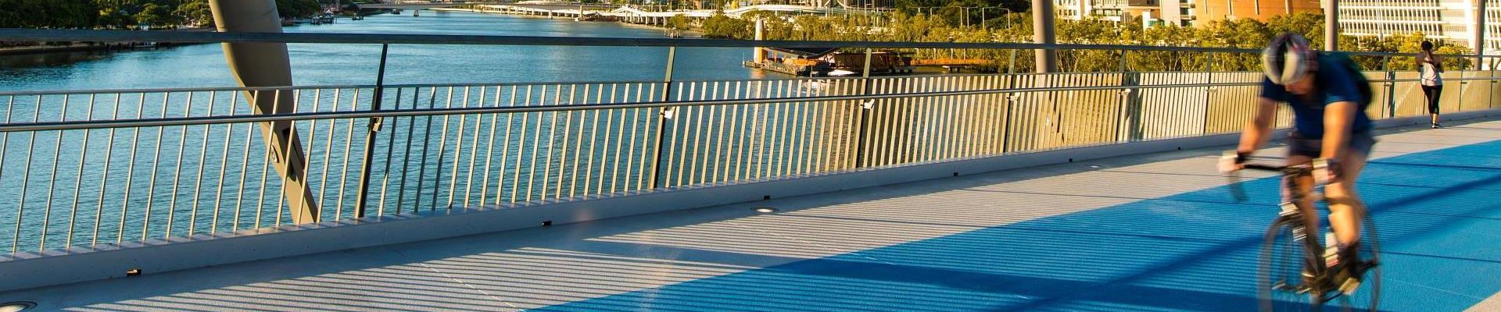
Global Pathways to Modernising Public Transport
RESILIENT MOBILITY
Resist → Reinforce. Adapt → Upgrade. Transform → Redesign.
Resistive: Stick to traditional land use and transport planning but make infrastructure stronger, larger, and more robust.
Adaptive: Keep the same land use patterns but switch to smarter, greener mobility—like electric, automated, and connected public transport.
Transformational: Rethink how cities function by blending living, working, and leisure into compact, mixed-use areas (like 15-minute neighbourhoods), prioritising human-centric streets and integrated mobility services.

Slide 22



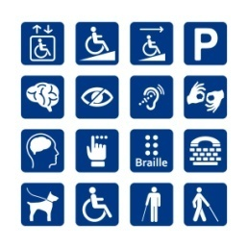


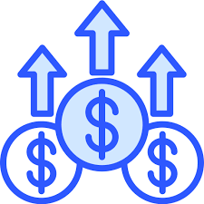

Global Pathways to Modernising Public Transport
KEY PILLARS OF MODERN PUBLIC TRANSIT
SAFETY
EFFICIENCY
SUSTAINABILITY
ACCESSIBILITY & INCLUSIVITY
CUSTOMER SATISFACTION
COMMUNITY INTEGRATION
ECONOMIC GROWTH
INNOVATION & TECHNOLOGY

Slide 23
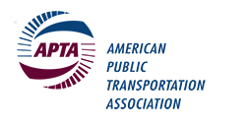

Global Pathways to Modernising Public Transport
KEY FINANCIAL BENEFITS OF PUBLIC TRANSIT
DESCRIPTION | VALUES
Investment in Transport Infrastructure | 1$ generates $8 in economic returns
Investment @ Public Transport | 1$ generates $4 in economic returns
Investment in Capital Cost @ PT | Every $10 million yields $30 million
Investment in Operational Cost @ PT | Every $10 million yields $32 million
Travelling by public transportation | 10 times safer/mile by automobile.
Using P.T. cuts accident risk by car | 90% over compared to driving a car
In the US, households living in auto-dependent locations spend | 25% of their income on transportation.
Reliable public transit lowers the cost of living for people with easy access | Saving users more than $10,000 per year
Source : WEF & APTA https://www.weforum.org/agenda/2019/07/autonomous-vehicles-driverless-cars-public-transport/

Slide 24

Global Pathways to Modernising Public Transport
NEGATIVE ECONOMIC & SOCIAL IMPACTS
Note: World Economic Forum

Slide 25
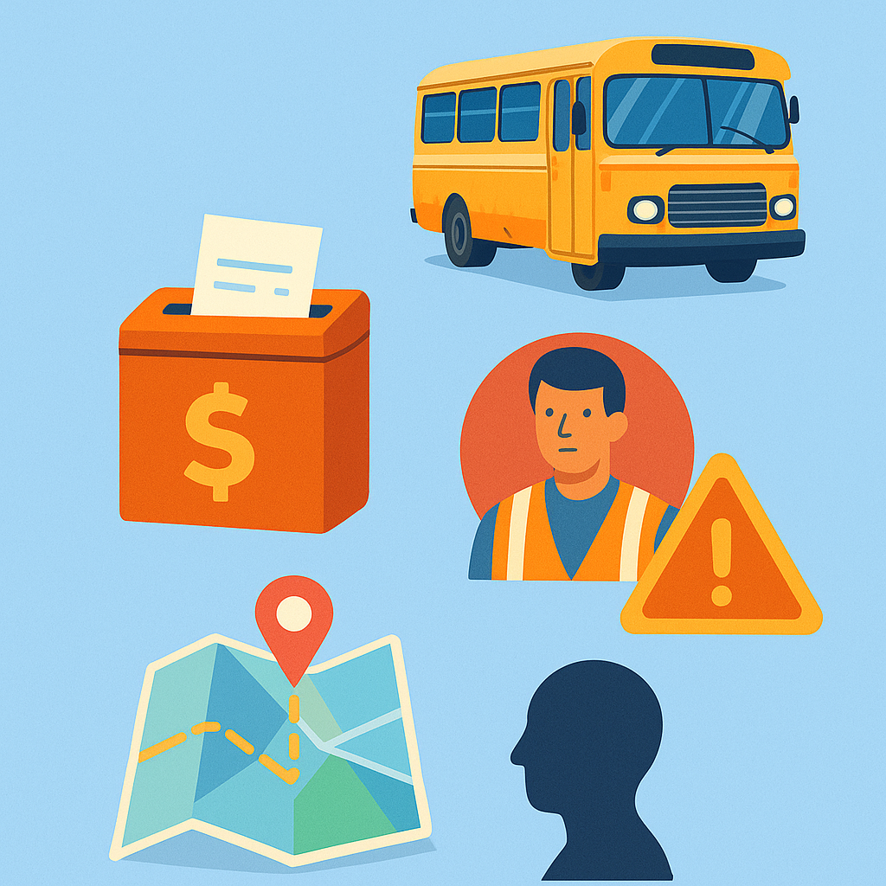
Global Pathways to Modernising Public Transport
COMMON BOTTLENECKS OF MODERN P.T. GLOBALLY
Ageing fleets and infrastructure
Fare box dependency and poor revenue models
Workforce shortages and outdated skill-sets
Weak integration and last-mile nightmares
Public perception: “Only for the poor” stigma
📍Same pain, different postcodes.

Slide 26






Global Pathways to Modernising Public Transport
FIVE GLOBAL PATHWAYS TO TRANSFORMATION
Decarbonisation & Green Tech
Digital Integration & “MaaS”
Policy, Governance & Finance Reforms
Customer-Centric Services
Equity & Accessibility First Approaches
1
2
3
3
5
6
📍Same pain, different postcodes.

Slide 27
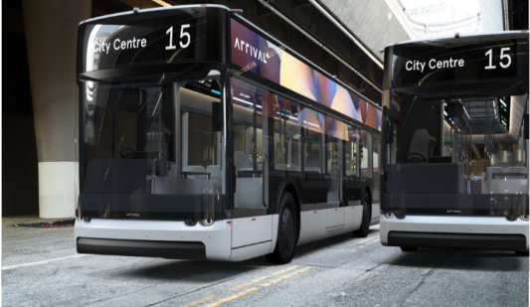
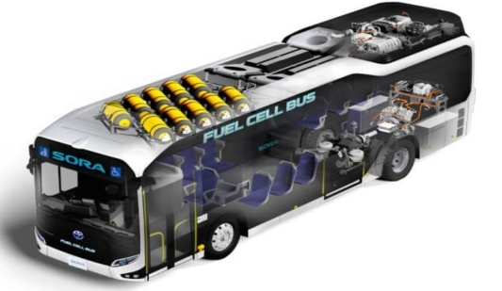
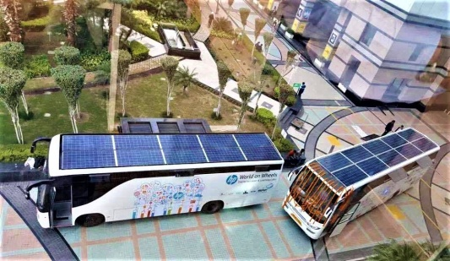
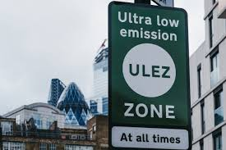
Global Pathways to Modernising Public Transport
PATHWAY : 1: DECARBONISATION & GREEN TECH
Electric Buses (India, China, Chile)
Hydrogen Fuel Cells (South Korea, Germany)
Solar-powered BRTs (Pakistan, Nigeria)
Ultra-Low Emission Zones (UK, EU)
1
2
3
4
⚡ Not just clean mobility—smart resilience.

Slide 28
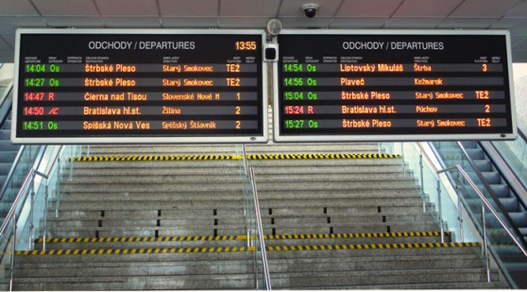

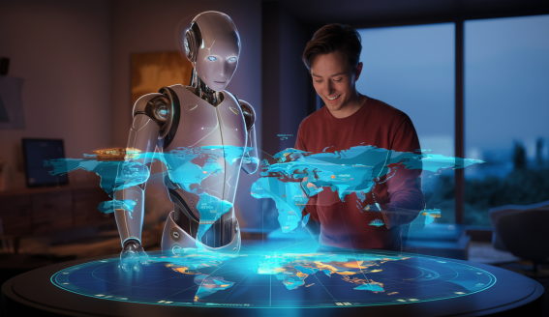
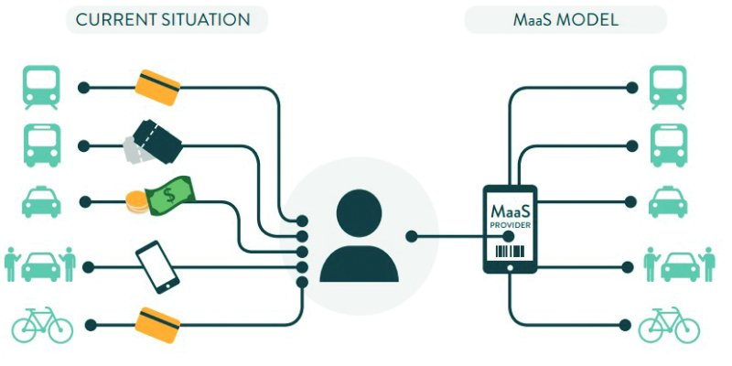
Global Pathways to Modernising Public Transport
PATHWAY : 2 : DIGITALISATION & “Maas”
Real-Time Passenger Info Systems
Mobile ticketing & contactless payments
Journey planning with AI
Mobility-as-a-Service (MaaS) pilots – Helsinki, Singapore, Los Angels
1
2
3
4
🔍 Make the bus smarter than the car.

Slide 29
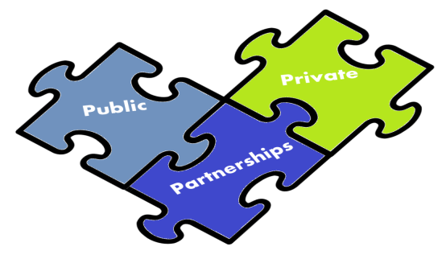



Global Pathways to Modernising Public Transport
PATHWAY : 3 : GOVERNANCE & FINANCING REFORMS
Public-Private Partnership models (Bogotá, Dubai)
Bus Contracting Models (Singapore, UK,India)
National Urban Transport Policies (India, Brazil)
Multilateral funding (World Bank, ADB, Green Climate Fund)
1
2
3
4
💸 Subsidy ≠ Charity. It’s an investment in social equity.

Slide 30
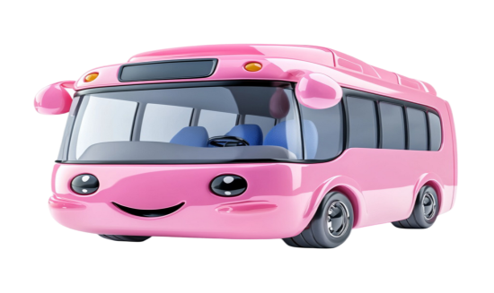



Global Pathways to Modernising Public Transport
PATHWAY : 4 : MAKE IT PASSENGER CENRIC
Women-only buses (Mexico City, Delhi)
Safety-focused apps and surveillance
Dynamic scheduling & frequency-based services
Branding public transport as aspirational (Seoul, Tokyo)
1
2
3
4
💡 If it feels premium, it earns respect..

Slide 31
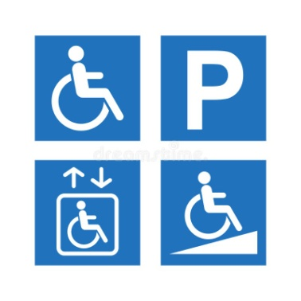
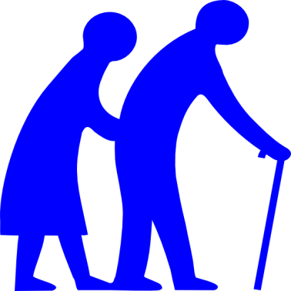

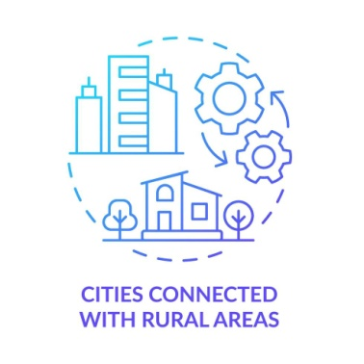
Global Pathways to Modernising Public Transport
PATHWAY : 5 : INCLUSIVE AND ACCESSIBLE TRANSIT
Universal design – lifts, ramps, braille maps
Services for elderly and differently-abled
Gender-sensitive planning and mobility audits
Rural connectivity (Tamil Nadu’s TNSTC models)
1
2
3
4
🎯 No one left behind. Literally.

Slide 32
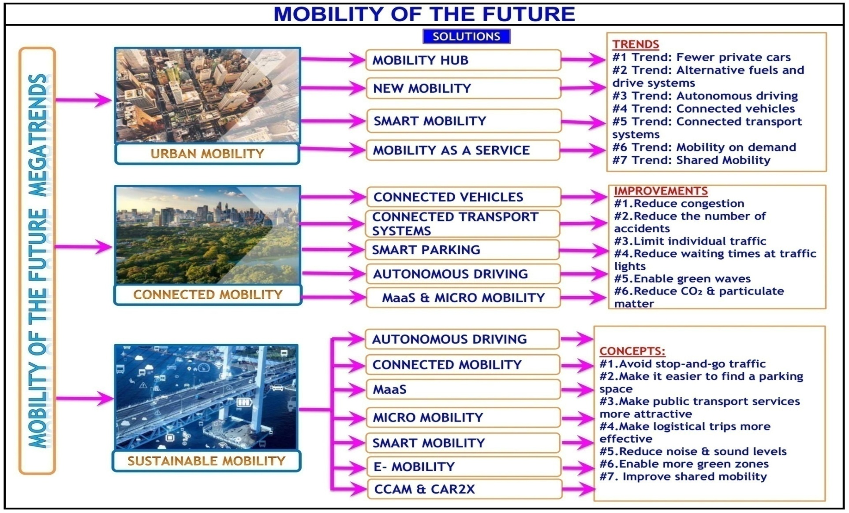
Global Pathways to Modernising Public Transport
CONCLUSION
🔗 Modernisation is not a destination—it’s a journey.

Slide 33
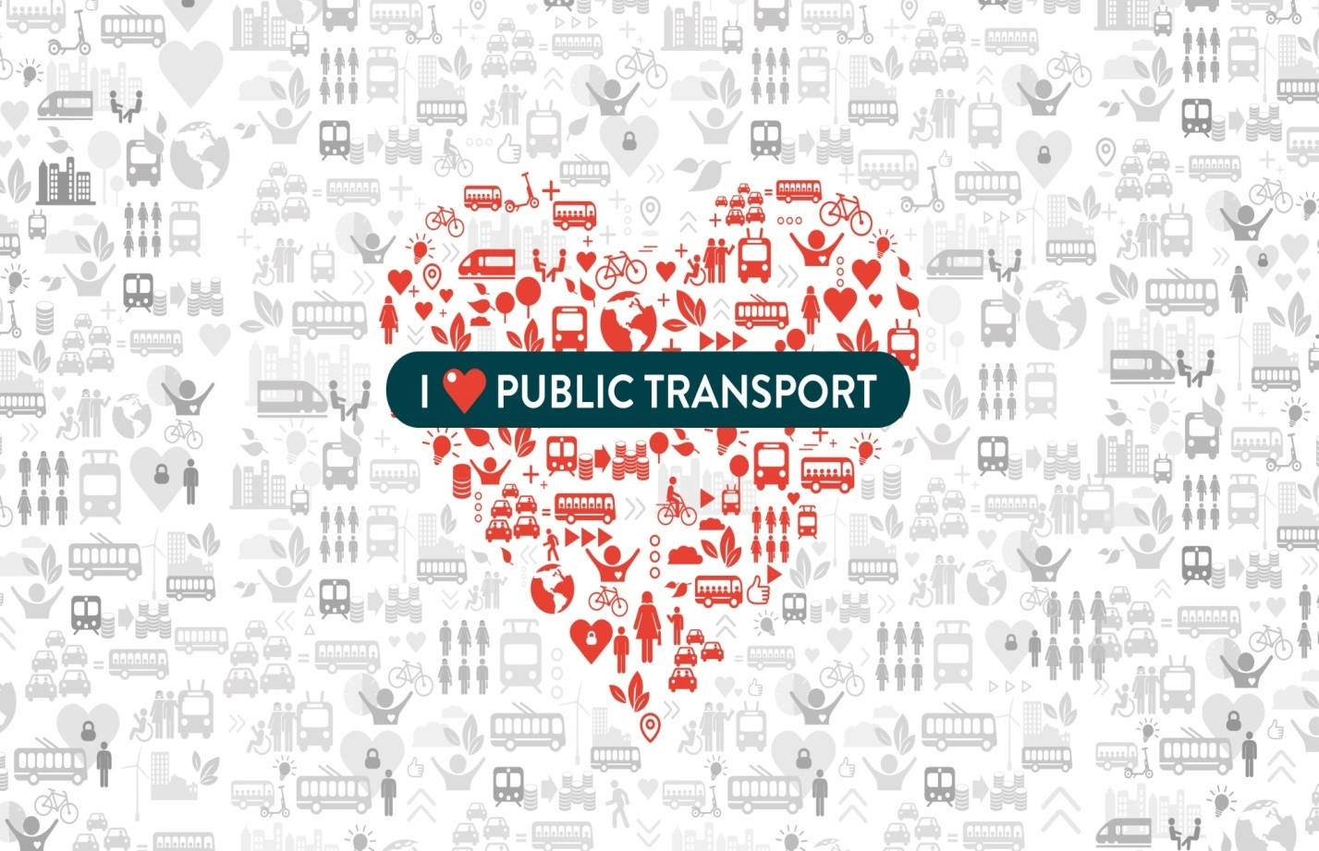
Global Pathways to Modernising Public Transport
DO YOU LOVE PUBLIC TRANSIT ?
❤🚍 Love your Public Transit — 🗓Ride daily, 😄 Smile freely! 🌆 ♻.

Slide 34

Global Pathways to Modernising Public Transport

