Slide 1


Riding the Wave of the Mobility Future
CLEAN FUELS
We have alternative fuels, but we don’t have alternate future.
Global Public Transport Expert
1/974,NSC Bose Street,
Bavaani Nagar, Redhills,
Chennai-600 052.
Mail id : adroit.amudhan@gmail.com Phone : +91-9789959270

Slide 2

Riding the Wave of the Mobility Future
COP26 OUTCOME:
CHANGE THE WAY WE MOVE BEGINS WITH THE CHANGING WAY WE THINK,DESIGN & FINANCE OUR MOBILITY SYSTEMS.
WE CANNOT TACKLE THE CLIMATE CRISIS WITHOUT RETHINKING MOBILITY
IF WE DON’T ADDRESS THE CLIMATE CHANGE, IT WILL AFFECT OUR GROWTH,OUR DEVELOPMENT & PRODUCTIVITY.
THE END OF IC ENGINES CANNOT AND SHOULD NOT BE TABOO ANYMORE IN OUR SOCIETY, SUITABLE ACTIONS SHOULD BE TAKEN
ADAPTING EV VEHICLES ALONE IS NOT ENOUGH.WE MUST CHANGE HOW WE MOVE ,AND BETTER PUBLIC TRANSPORTATION IS ESSENTIAL
2W/3W/4W’s ALL MUST GO ELECTRIC IN THE NEXT 4 TO 5 YEARS.
LONG DISTANCE TRANSPORT SHOULD ALL MOVE TOWARDS GREEN H₂.
THERE IS ALWAYS SOME MONEY FOR TRANSPORT, BUT THE QUESTION IS WHERE IS THE MONEY GOING TO GO.
REDIRECTING INVESTMENT WILL BE IN CRITICAL IN ORDER TO SHIFT MOVEMENT AWAY FROM CARS & TRUCKS AND TOWARDS PUBLIC TRANSPORT, ACTIVE MOBILITY, AND OTHER MODES THAT ARE CLEANER AND INCLUSIVE
WE NEED TO HAVE INVESTMENT STRATEGIES THAT ARE INCLUSIVE AND DECARBONISED FROM THE START

Slide 3
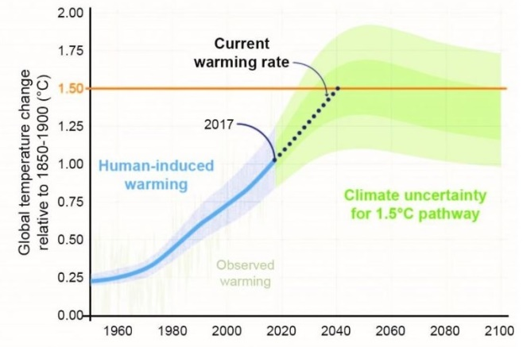
Riding the Wave of the Mobility Future
CLIMATE CHANGE
NOTE : The average surface temperature on Earth is approximately 59º degrees Fahrenheit (15º degrees Celsius), according to NASA

Slide 4
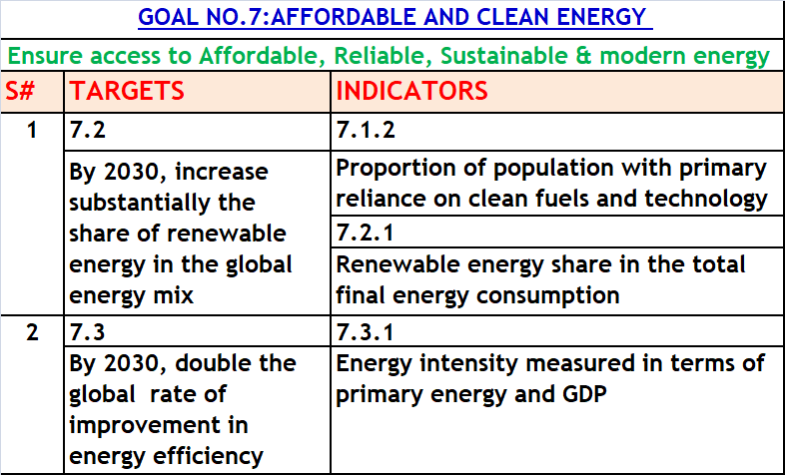
Riding the Wave of the Mobility Future

Slide 5
Riding the Wave of the Mobility Future
PROBLEM STATEMENT : CLEAN ENERGY
High Diesel Expenditure leads to go for Alternate Fuels
EPKM = Rs 30 /- (Approximate) , KMPL = 4.5 (Approximate)
Total earning for 4.5 = Rs 30 x 4.5 = 135/-
One Litre Diesel Cost = Rs 94.39 = 94.39/-
Diesel Expenses Related to earning = 94.39/135
(without Subsidiary) = 69.90% = 70% (Approx)
Diesel Expenses Related to earning = 66/135
(with Subsidiary) = 48.88% = 50% (Approx)
Diesel Expenses per kilometre = 94.39/4.5
= 20.97 = Rs 21/-
Total earning Rs 30, Diesel Cost =Rs 21, Rs 9/- only for other expenses.

Slide 6
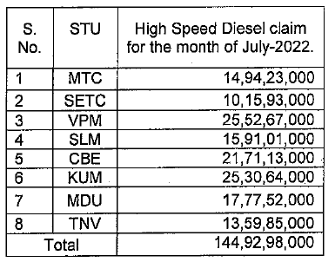
Riding the Wave of the Mobility Future
DIESEL CLAIM BY THE STU FROM TN.GOVT.
Total Value of Rs 145/- Crores approximately

Slide 7
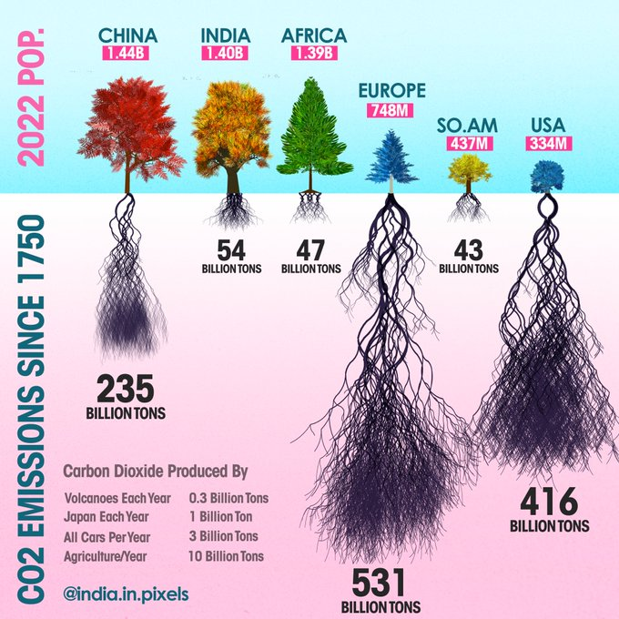
Riding the Wave of the Mobility Future
CO₂ Production –Global View

Slide 8
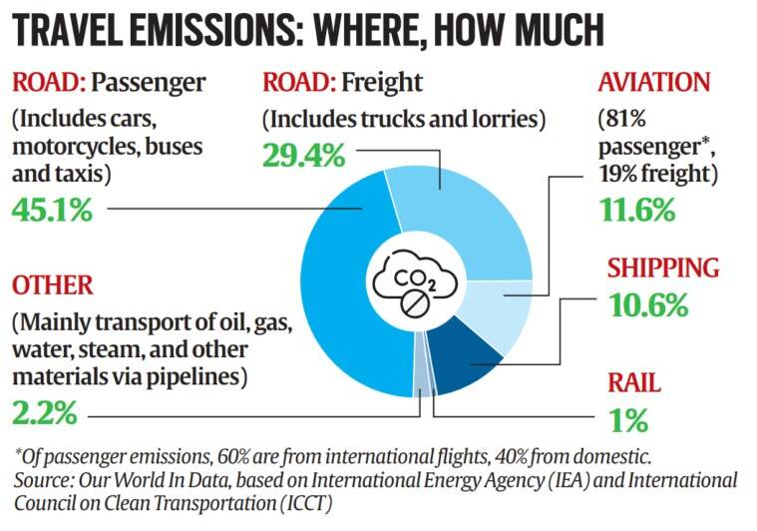
Riding the Wave of the Mobility Future
Data’s related to Global Emissions

Slide 9
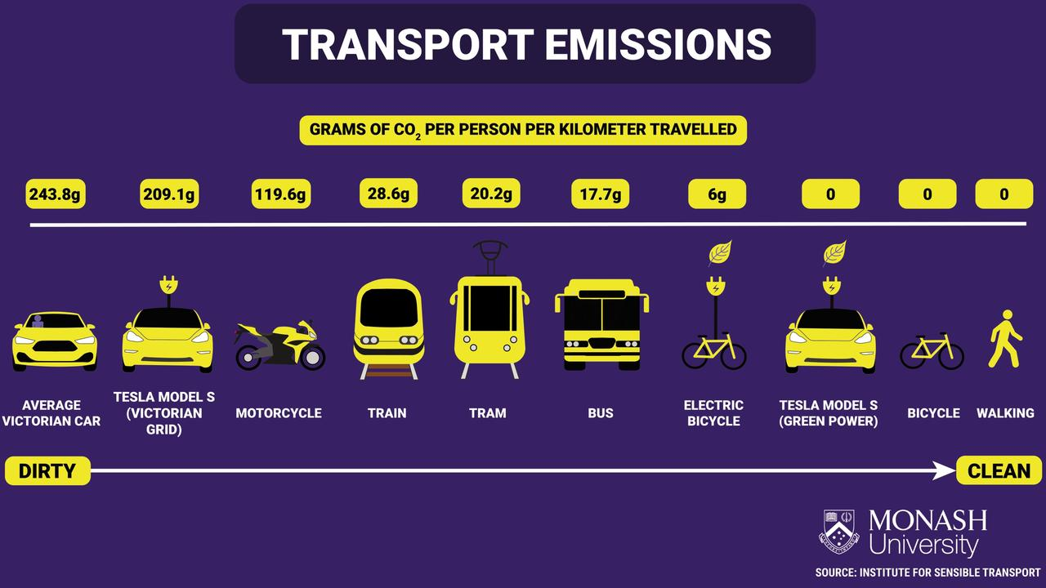
Riding the Wave of the Mobility Future

Slide 10
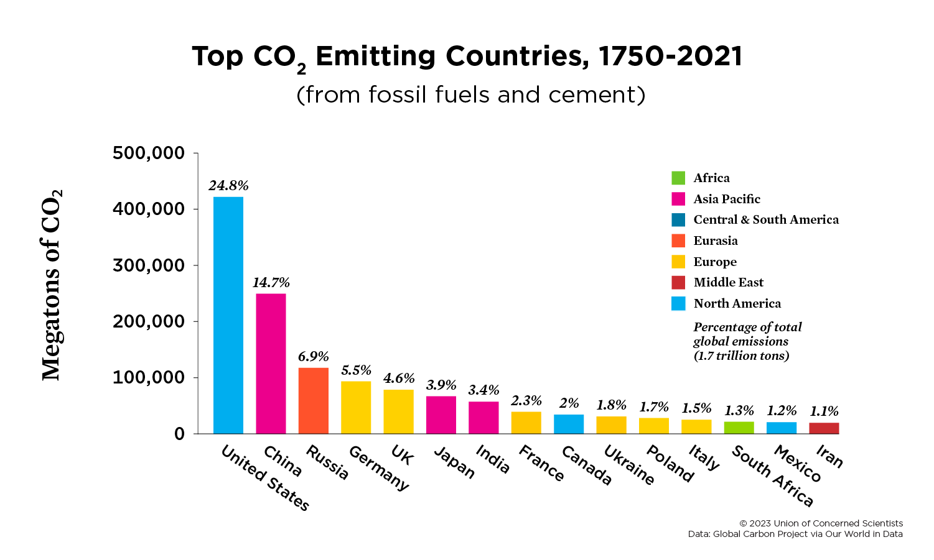
Riding the Wave of the Mobility Future

Slide 11
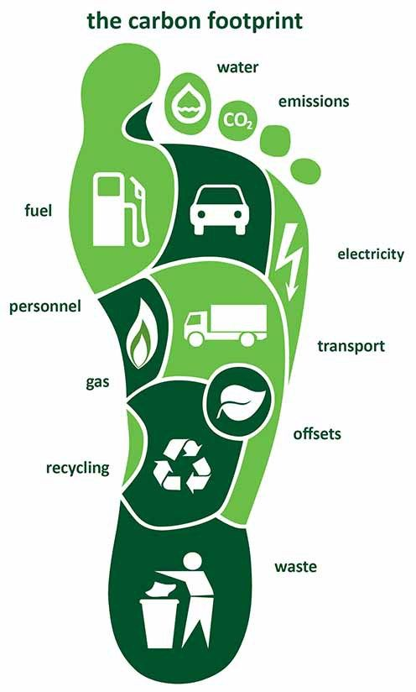
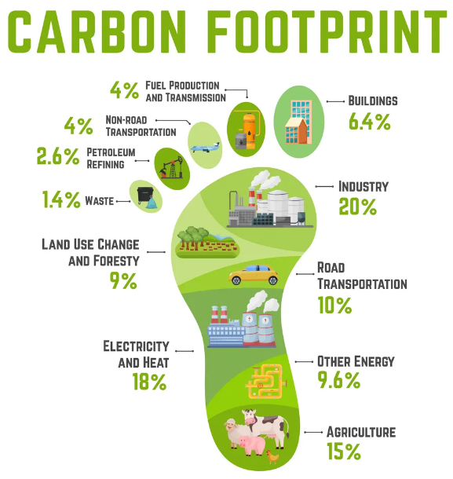
Riding the Wave of the Mobility Future
CARBON FOOT PRINT

Slide 12

Riding the Wave of the Mobility Future
ASSOCIATED IMPACTS OF CLIMATE CHANGE
Frequent severe droughts (கடுமையான வறட்சி)
Less Rainfall
Heat Waves
Heavy Rainfall
Sea Level Rise
Corals Bleach (பவளப்பாறைகள் சேதம் )
Oceans Acidification
Acid rain fall
Bio Diversity is being lost
Tropical Cyclones
Forest Burning
Earthquake
Tsunami

Slide 13

Riding the Wave of the Mobility Future
EFFECTS ASSOCIATED WITH CLIMATE CHANGE
Gender Equity
Human Rights
Renewable Energy
Intersecting Inequalities
Natural Resources
Public Services
Health
Infrastructures

Slide 14
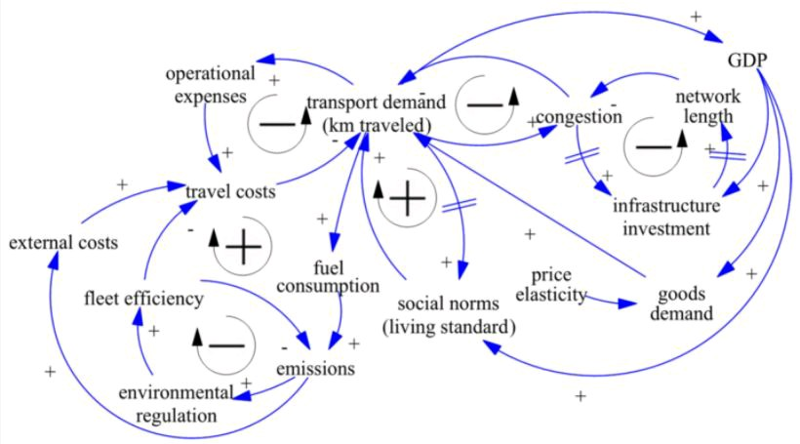
Riding the Wave of the Mobility Future
GDP RELATED TRANSPORT & FUEL

Slide 15
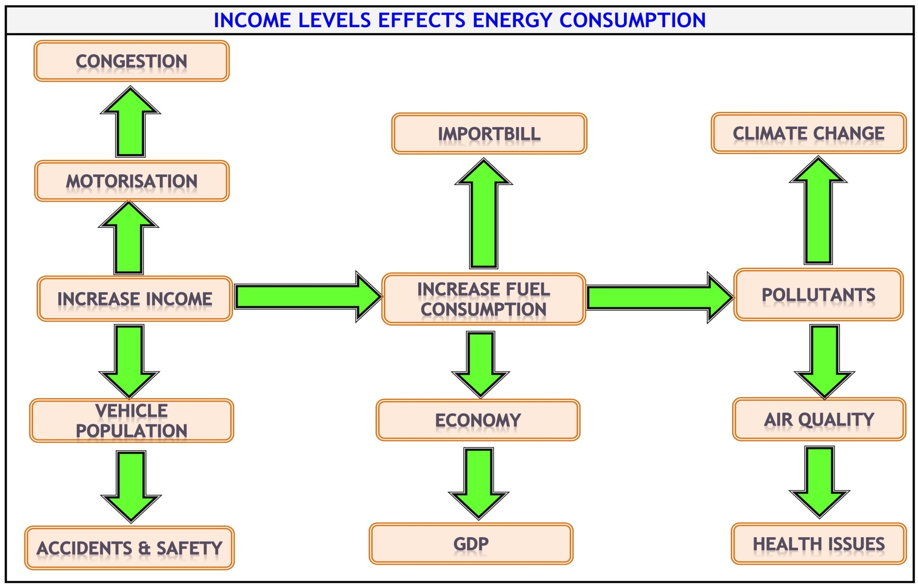
Riding the Wave of the Mobility Future

Slide 16
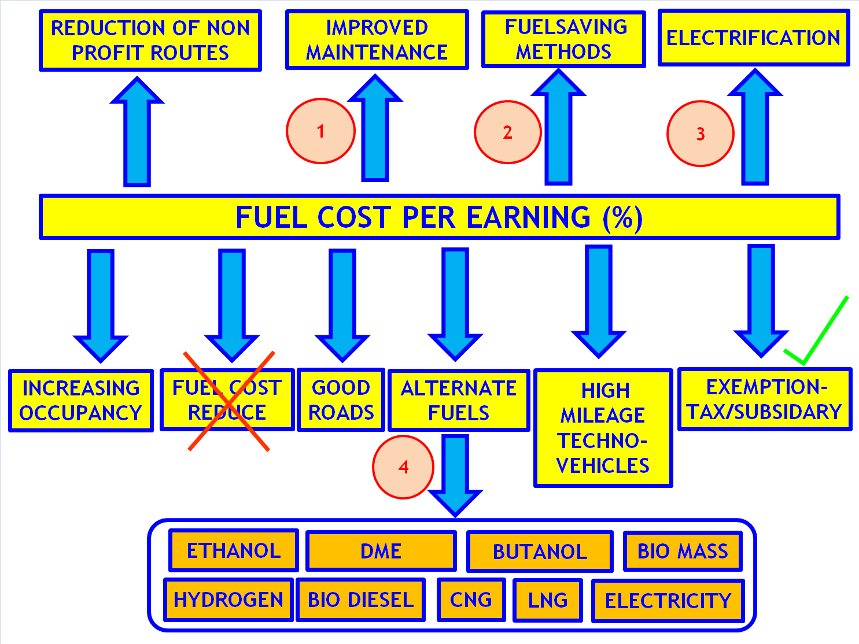
Riding the Wave of the Mobility Future

Slide 17
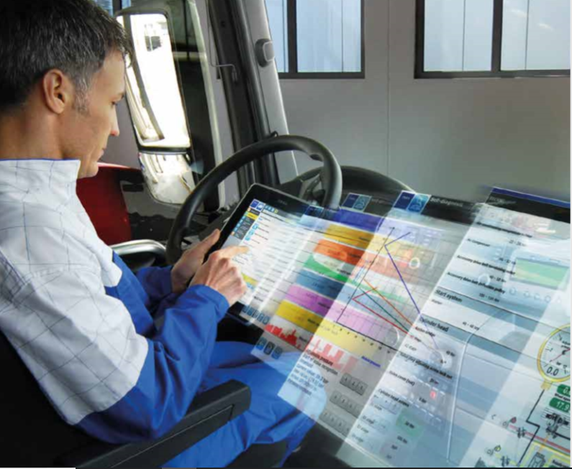
Riding the Wave of the Mobility Future
1. IMPROVED MAINTENANCE

Slide 18










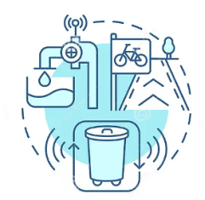




Riding the Wave of the Mobility Future
MAINTENANCE PRACTICES IN PUBLIC TRANSIT (Micro)
PREVENTIVE MAINTENANCE
CORRECTIVE MAINTENANCE
PREDICTIVE MAINTENANCE
CONDITION BASED MAINTENANCE
RELIABILITY CENTERED MAINTENANCE (RCM)
SCHEDULED MAINTENANCE
UNSCHEDULED MAINTENANCE
OVERHAUL & REFURBISHMENT
CLEANING & HYGIENE
SAFETY & COMPLIANCE
INFRASTRUCTURE MAINTENANCE
EMERGENCY MAINTENANCE
ENVIRONMENTAL MAINTENANCE
INFORMATION & COMMUNICATION TECHNOLOGY(ICT)
MAINTENANCE
FACILITY
MAINTENANCE

Slide 19
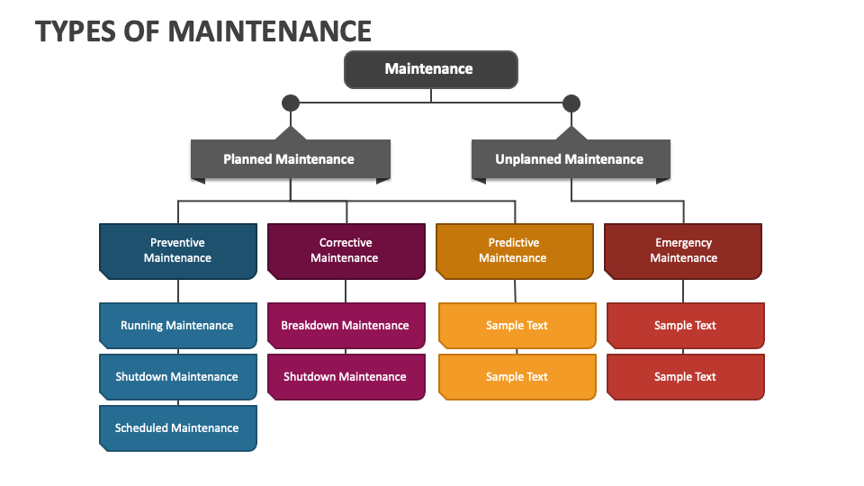
Riding the Wave of the Mobility Future
TYPES OF MAINTENANCE
Proactive Maintenance
Statistic Based Maintenance
On condition Maintenance
Condition Based Maintenance
Repair Maintenance
Replacement Maintenance
Predictive Tools
Break Down Maintenance
Deferred Maintenance
Shutdown Maintenance
Remedial Maintenance

Slide 20
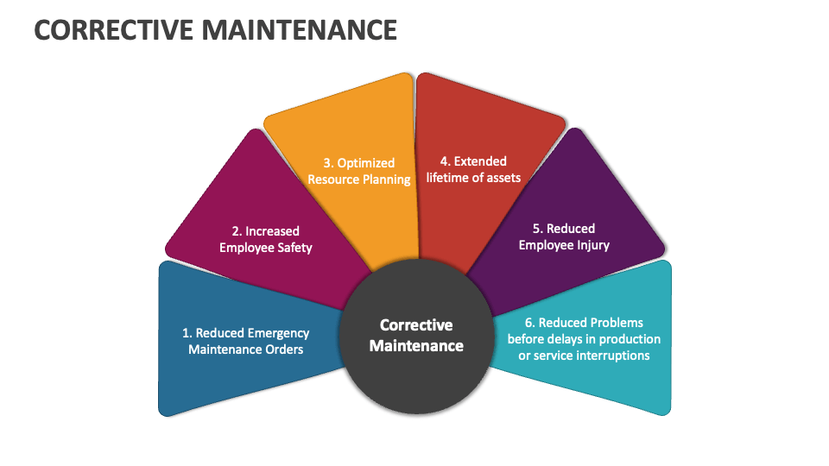
Riding the Wave of the Mobility Future
CORRECTIVE MAINTENANCE
Corrective Maintenance
Fault Detection
Fault Isolation
Fault Elimination
Fault Verification

Slide 21
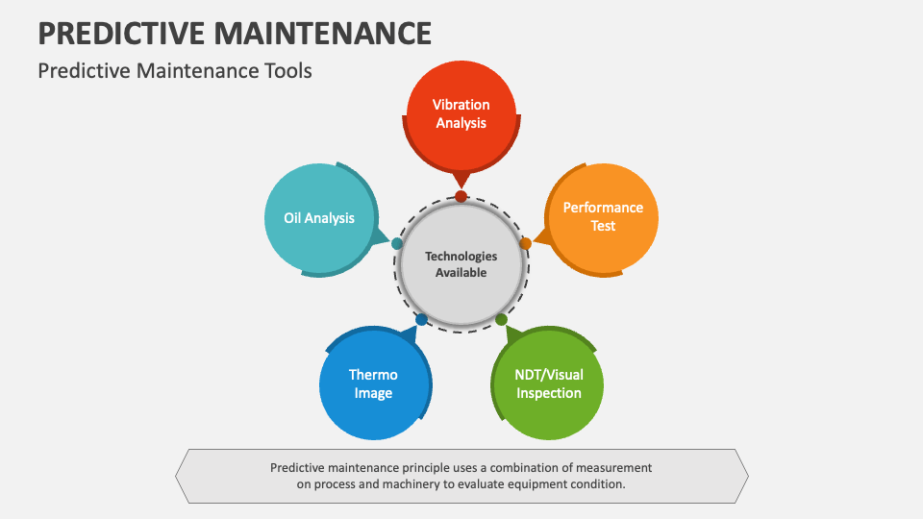
Riding the Wave of the Mobility Future
PREDICTIVE MAINTENANCE TECHNOLOGIES

Slide 22




Riding the Wave of the Mobility Future
PREDICTIVE MAINTENANCE KEY ELEMENTS
BUS MAINTENANCE
PREDICTIVE MAINTENANCE
REMOTE DIAGNOSTICS
AUTOMATED MAINTENANCE
Monitor Wear & Tear
Avoid Break Downs
Future Proof
Fleet Overview
Vehicle Overview
Diagnostics Trouble Codes
Customized Alerts
Metrics
Sensor Readings
Real Time Notifications
Create Plans
Control Dates Automatically
Adjust as easily as go

Slide 23
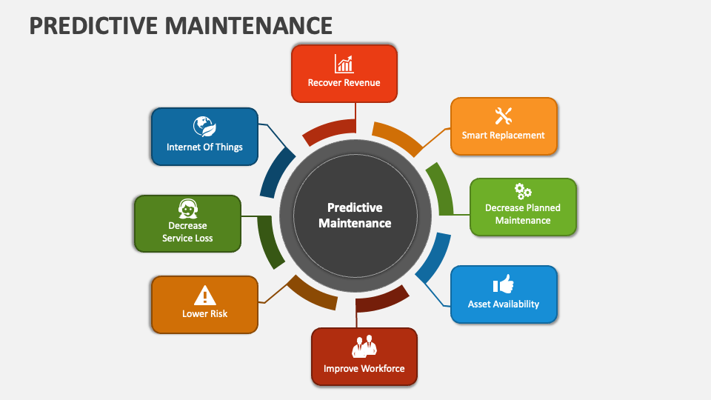
Riding the Wave of the Mobility Future
PREDICTIVE MAINTENANCE BENEFITS

Slide 24
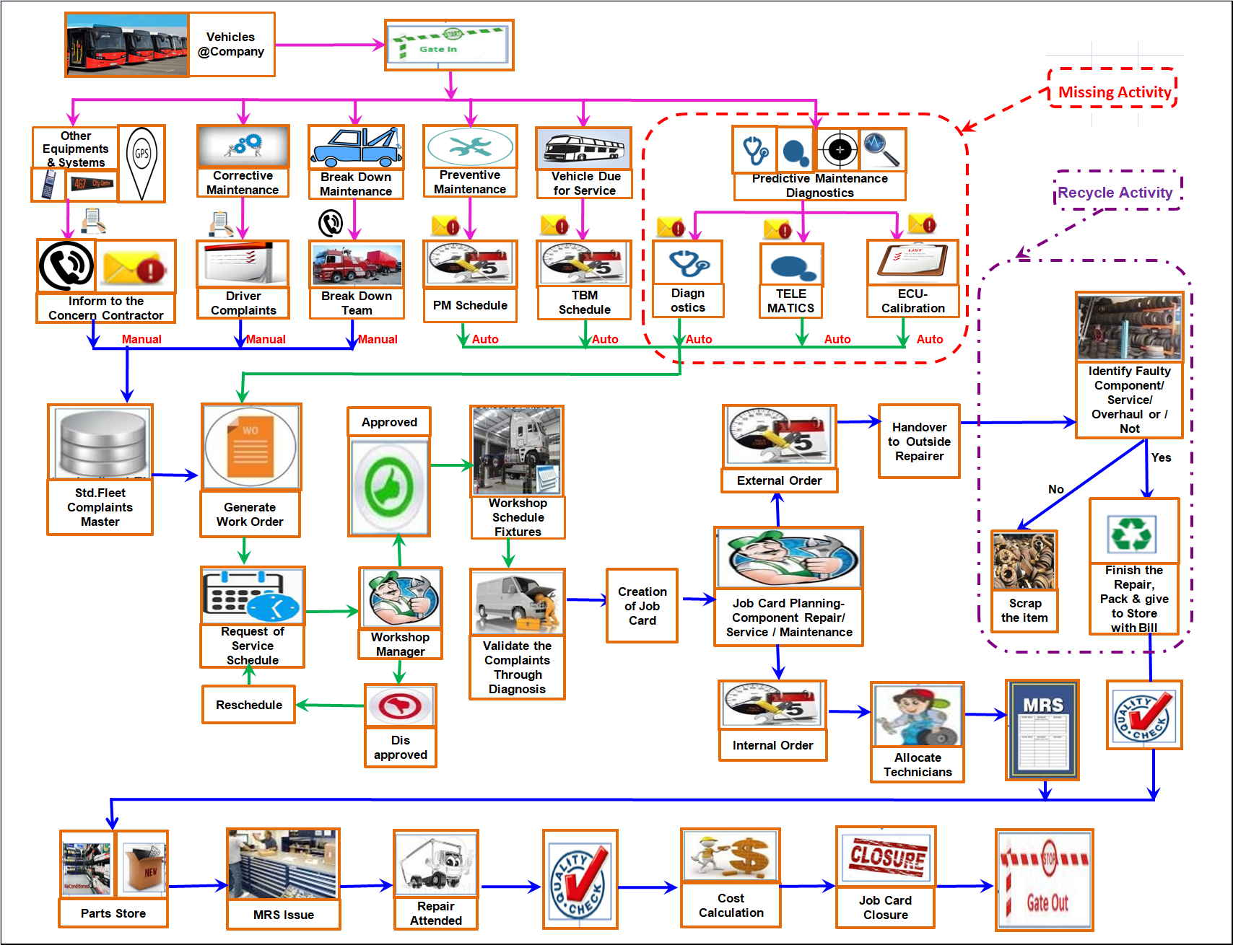
Riding the Wave of the Mobility Future
MAINTENANCE FLOW CHART

Slide 25
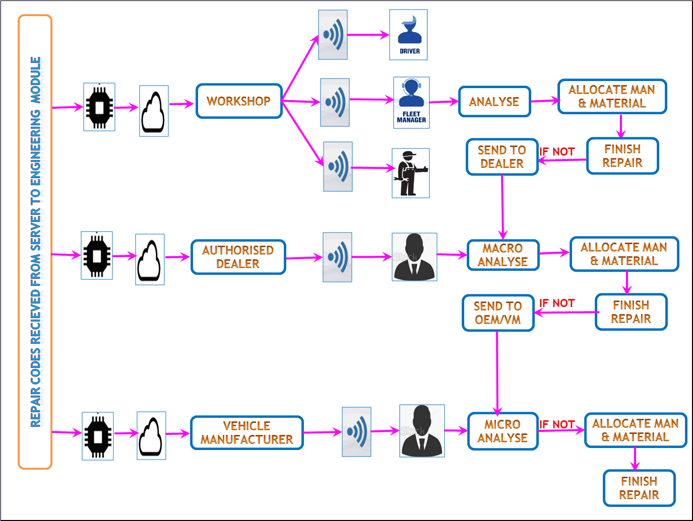
Riding the Wave of the Mobility Future
OEM/STU’s VEHICLE MAINTENANCE FLOW CHART

Slide 26
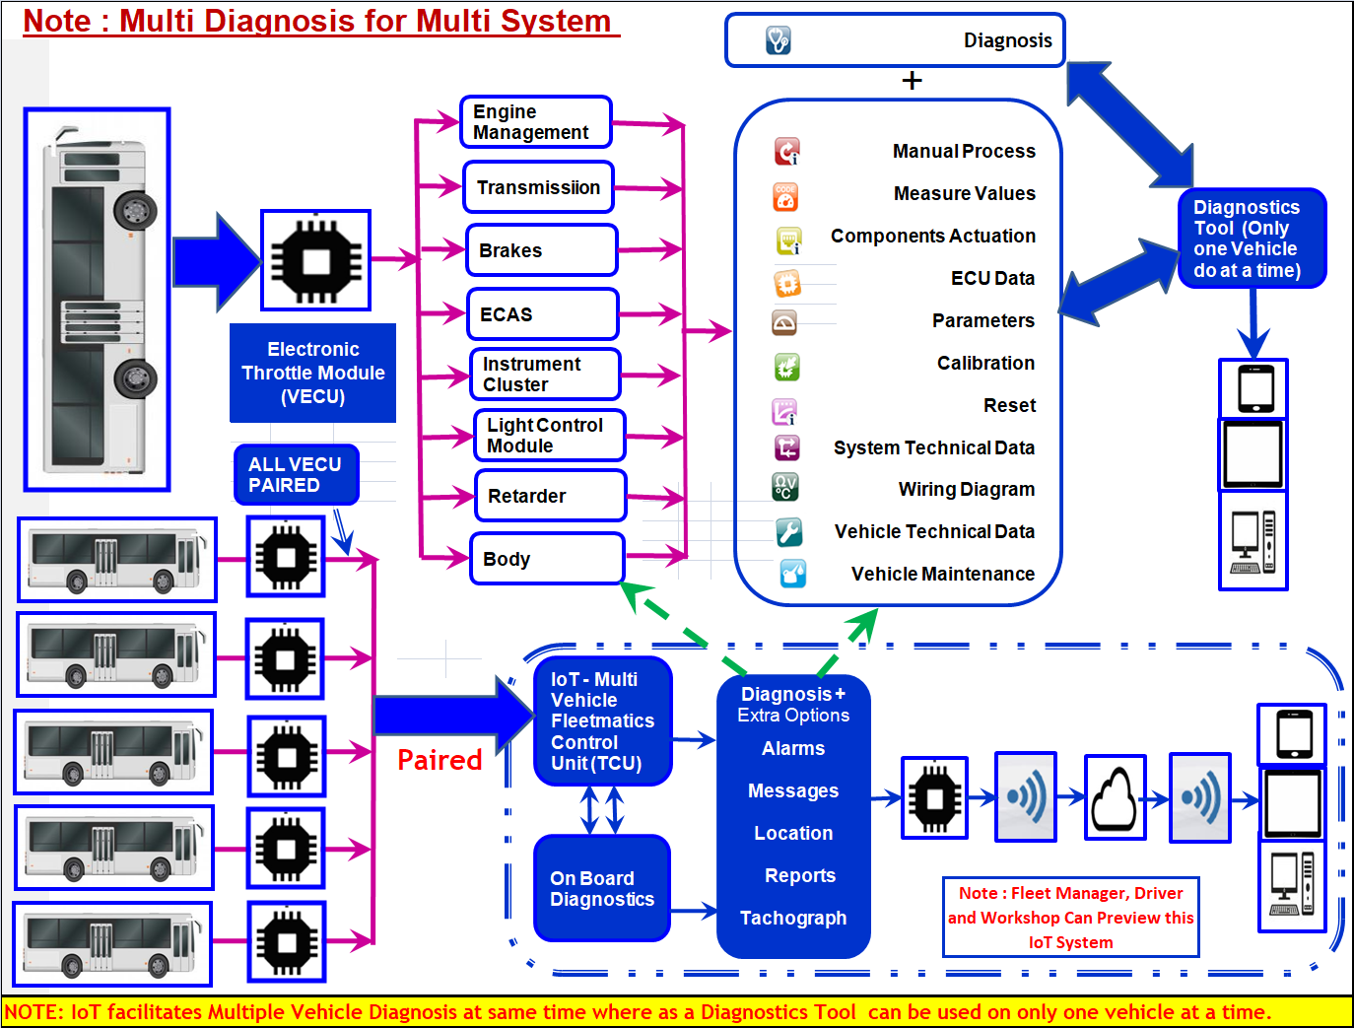
Riding the Wave of the Mobility Future
DIFFERENCE BETWEEN DIAGNOSTIC TOOL & IoT

Slide 27
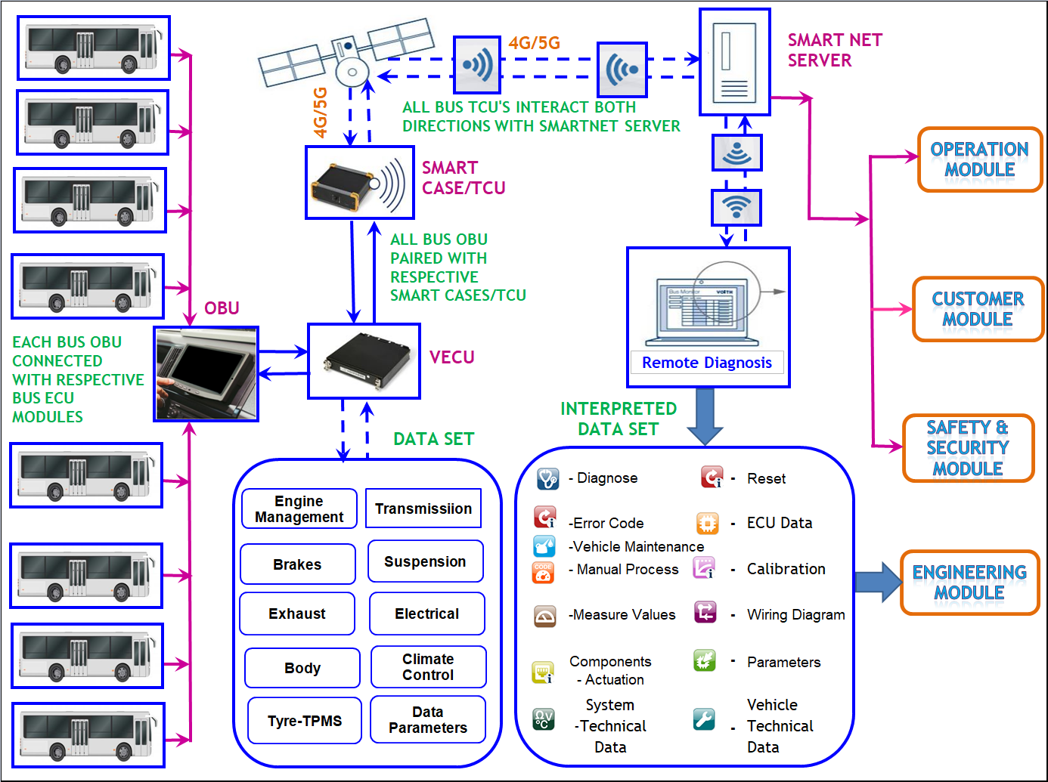
Riding the Wave of the Mobility Future
SMART MONITORING OF BUSES

Slide 28
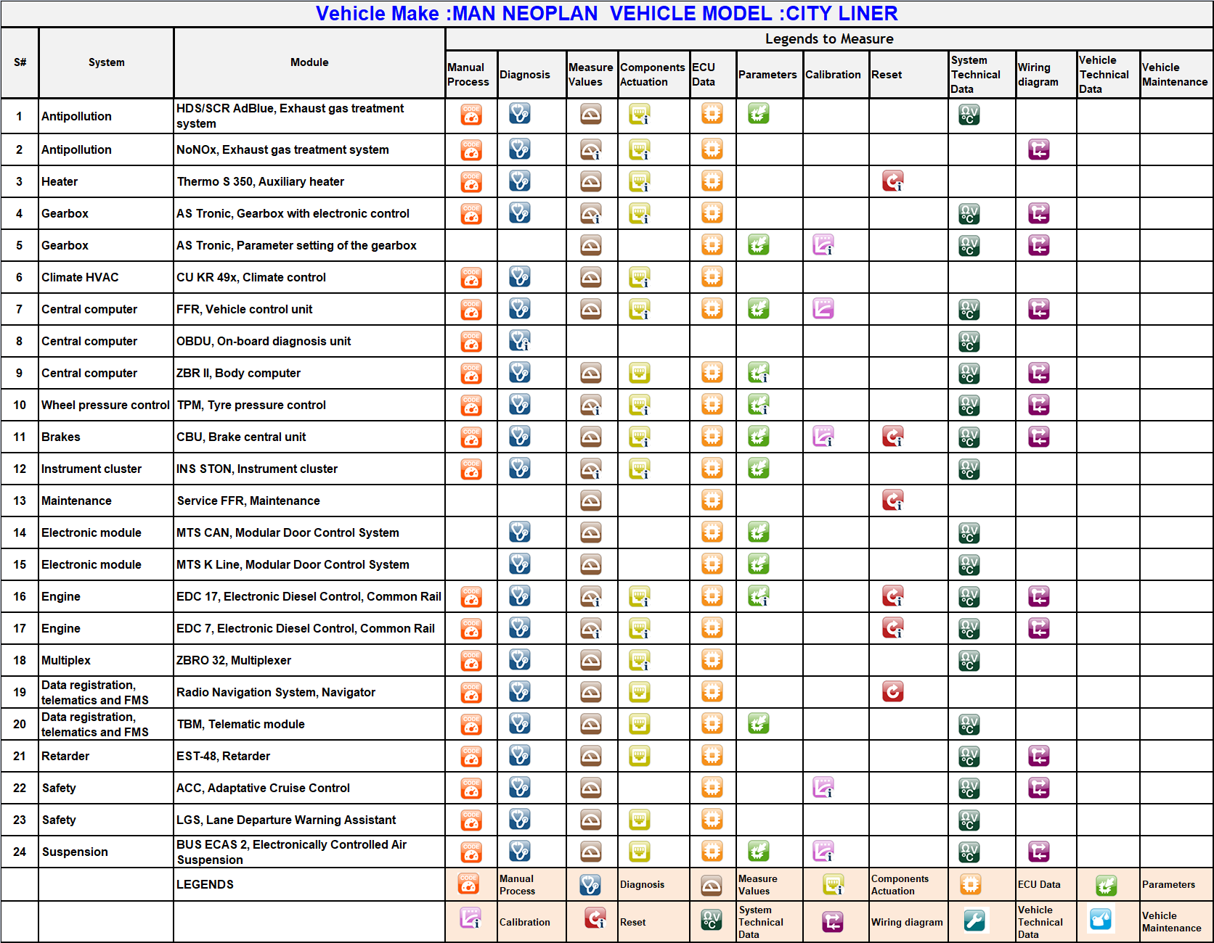
Riding the Wave of the Mobility Future
DIAGNOSTICS RESULTS – DATA SHEET

Slide 29
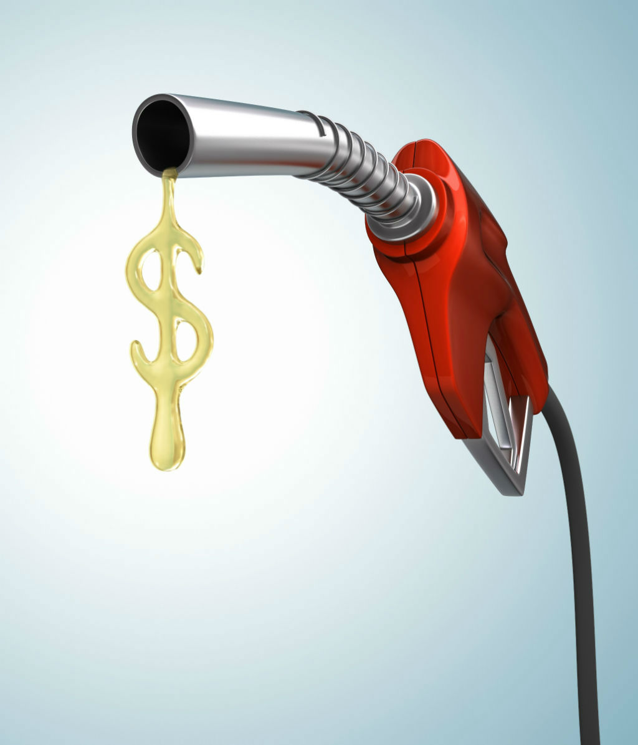

Riding the Wave of the Mobility Future
FUEL SAVING SYSTEMS & TECHNIQUES

Slide 30

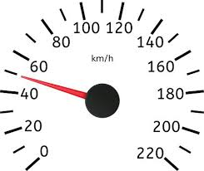

























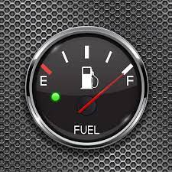

Riding the Wave of the Mobility Future
2.FUEL SAVING TECHNIQUES
Smooth driving
Steady Speed
Proper Tyre Maintenance
Synthetic Oils Usage
Lighten the Load (Goods)
Aero
Dynamics
Proper Maintenance
Use Right Fuel
Plan the Apt Trip
Avoid Excess Idling
Use Apt Gears
Apt level – A/c Use
Axle Alignment
Check
Battery Cables
Accelerate when need
Alternative Modes
Monitor Fuel Economy
Avoid Rapid Start
Smart Driving
No Fast Driving
Hi-Mileage Techno Vehicles
Use Cruise Control
Time of Fuel Pump
Clean Air filter
Avoid Rush Hour Travel
Use Fast Tag
Avoid Overfilling
Use Alternate
Fuels & Drives

Slide 31
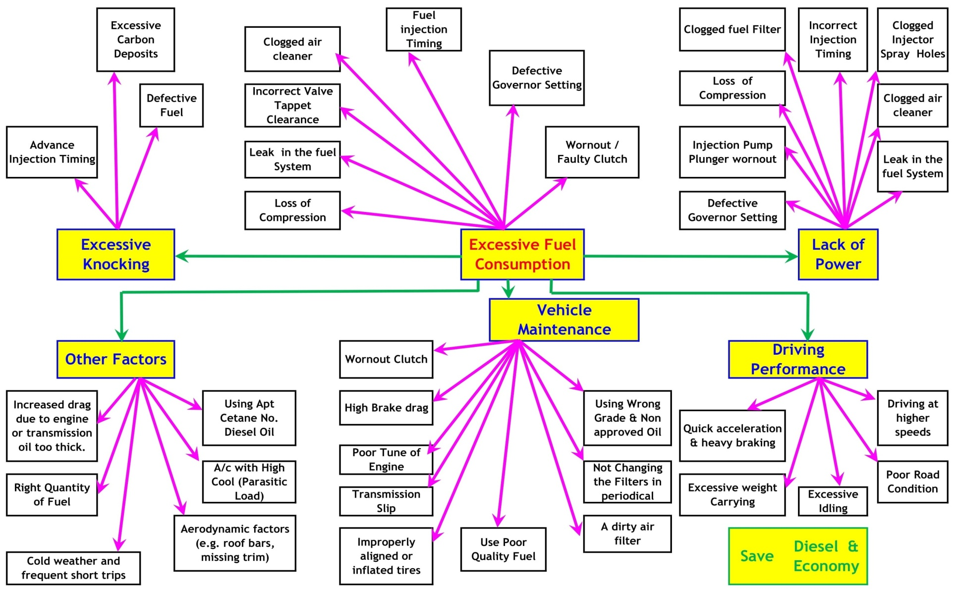
Riding the Wave of the Mobility Future
FUEL SAVING - CONSUMPTION REDUCTION

Slide 32
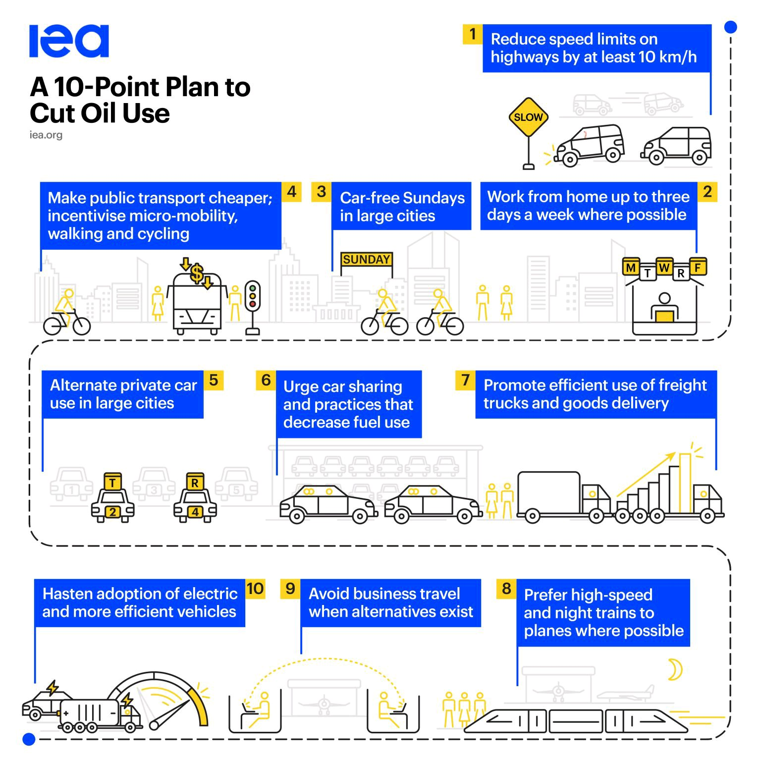
Riding the Wave of the Mobility Future
PLAN TO CUT OIL USE - 10 POINTS

Slide 33
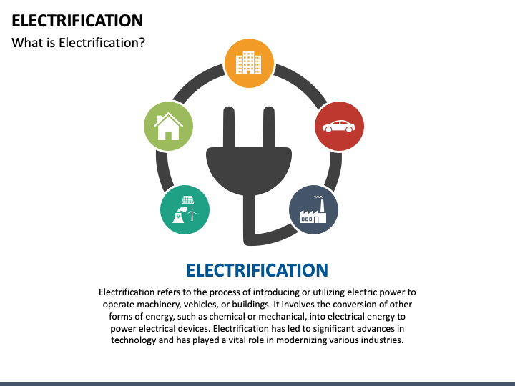
Riding the Wave of the Mobility Future
3.ELECTRIFICATION
Electrification refers to the process of utilising electric power to operate vehicles/machinery/buildings. It involves the conversion of other forms of energy , such as chemical or mechanical, into electrical energy to power electrical devices. Electrification has led to significant advances in technology and has played a vital role in modernising various industries.

Slide 34
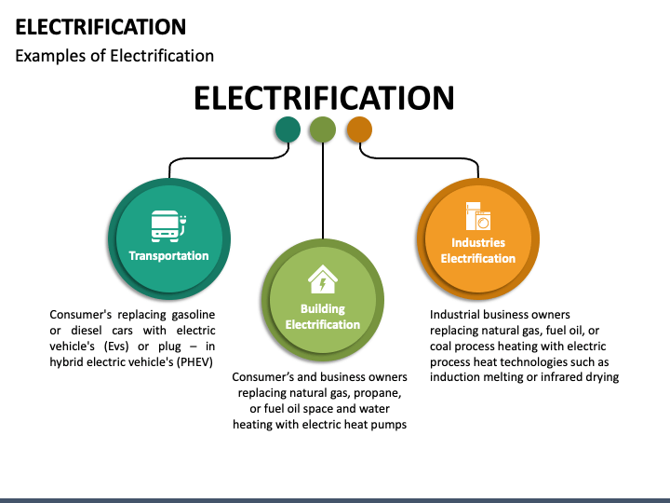
Riding the Wave of the Mobility Future
ELECTRIFICATION

Slide 35
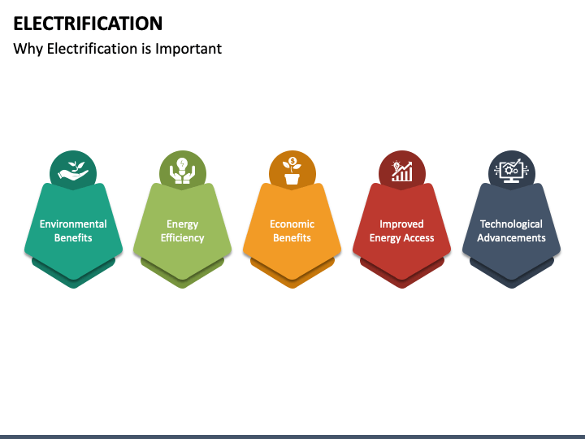
Riding the Wave of the Mobility Future
WHY ELECTRIFICATION IMPORTANT ?

Slide 36
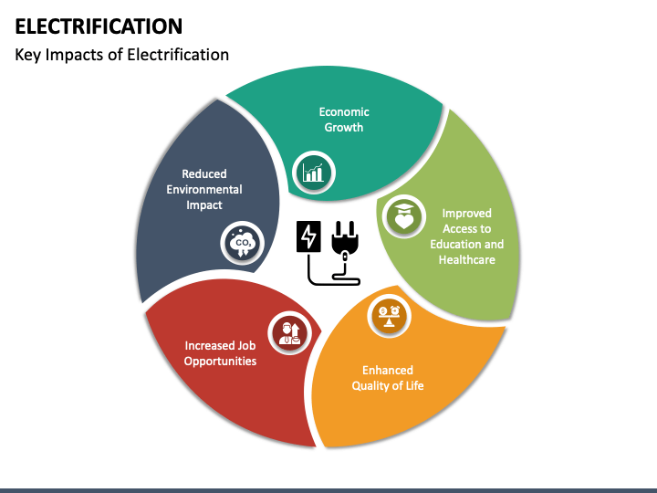
Riding the Wave of the Mobility Future
ELECTRIFICATION IMPACTS

Slide 37
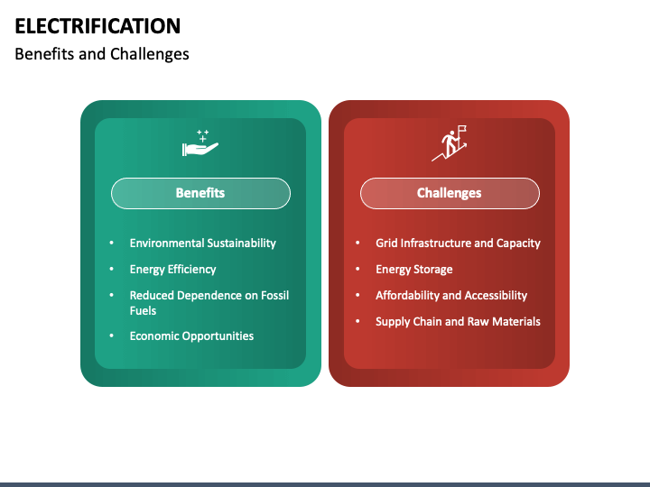
Riding the Wave of the Mobility Future
ELECTRIFICATION BENEFITS & CHALLENGES

Slide 38
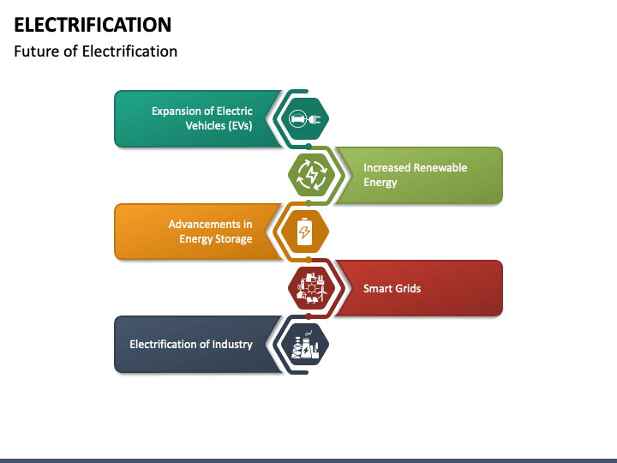
Riding the Wave of the Mobility Future
FUTURE OF ELECTRIFICATION

Slide 39
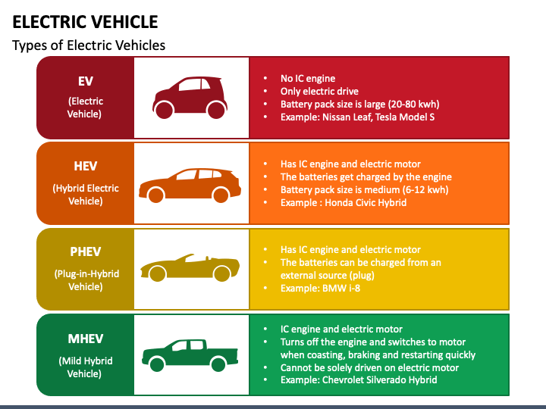




Riding the Wave of the Mobility Future
ELECTRIC VEHICLE TYPES

Slide 40
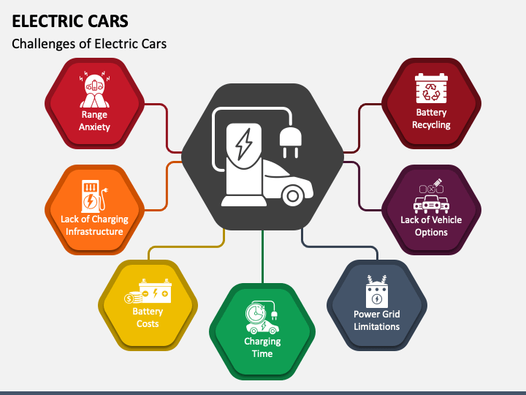

Riding the Wave of the Mobility Future
ELECTRIFICATION : ELECTRIC BUS CHALLENGES

Slide 41
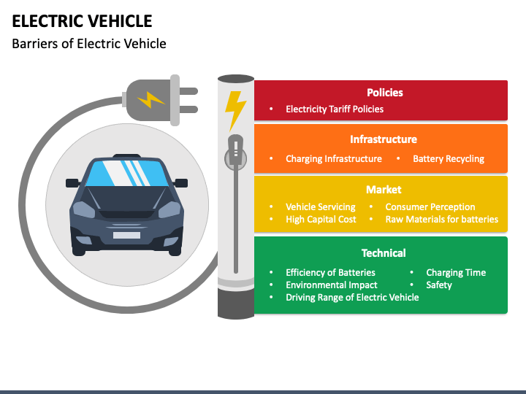
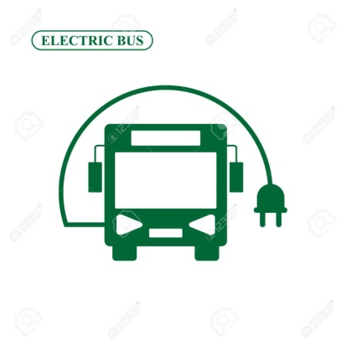
Riding the Wave of the Mobility Future
ELECTRIC BUS BARRIERS

Slide 42








Riding the Wave of the Mobility Future
WHY WE NEED ELECTRIC BUS ?
IMPROVE LOCAL
AIR QUALITY
REDUCE NOISE FROM TRANSPORT
IMPROVE PT ACCESSIBILITY IN URBAN AREAS
CO₂ AND GHG SDG REDUCTION TARGETS
BUILD ENERGY SOURCE DIVERSITY & RENEWABLE STORAGE CAPACITY
IMPROVE IMAGE OF LOCAL BUSES
IMPROVE PUBLIC TRANSIT MARKET SHARE
REDUCE OPERATING COSTS

Slide 43
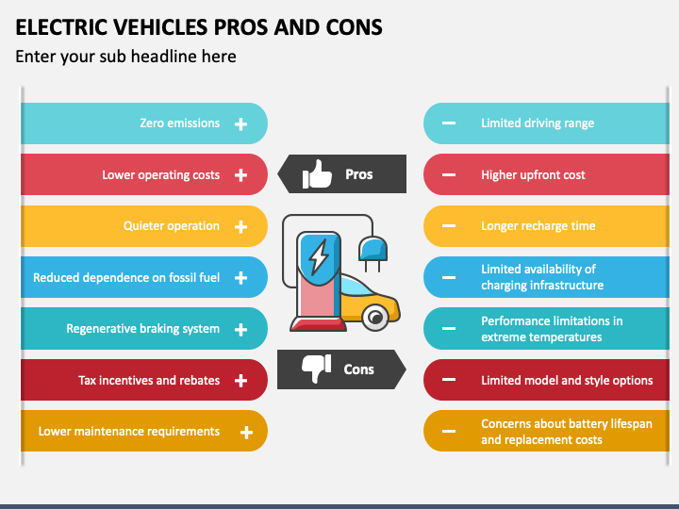

Riding the Wave of the Mobility Future
ELECTRIC BUS PRO’S & CONS

Slide 44
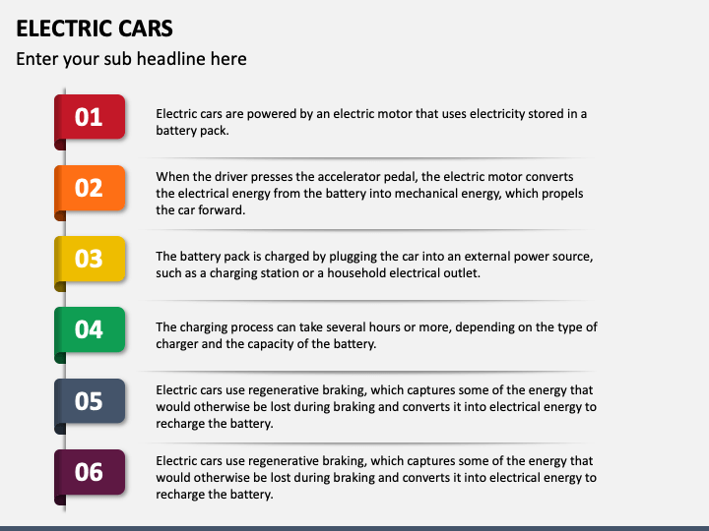
Riding the Wave of the Mobility Future
ELECTRIC BUS
Electric buses are powered by an electric motor that uses electricity in a battery pack
When the driver presses the accelerator pedal, the electric motor converts the electrical energy from the battery into mechanical energy, which propels the bus forward.
The Battery pack is charged by plugging the bus into an external power source such as a charging station or a house hold electrical outlet.
The Charging process can take several hours or more, depending on the type of charger and the capacity of the battery.
Electric Buses use regenerative braking, which captures some of the energy that would otherwise be lost during braking and converts it into electrical energy to recharge the battery.

Slide 45
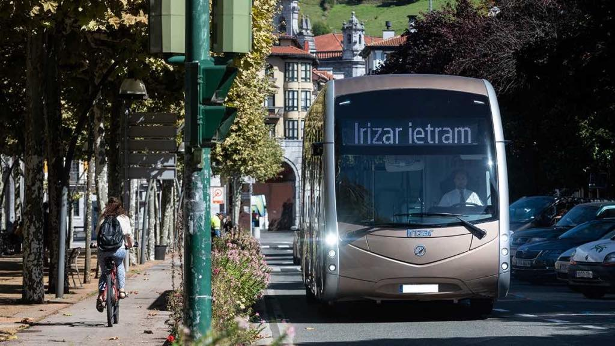
Riding the Wave of the Mobility Future
ELECTRIFICATION : ELECTRIC BUS

Slide 46
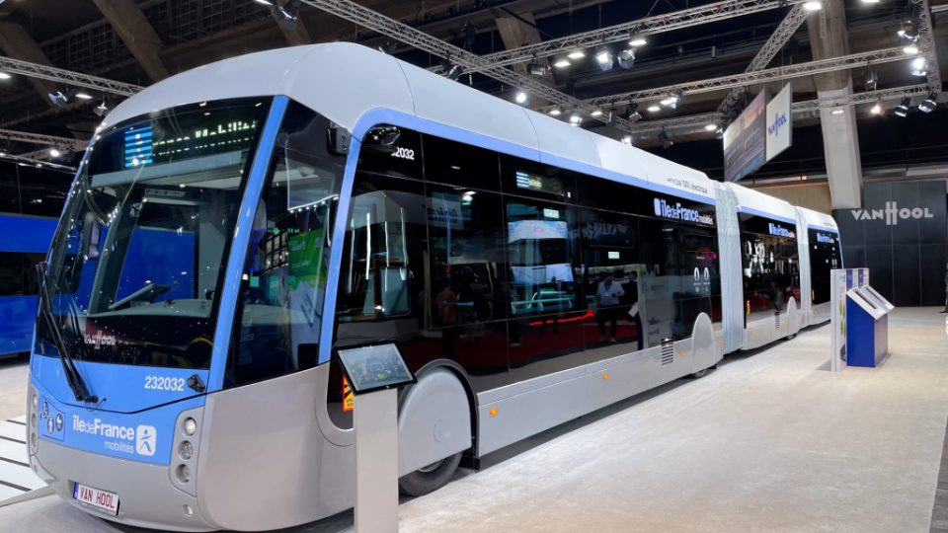
Riding the Wave of the Mobility Future
ARTICULATED BUS ELECTRICITY CHARGING

Slide 47
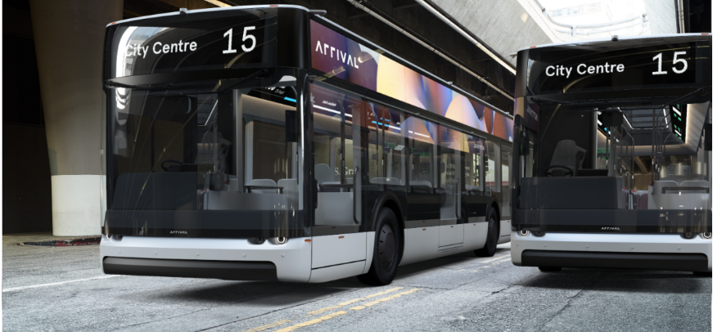
Riding the Wave of the Mobility Future
ARTICULATED BUS ELECTRICITY CHARGING
Between 1.65 and 1.84 kilowatt hours per Km for articulated bus
(a 18-meter bus with 350 kWh of capacity can cover a range between 190 &210 Km)
12metre buses with full-electric heating, “diluted” over 100 km, stands in the range between 179 and 235 kWh.

Slide 48
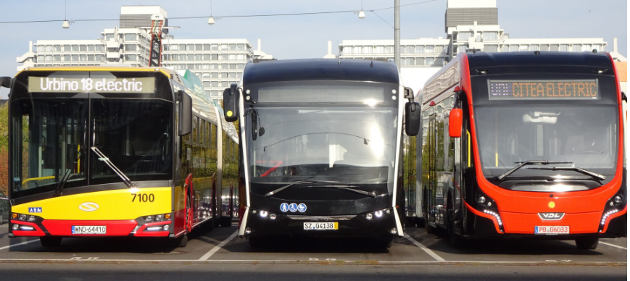
Riding the Wave of the Mobility Future
ARTICULATED BUS ELECTRICITY CHARGING
Between 1.65 and 1.84 kilowatt hours per Km for articulated bus
(a 18-meter bus with 350 kWh of capacity can cover a range between 190 &210 Km)

Slide 49
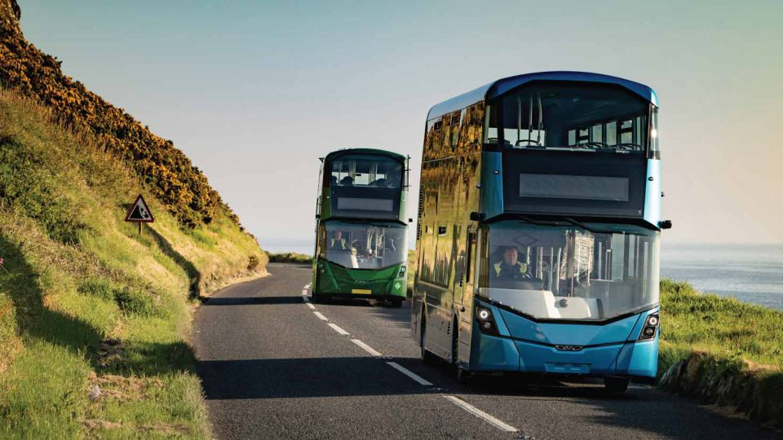
Riding the Wave of the Mobility Future
DOUBLE DECKER E- BUS

Slide 50
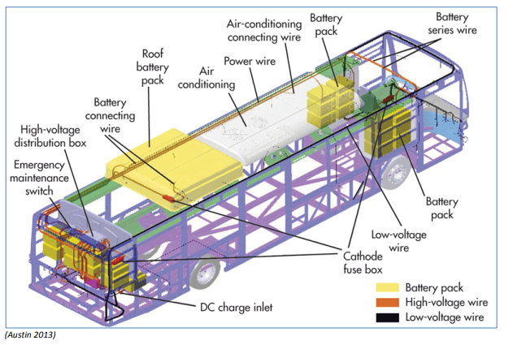
Riding the Wave of the Mobility Future
ELECTRIC BUS : ELECTRICAL LAYOUT - BATTERY

Slide 51
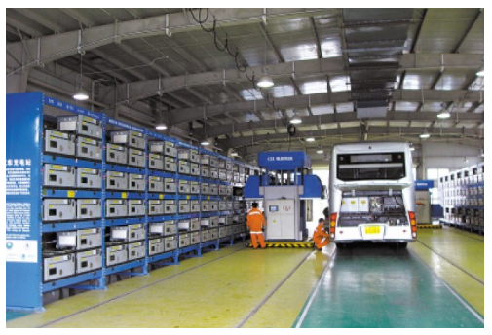
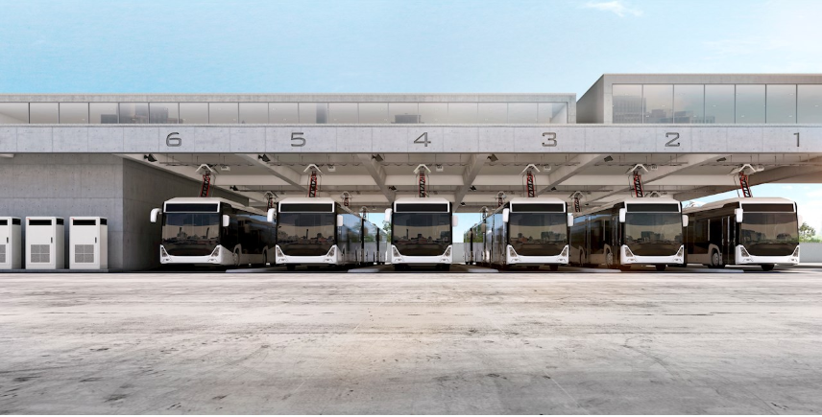
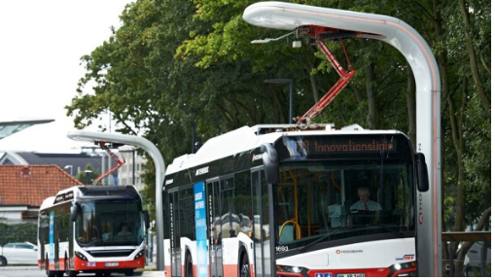
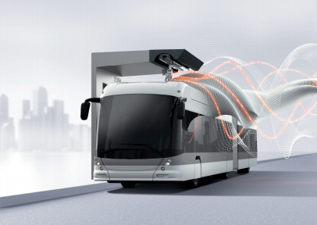
Riding the Wave of the Mobility Future
BATTERY MODEL CHARGING E-BUS
BATTERY SWAPPING
UP PANTOGRAPH
DOWN PANTOGRAPH
FLASH CHARGING

Slide 52

Riding the Wave of the Mobility Future
INDUCTING MODEL CHARGING E-BUS

Slide 53


Riding the Wave of the Mobility Future
INDUCTING MODEL CHARGING E-BUS

Slide 54


Riding the Wave of the Mobility Future
INDUCTING MODEL CHARGING E-BUS

Slide 55

Riding the Wave of the Mobility Future
EV CHARGING CONNECTORS

Slide 56





Riding the Wave of the Mobility Future
BATTERY CHARGING METHODS
1. Level 1 Charging (120V AC)
2. Level 2 Charging (240V AC)
3. DC FAST CHARGING
4. PORTABLE CHARGERS
5. TESLA SUPER CHARGERS
6. WIRELESS CHARGING
7. RESIDENTIAL COMMERCIAL CHARGERS

Slide 57












Riding the Wave of the Mobility Future
BATTERY TYPES
Lead-Acid
Lithium-ion
Fuel Cell
Nickel-Metal Hydride
Sodium-Ion
Solid-State
GEL LEAD ACID
ABSORBENT GLASS MAT
Super Capacitors
Ultra Capacitors
Smart Battery
Redox Battery

Slide 58



Riding the Wave of the Mobility Future
BATTERY TYPES (Lithium, Nickel based etc)
NICKEL BASED BATTERIES
LITHIUM ION BATTERIES
NICKEL BASED BATTERIES
Nickel-cadmium (NiCd)
Nickel-metal-hydride (NiMH)
Nickel-iron (NiFe)
Nickel-zinc (NiZn)
Nickel-hydrogen (NiH)
LITHIUM ION BASED BATTERIES
Lithium Cobalt Oxide(LiCoO₂) — LCO
Lithium Manganese Oxide (LiMn₂O₄) — LMO
Lithium Nickel Manganese Cobalt Oxide (LiNiMnCoO₂)—NMC
Lithium Iron Phosphate(LiFePO₄) — LFP
Lithium Nickel Cobalt Aluminum Oxide (LiNiCoAlO₂) — NCA
FUTURE BATTERIES
Lithium-air (Li-air)
Lithium-metal (Li-metal)
Solid-state Lithium
Lithium-Sulfur (Li-S)
Sodium-ion (Na-ion)
Sodium-Nickel Chloride (Na-NiCl2)
SMART BATTERY
SINGLE WIRE BUS
SM BUS
REDOX BATTERY
Hydrogen bromine
Iron-chrome
Vanadium/Polyhalide
Vanadium/Vanadium
Bromine polysulphide
Zinc-Bromine

Slide 59

Riding the Wave of the Mobility Future
BATTERY TYPE COMPARISON
Note : Typical specific energy of lead-, nickel- and lithium-based batteries. NCA enjoys the highest specific energy; however, manganese and phosphate are superior in terms of specific power and thermal stability. Li-titanate has the best life span. Source : Cadex

Slide 60

Riding the Wave of the Mobility Future
BATTERY TYPE COMPARISON
Note :
1. Driving range as a function of energy storage ^{[1] .}
2. 35MPa hydrogen tank refers to 5,000psi pressure; 70MPa is 10,000psi.
3. ^{[1]} Source: International Journal of Hydrogen Energy, 34, 6005-6020 (2009)+

Slide 61
Riding the Wave of the Mobility Future
BATTERY TYPE COMPARISON

Slide 62


Riding the Wave of the Mobility Future
4.ALTERNATE FUELS
EV Charging
CNG Fuelling
LNG Fuelling
LPG Fuelling
Hydrogen Fuelling

Slide 63

Riding the Wave of the Mobility Future
Exploring Sustainable Alternatives: A Response to Rising Diesel Costs in TNSTU
Considering the steep expenses associated with diesel, TNSTU ought to explore alternative fuel options. It's crucial to compile a list of substitutes for petroleum-based fuels that can be adopted in public transportation. The escalating prices of diesel necessitate a thoughtful examination of alternative fuel possibilities. This evaluation should encompass on the following for our current fleet..
Economically competitive
Technical acceptability for
existing vehicles
Environmentally acceptable
Safety & availability.

Slide 64

Riding the Wave of the Mobility Future
BENEFITS OF GOING ALTERNATIVE ENERGY SOURCES
Conserve fossil fuels
Slow climate change
Reverse Climate Change
Save lives
Reduce severe weather
Minimize Fuel dependency
Economic & Job
Development
Notes:
Hello everyone,
This is Amudhan, and I am delighted to present to you today on the fascinating topic of "Mobility of the Future: Trends and Developments in Public Transport." As our world continues to evolve, so does the way we move around our cities and communities.

Slide 65
Riding the Wave of the Mobility Future
WHY WE MOVE ALTERNATE FUELS & DRIVE SYSTEMS
DIESEL
C_{14.09}H_{24.78}
PETROL
C₅H₁₅
CNG
CH₄
LNG
CH₄
HYDROGEN
H₂
DME
C₂H₆O
BIO-DIESEL
RCO₂CH₃
N-Butanol
C₄H₉0H
ETHANOL
C₂H₅OH
(P Series)
METHANOL
CH₃OH
BUTANE
C₄H₁₀
OCTANE
C₈H₁₈
PROPANE
C₃H₈
E-FUELS
e-kerosene,
e-methanol etc
CBG
(Mix of CH₄+ CO₂ +H₂O+H₂S)
BIO-H₂
(Photo fermentation)
BIO-CH₄
(Mix of CH₄+ CO₂ +H₂O+O₂+ N₂+H₂S)
AMMONIA
( NH₃)
SOLAR
( PV-Photovoltaic)
Note : e – Fuels are synthetic fuels produced from renewable raw materials such as maize, rapeseed, wheat and palm oil (e.g. bio-ethanol). R* - Fatty Acid. P- Indicates Methanol Percentage
2. Diesel - Liquid methylnaphthalene (45 TO 55 Cetane), 3. Petrol - Mixture of Iso-octane & Heptane (91 TO 95 Octane) 4. Photo-fermentation reaction: C6H12O6→6CO2 + 12H2

Slide 66










Riding the Wave of the Mobility Future
ALTERNATE FUELS OTHER THAN THE DIESEL IN INDIA
BIO DIESEL
BUTANOL
ETHANOL
(P SERIES FUELS)
DIMETHYL
ETHER (DME)
ELECTRIC
CNG
LNG
COMPRESSED BIOGAS
HYDROGEN
SOLAR

Slide 67


Riding the Wave of the Mobility Future
2.HYDROGEN AS A FUEL & TECHNOLOGIES

Slide 68

Riding the Wave of the Mobility Future
HYDROGEN GENERATION TYPES

Slide 69




Riding the Wave of the Mobility Future
HYDROGEN COMPONENTS & SYSTEMS
HYDROGEN CHECK VALVE
FILLING RECEPTABLE
TUBE & FITTINGS & MANUAL BALL VALVE
HYDROGEN TANK SYSTEM
Note :The hydrogen buses save an estimated one kilogram of CO₂ per kilometre

Slide 70

Riding the Wave of the Mobility Future
HYDROGEN ENERGY TRANSFORMATION

Slide 71
Riding the Wave of the Mobility Future
HYDROGEN GENERATION TYPES

Slide 72

Riding the Wave of the Mobility Future
RENEWABLE HYDROGEN AS A FUEL

Slide 73

Riding the Wave of the Mobility Future
HOW A DIRECT HYDROGEN FUELCELL WORKS
Notes:
A fuel cell is composed of an anode, cathode, and an electrolyte membrane. A typical fuel cell works by passing hydrogen through the anode of a fuel cell and oxygen through the cathode. At the anode site, a catalyst splits the hydrogen molecules into electrons and protons. The protons pass through the porous electrolyte membrane, while the electrons are forced through a circuit, generating an electric current and excess heat. At the cathode, the protons, electrons, and oxygen combine to produce water molecules. As there are no moving parts, fuel cells operate silently and with extremely high reliability.

Slide 74

Riding the Wave of the Mobility Future
HYDROGEN + CNG FUEL BUS RUNNING IN DELHI
SOURCE: https://www.businessworld.in/article/CNG-To-HCNG-Model-Capital-Intensive-Delhi-Govt-Unlikely-To-Scale-Up-Pilot-Project/30-09-2021-406749/

Slide 75

Riding the Wave of the Mobility Future
HYDROGEN FUEL CELL BUS
Notes:
Hello everyone,
This is Amudhan, and I am delighted to present to you today on the fascinating topic of "Mobility of the Future: Trends and Developments in Public Transport." As our world continues to evolve, so does the way we move around our cities and communities.

Slide 76

Riding the Wave of the Mobility Future
HYDROGEN FUEL CELL BUS
Notes:
Hello everyone,
This is Amudhan, and I am delighted to present to you today on the fascinating topic of "Mobility of the Future: Trends and Developments in Public Transport." As our world continues to evolve, so does the way we move around our cities and communities.

Slide 77





Riding the Wave of the Mobility Future
BIO-DIESEL,CNG/LNG, CBG/RNG
BIO- DIESEL
CNG
LNG
DME
RNG

Slide 78











Riding the Wave of the Mobility Future
BIO DIESEL RAW MATERIALS
Sunflower
Seed oil
Cottonseed Oil
Rapeseed Oil
Olive Oil
Palm Oil
Soy bean Oil
Animal Fat
(Lard – Pork)
(Tallow – Beef)
(Schmaltz- Chicken)
Peanut Oil
Linseed Oil
Safflower Oil
Used Cooking Oil
Notes:
Hello everyone,
This is Amudhan, and I am delighted to present to you today on the fascinating topic of "Mobility of the Future: Trends and Developments in Public Transport." As our world continues to evolve, so does the way we move around our cities and communities.

Slide 79

Riding the Wave of the Mobility Future
COMPRESSED NATURAL GAS

Slide 80


Riding the Wave of the Mobility Future
COMPRESSED BIO GAS

Slide 81

Riding the Wave of the Mobility Future
DI METHYL ETHER

Slide 82

Riding the Wave of the Mobility Future
COMPARISONS OF ALTERNATIVE FUEL DRIVE
Notes:
Hello everyone,
This is Amudhan, and I am delighted to present to you today on the fascinating topic of "Mobility of the Future: Trends and Developments in Public Transport." As our world continues to evolve, so does the way we move around our cities and communities.

Slide 83

Riding the Wave of the Mobility Future
TECHNOLOGIES & ALTERNATIVE FUEL FEASIBILITIES
SOURCE : SAE INDIA
Notes:
Hello everyone,
This is Amudhan, and I am delighted to present to you today on the fascinating topic of "Mobility of the Future: Trends and Developments in Public Transport." As our world continues to evolve, so does the way we move around our cities and communities.

Slide 84

Riding the Wave of the Mobility Future
CLEAN FUEL TECHNOLOGIES
NOTE:
1. High: Strong potential of achieving this benefit
2. Medium: Possibility of achieving this benefit, according to local context, operational conditions and limits of the energy source
3. Low: The benefit is not applicable or does not work well for this technology
SOURCE : UITP
Notes:
Hello everyone,
This is Amudhan, and I am delighted to present to you today on the fascinating topic of "Mobility of the Future: Trends and Developments in Public Transport." As our world continues to evolve, so does the way we move around our cities and communities.

Slide 85
Riding the Wave of the Mobility Future
FUEL TECHNOLOGY COMPARISON
DESCRIPTION | DIESEL | BIO DIESEL | ELECTRIC | CNG | LNG | DME | H₂ | H₂ FUEL CELLS
COST | NO | YES | YES | YES | YES | YES | YES | YES
DRIVING RANGE | YES | YES | YES | YES | YES | YES | YES | YES
FUEL AVAILABILITY | YES | YES | YES | YES | YES | NO | NO | NO
PAY LOAD | YES | YES | YES | YES | YES | YES | YES | YES
RELIABILITY | YES | YES | YES | YES | YES | YES | YES | YES
SERVICE LIFE | YES | YES | YES | YES | YES | YES | YES | YES
CLIMATE PROTECTION | NO | YES | NO | YES* | YES* | YES | YES | YES
POLLUTION CONTROL | NO | YES | YES | YES* | YES* | YES | YES | YES
SOURCE : SAE INDIA
Notes:
Hello everyone,
This is Amudhan, and I am delighted to present to you today on the fascinating topic of "Mobility of the Future: Trends and Developments in Public Transport." As our world continues to evolve, so does the way we move around our cities and communities.

Slide 86
Riding the Wave of the Mobility Future
EMISSIONS FROM VARIOUS ALTERNATIVE FUELS
Fuel | PM | NO _{x} | THC | CO | Toxic Waste | Ozone Potential | Equ-CO₂ GHG
Diesel | 2.000 | 4.60 | 0.750 | 2.00 | 0.005 | 0.80 | 342.2
MeOH (NG) | 0.035 | 2.25 | 0.275 | 0.50 | 0.05 | 0.65 | 400.9
CNG(Lean Burn) | 0.050 | 3.00 | 1.200 | 0.35 | 0.00 | 0.40 | 285.5
CNG (Stoich) | 0.025 | 1.40 | 0.730 | 1.00 | 0.00 | 0.40 | 302.2
EtOH(FromCorn) | 0.050 | 5.00 | 0.500 | 0.50 | 0.05 | 0.80 | 229.1
LNG (Stoich) | 0.025 | 1.38 | 0.730 | 1.00 | 0.00 | 0.40 | 499.7
H2DI(Steam) | 0.025 | 3.00 | 0.000 | 0.00 | 0.00 | 0.10 | 389.0
PEM FuelCell(H₂) | 0.000 | 0.00 | 0.000 | 0.00 | 0.00 | 0.10 | 207.5
Pb-acid Bat-CNG | 0.013 | 0.70 | 0.365 | 0.50 | SO₂ | 0.25 | 304.6
Pb-acid Battery | 0.000 | 0.00 | 0.000 | 0.00 | SO₂ | 0.10 | 307.7
Pb-acid Battery /PEM- H₂ | 0.000 | 0.00 | 0.000 | 0.00 | SO₂ | 0.10 | 257.2
SOURCE : SAE INDIA

Slide 87

Riding the Wave of the Mobility Future
WHICH BUS IS ECONOMICAL EV/DIESEL FUEL BUS?
??????

Slide 88

Riding the Wave of the Mobility Future

Slide 89

Riding the Wave of the Mobility Future
5 WAYS TO REDUCE TRAFFIC EMISSIONS

