Slide 1


We have alternate fuels, don’t have alternate future
CLEAN FUELS
We have alternative fuels, but we don’t have alternate future.
Change the way we move begins with changing the way we think , design & Finance our mobility systems.
Global Public Transport Expert
1/974,NSC Bose Street,
Bavaani Nagar, Redhills,
Chennai-600 052.
Mail id : adroit.amudhan@gmail.com Phone : +91-9789959270

Slide 2




Dr.V.Amudhan
(Global Public Transport Expert , “MaaS”, EV & Charging , Alternate Fuels Expert)
B.E, M.S,Ph.D,MITE(USA),MISQM(USA),FIE(INDIA), C.Eng(India)
Address : No.1/974, NSC Bose Street, Bhavaani Nagar, Redhills,Chennai-600052.
Phone.No: +91-97899 59270, Mail : adroit.amudhan@gmail.com

Slide 3
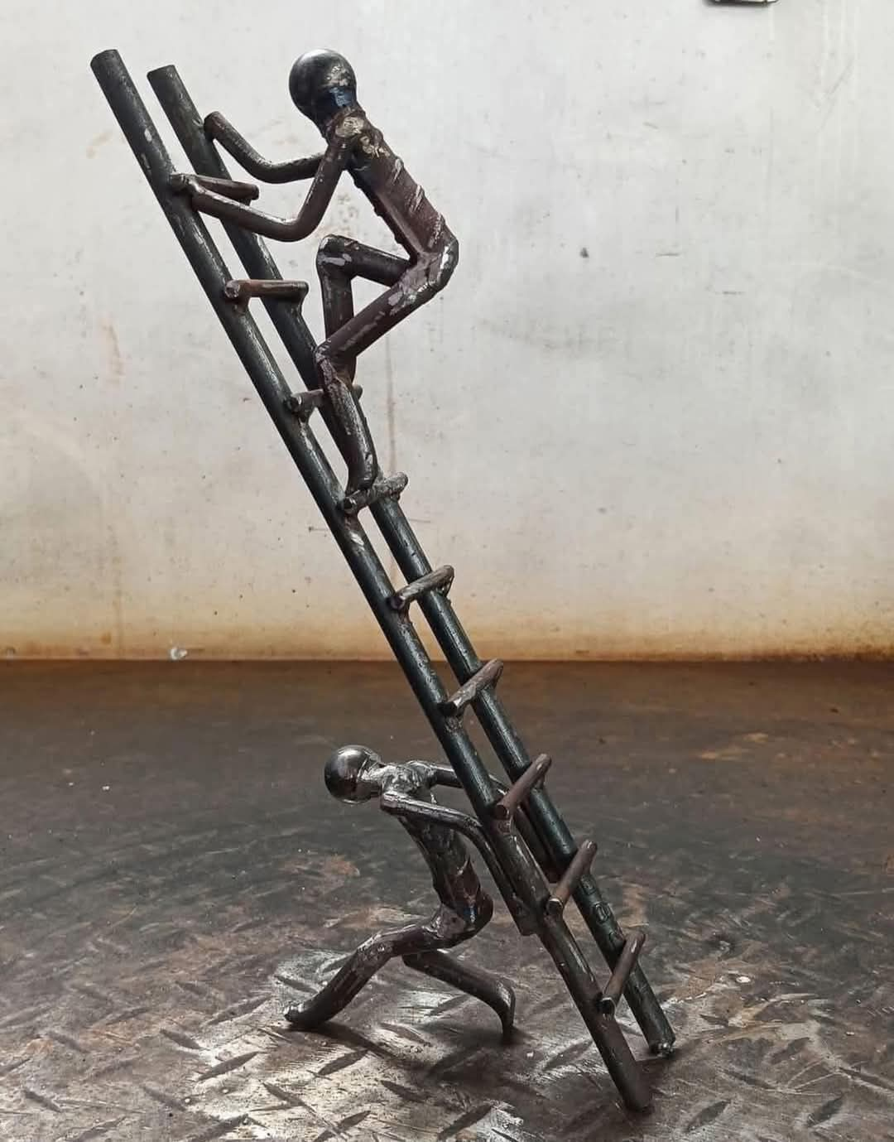
We have alternate fuels, don’t have alternate future
பல கற்றோம் யாமென்று தற்புகழ வேண்டா
அலர்கதிர் ஞாயிற்றைக் கைக்குடையும் காக்கும்
சிலகற்றார் கண்ணும் உளவாம்
பலகற்றார்க் கச்சாணி யன்னதோர் சொல்.
---- நாலடியார்

Slide 4
We have alternate fuels, don’t have alternate future
PROBLEM STATEMENT : CLEAN ENERGY
High Diesel Expenditure leads to go for Alternate Fuels
EPKM = Rs 35 /- (Approximate) , KMPL = 4.5 (Approximate)
Total earning for 4.5 = Rs 35 x 4.5 = 157.50/-
One Litre Diesel Cost = Rs 94.39 = 91.24/-
Diesel Expenses Related to earning = 91.24/157.50
(without Subsidiary) = 57.93% = 58% (Approx)
Diesel Expenses Related to earning = 61.24/157.50
(with Subsidiary) = 38.88% = 39% (Approx)
Diesel Expenses per kilometre = 91.24/4.5
= 20.27
Total earning Rs 35, Diesel =Rs 20.30, Rs 14.73/- for other expenses.

Slide 5
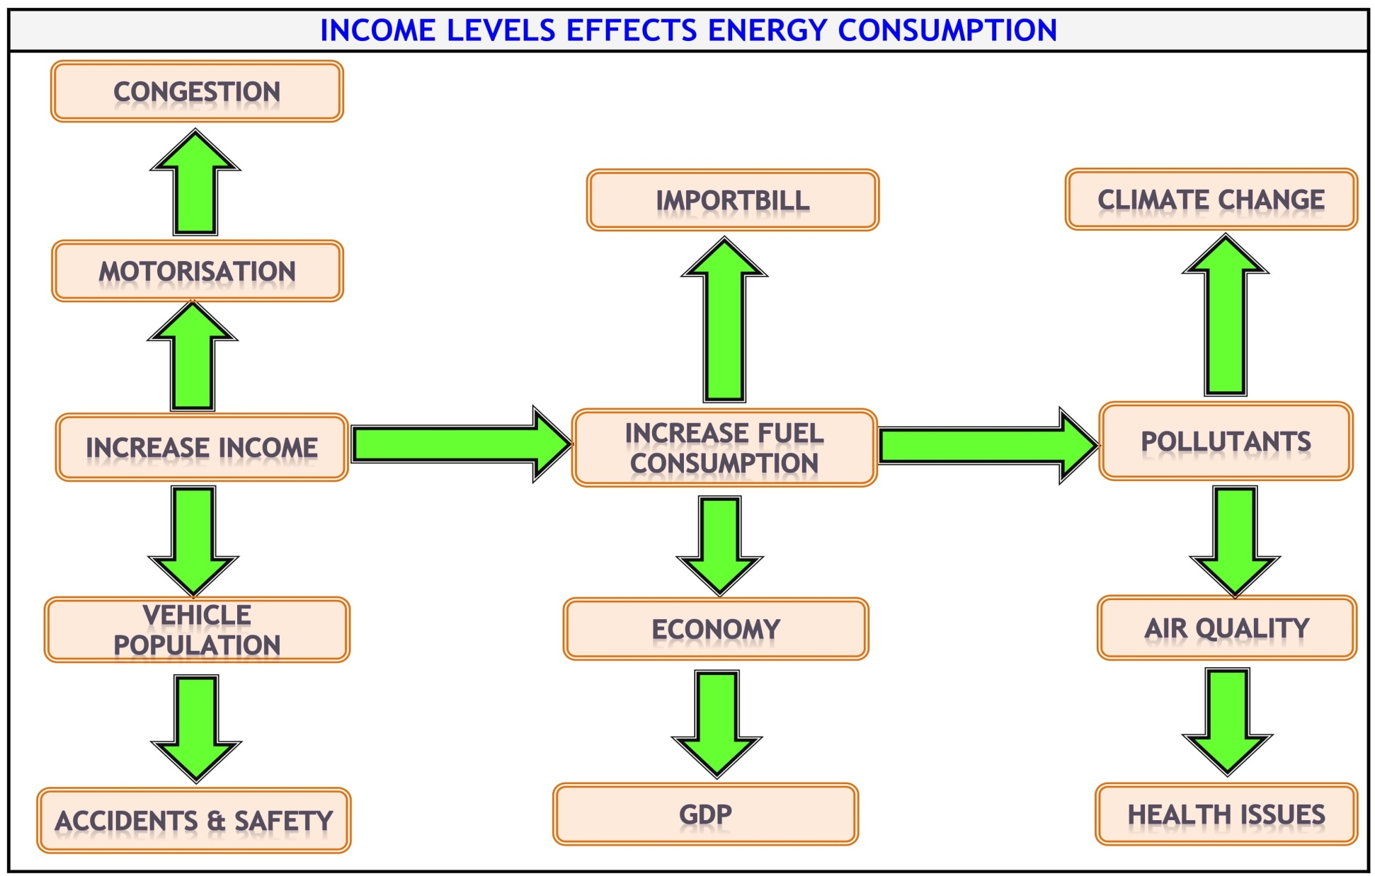
We have alternate fuels, don’t have alternate future

Slide 6
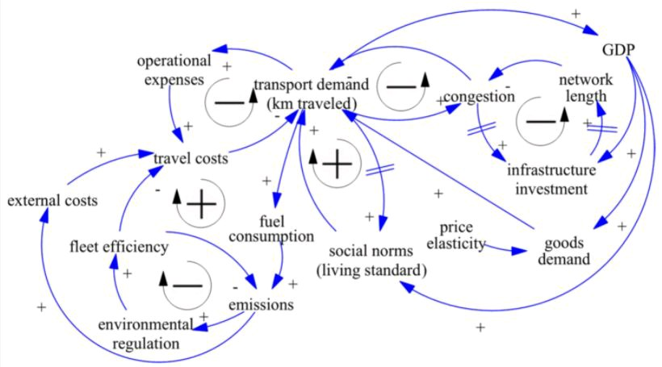
Riding the Wave of the Mobility Future
GDP RELATED TRANSPORT & FUEL

Slide 7
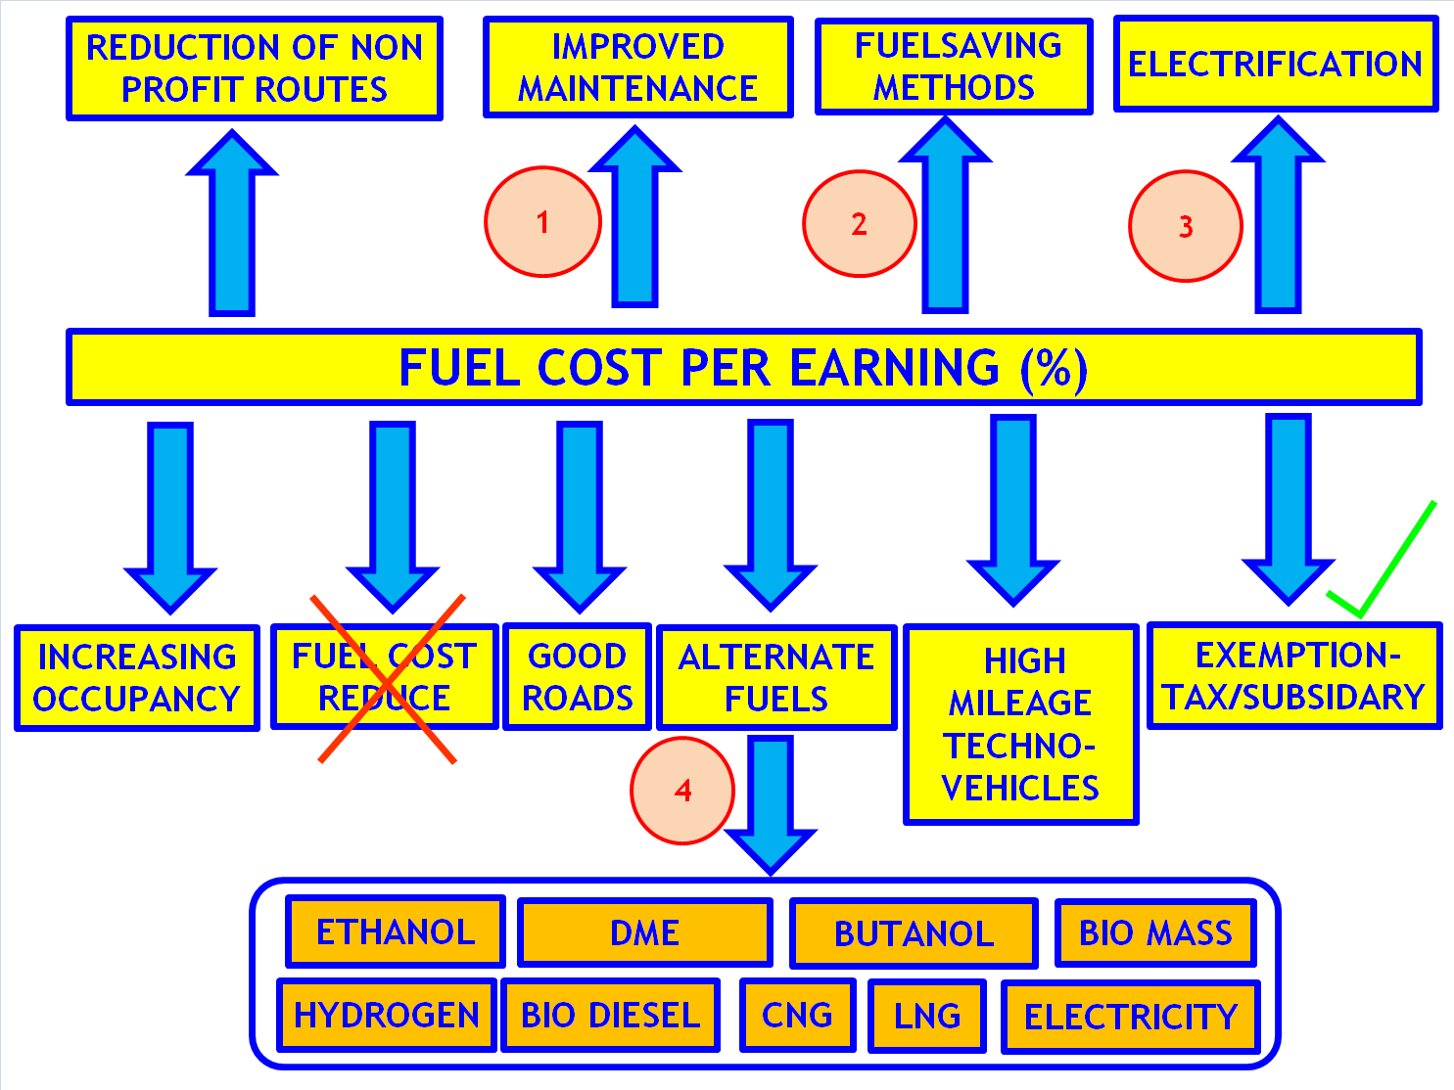
Riding the Wave of the Mobility Future

Slide 8
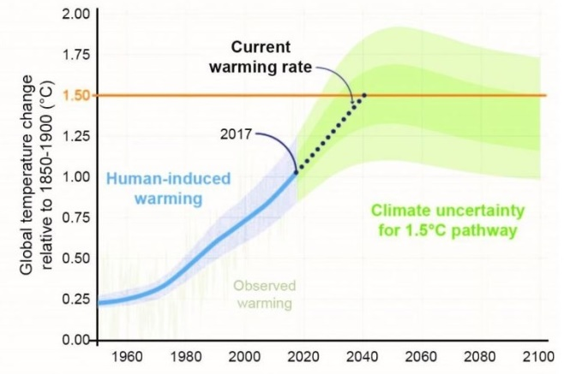
We have alternate fuels, don’t have alternate future
CLIMATE CHANGE
NOTE : The average surface temperature on Earth is approximately 59º degrees Fahrenheit (15º degrees Celsius), according to NASA

Slide 9
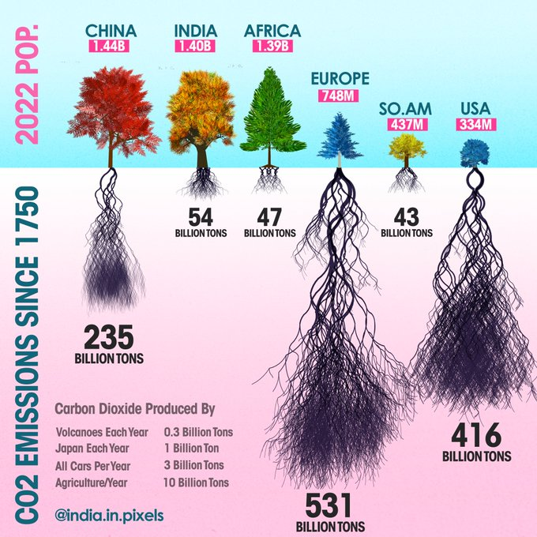
We have alternate fuels, don’t have alternate future
CO₂ Production –Global View

Slide 10
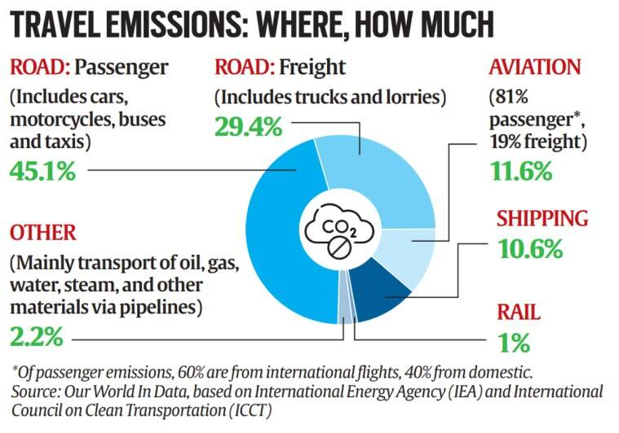
We have alternate fuels, don’t have alternate future
Data’s related to Global Emissions

Slide 11
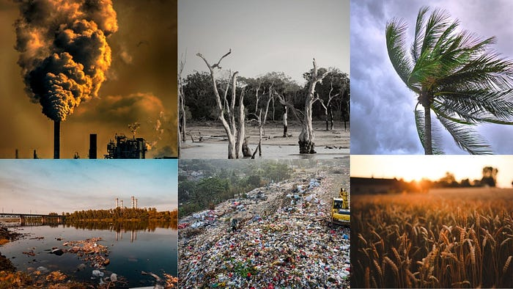
We have alternate fuels, don’t have alternate future
ASSOCIATED IMPACTS OF CLIMATE CHANGE
Frequent severe droughts (கடுமையான வறட்சி)
Less Rainfall
Heat Waves
Heavy Rainfall
Sea Level Rise
Corals Bleach (பவளப்பாறைகள் சேதம் )
Oceans Acidification
Acid rain fall
Bio Diversity is being lost
Tropical Cyclones
Forest Burning
Earthquake
Tsunami

Slide 12
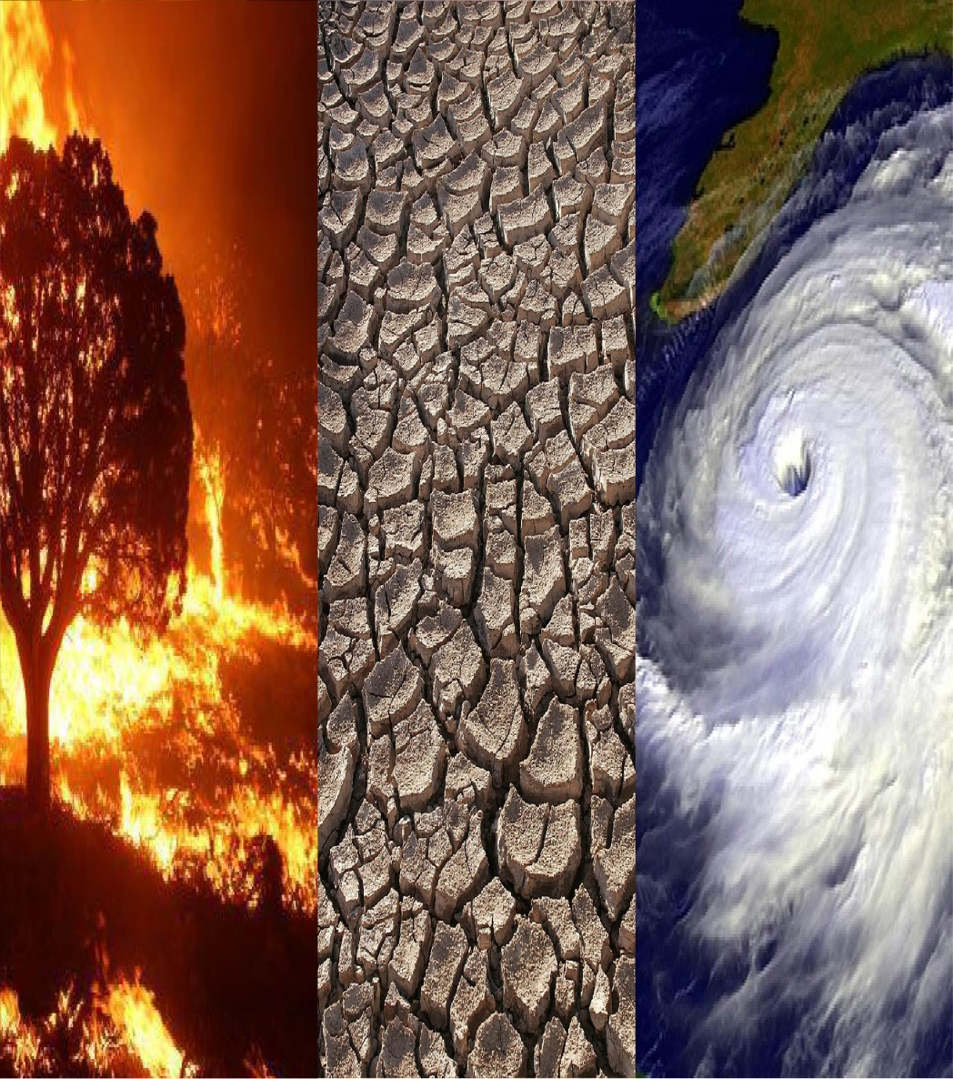
We have alternate fuels, don’t have alternate future
EFFECTS ASSOCIATED WITH CLIMATE CHANGE
Gender Equity
Human Rights
Renewable Energy
Intersecting Inequalities
Natural Resources
Public Services
Health
Infrastructures

Slide 13
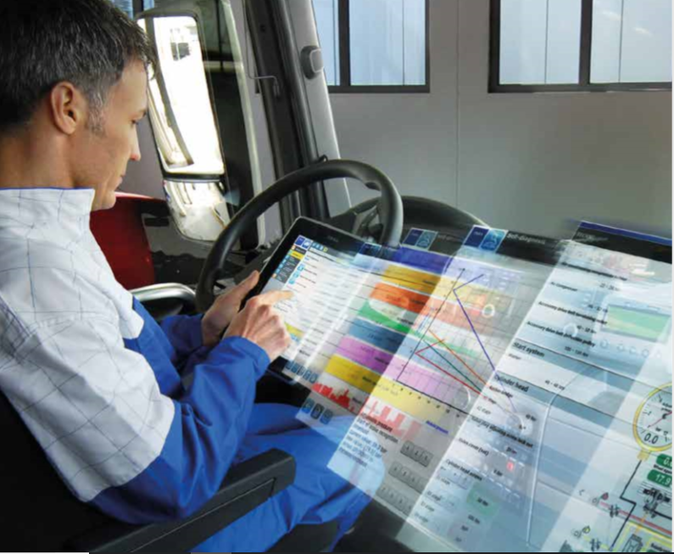
We have alternate fuels, don’t have alternate future
1. IMPROVED MAINTENANCE

Slide 14










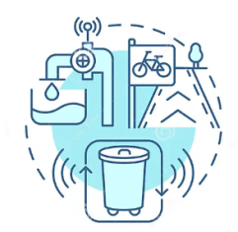




We have alternate fuels, don’t have alternate future
MAINTENANCE PRACTICES IN PUBLIC TRANSIT (Micro)
PREVENTIVE MAINTENANCE
CORRECTIVE MAINTENANCE
PREDICTIVE MAINTENANCE
CONDITION BASED MAINTENANCE
RELIABILITY CENTERED MAINTENANCE (RCM)
SCHEDULED MAINTENANCE
UNSCHEDULED MAINTENANCE
OVERHAUL & REFURBISHMENT
CLEANING & HYGIENE
SAFETY & COMPLIANCE
INFRASTRUCTURE MAINTENANCE
EMERGENCY MAINTENANCE
ENVIRONMENTAL MAINTENANCE
INFORMATION & COMMUNICATION TECHNOLOGY(ICT)
MAINTENANCE
FACILITY
MAINTENANCE

Slide 15




We have alternate fuels, don’t have alternate future
PREDICTIVE MAINTENANCE KEY ELEMENTS
BUS MAINTENANCE
PREDICTIVE MAINTENANCE
REMOTE DIAGNOSTICS
AUTOMATED MAINTENANCE
Monitor Wear & Tear
Avoid Break Downs
Future Proof
Fleet Overview
Vehicle Overview
Diagnostics Trouble Codes
Customized Alerts
Metrics
Sensor Readings
Real Time Notifications
Create Plans
Control Dates Automatically
Adjust as easily as go

Slide 16
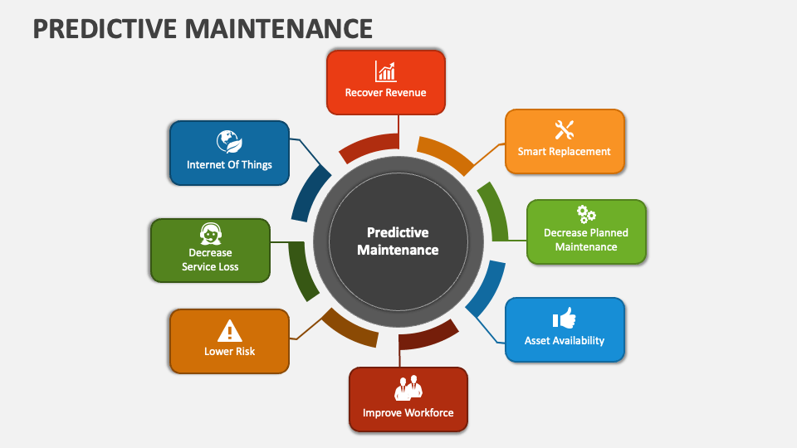
We have alternate fuels, don’t have alternate future
PREDICTIVE MAINTENANCE BENEFITS

Slide 17
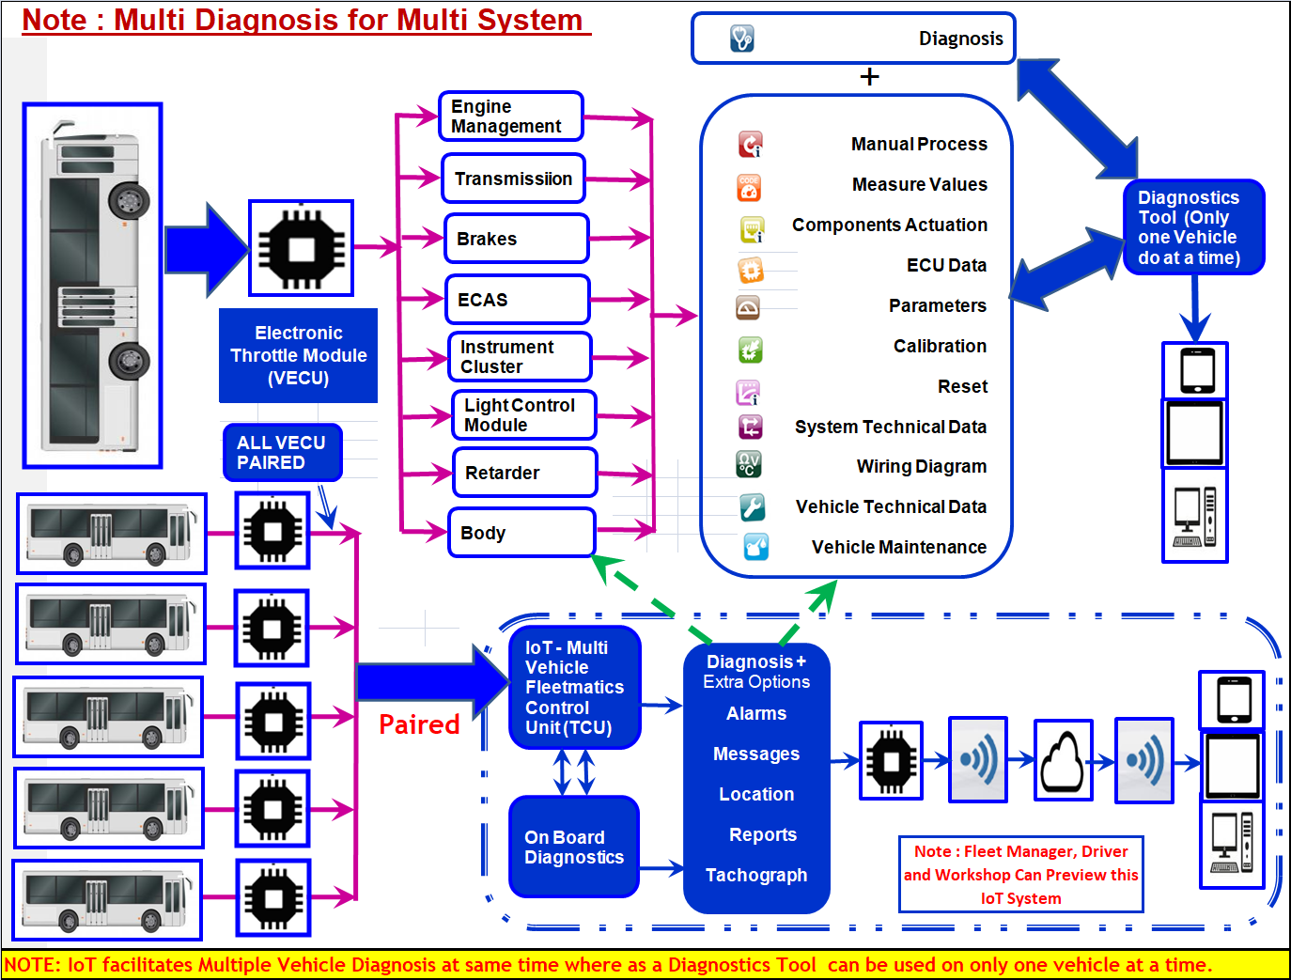
We have alternate fuels, don’t have alternate future
DIFFERENCE BETWEEN DIAGNOSTIC TOOL & IoT

Slide 18

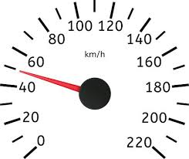


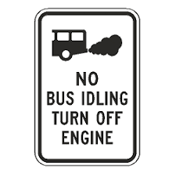














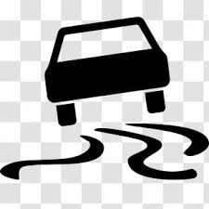



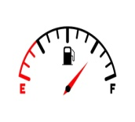



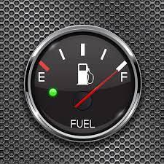

We have alternate fuels, don’t have alternate future
2.FUEL SAVING TECHNIQUES
Smooth driving
Steady Speed
Proper Tyre Maintenance
Synthetic Oils Usage
Lighten the Load (Goods)
Aero
Dynamics
Proper Maintenance
Use Right Fuel
Plan the Apt Trip
Avoid Excess Idling
Use Apt Gears
Apt level – A/c Use
Axle Alignment
Check
Battery Cables
Accelerate when need
Alternative Modes
Monitor Fuel Economy
Avoid Rapid Start
Smart Driving
No Fast Driving
Hi-Mileage Techno Vehicles
Use Cruise Control
Time of Fuel Pump
Clean Air filter
Avoid Rush Hour Travel
Use Fast Tag
Avoid Overfilling
Use Alternate
Fuels & Drives

Slide 19
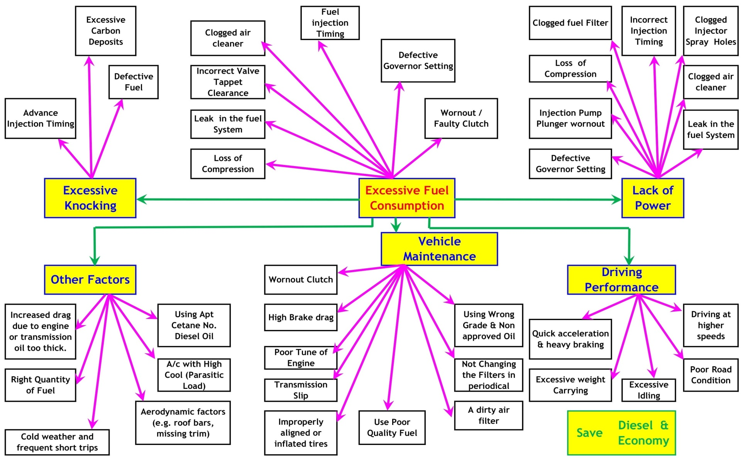
We have alternate fuels, don’t have alternate future
FUEL SAVING - CONSUMPTION REDUCTION

Slide 20
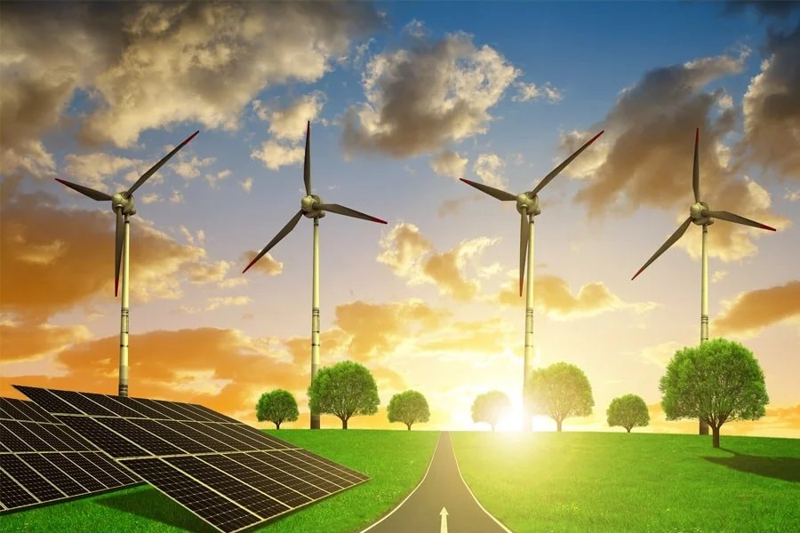
We have alternate fuels, don’t have alternate future
3.ALTERNATE FUELS
Considering the steep expenses associated with diesel, TNSTU ought to explore alternative fuel options. It's crucial to compile a list of substitutes for petroleum-based fuels that can be adopted in public transportation. The escalating prices of diesel necessitate a thoughtful examination of alternative fuel possibilities. This evaluation should encompass on the following for our current fleet..
Economically competitive
Technical acceptability for
existing vehicles
Environmentally acceptable
Safety & availability.

Slide 21










We have alternate fuels, don’t have alternate future
ALTERNATIVE ENERGY SOURCES - FUTURE?
WIND
ENERGY
SOLAR
ENERGY
HYDRO-POWER
ENERGY
TIDAL ENERGY
ELECTRICAL
ENERGY
WAVE
ENERGY
GEO THERMAL
ENERGY
BIO MASS
ENERGY
NEUCLEAR
ENERGY
WASTE RECYCLING

Slide 22
We have alternate fuels, don’t have alternate future
WHY WE MOVE ALTERNATE FUELS & DRIVE SYSTEMS
DIESEL
C_{14.09}H_{24.78}
PETROL
C₅H₁₅
CNG
CH₄
LNG
CH₄
HYDROGEN
H₂
DME
C₂H₆O
BIO-DIESEL
RCO₂CH₃
N-Butanol
C₄H₉0H
ETHANOL
C₂H₅OH
(P Series)
METHANOL
CH₃OH
BUTANE
C₄H₁₀
OCTANE
C₈H₁₈
PROPANE
C₃H₈
E-FUELS
e-kerosene,
e-methanol etc
CBG
(Mix of CH₄+ CO₂ +H₂O+H₂S)
BIO-H₂
(Photo fermentation)
BIO-CH₄
(Mix of CH₄+ CO₂ +H₂O+O₂+ N₂+H₂S)
AMMONIA
( NH₃)
SOLAR
( PV-Photovoltaic)
Note : e – Fuels are synthetic fuels produced from renewable raw materials such as maize, rapeseed, wheat and palm oil (e.g. bio-ethanol). R* - Fatty Acid. P- Indicates Methanol Percentage
2. Diesel - Liquid methylnaphthalene (45 TO 55 Cetane), 3. Petrol - Mixture of Iso-octane & Heptane (91 TO 95 Octane) 4. Photo-fermentation reaction: C6H12O6→6CO2 + 12H2

Slide 23

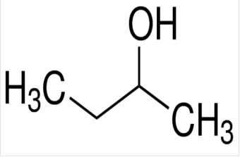
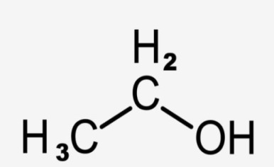


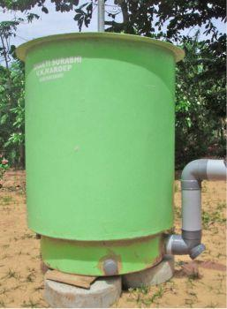
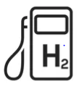


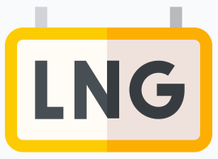
We have alternate fuels, don’t have alternate future
ALTERNATE FUELS OTHER THAN THE DIESEL IN INDIA
BIO DIESEL
BUTANOL
ETHANOL
(P SERIES FUELS)
DIMETHYL
ETHER (DME)
ELECTRIC
CNG
LNG
COMPRESSED BIOGAS
HYDROGEN
SOLAR

Slide 24
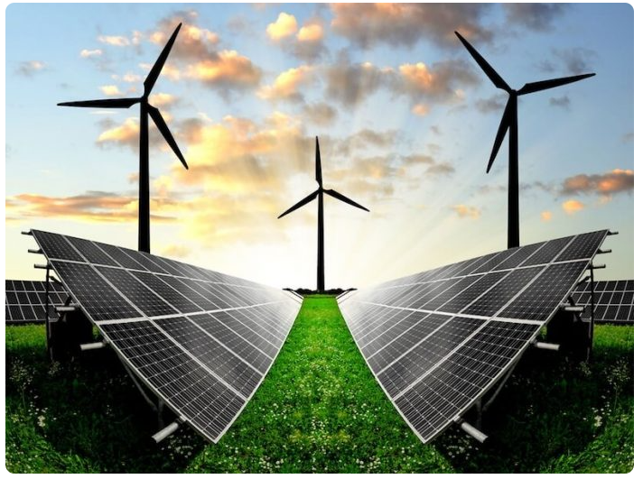
We have alternate fuels, don’t have alternate future
BENEFITS OF GOING ALTERNATIVE ENERGY SOURCES
Conserve fossil fuels
Slow climate change
Reverse Climate Change
Save lives
Reduce severe weather
Minimize Fuel dependency
Economic & Job
Development
Notes:
Hello everyone,
This is Amudhan, and I am delighted to present to you today on the fascinating topic of "Mobility of the Future: Trends and Developments in Public Transport." As our world continues to evolve, so does the way we move around our cities and communities.

Slide 25








We have alternate fuels, don’t have alternate future
WHY WE NEED ELECTRIC BUS ?
IMPROVE LOCAL
AIR QUALITY
REDUCE NOISE FROM TRANSPORT
IMPROVE PT ACCESSIBILITY IN URBAN AREAS
CO₂ AND GHG SDG REDUCTION TARGETS
BUILD ENERGY SOURCE DIVERSITY & RENEWABLE STORAGE CAPACITY
IMPROVE IMAGE OF LOCAL BUSES
IMPROVE PUBLIC TRANSIT MARKET SHARE
REDUCE OPERATING COSTS

Slide 26
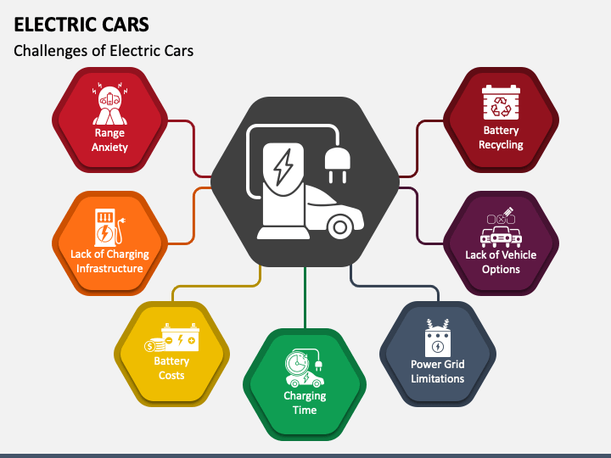

We have alternate fuels, don’t have alternate future
ELECTRIFICATION : ELECTRIC BUS CHALLENGES

Slide 27
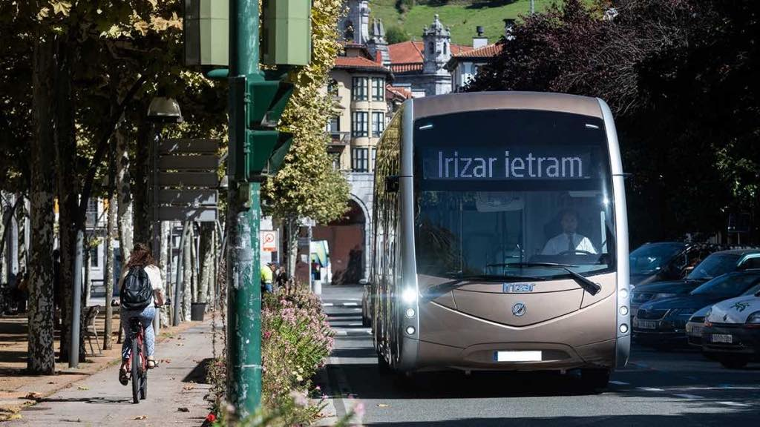
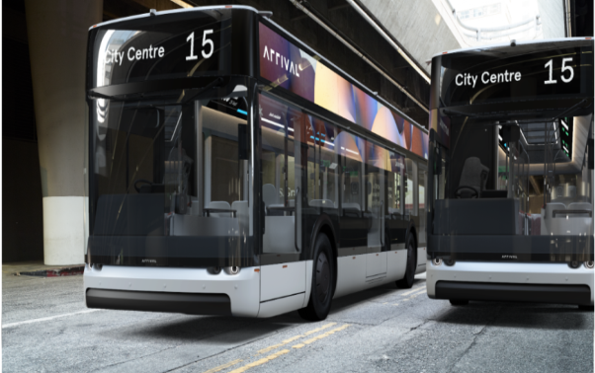
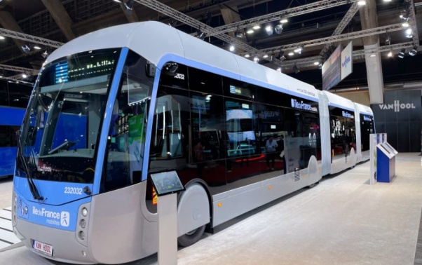
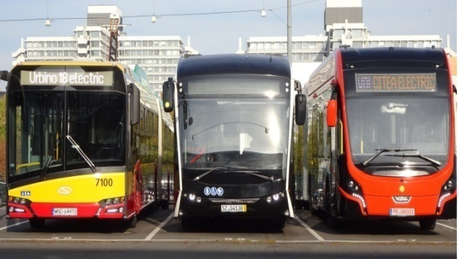
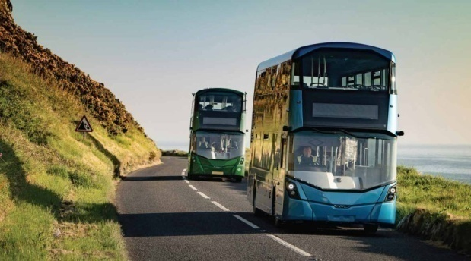
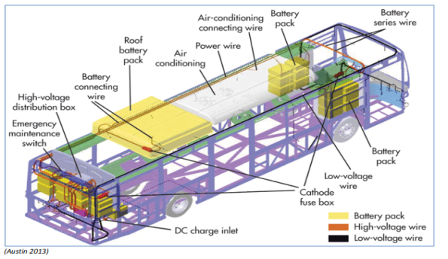
We have alternate fuels, don’t have alternate future
VARIOUS E- BUS
ELECTRIC BUS
ARTICULATED
E BUS
DOUBLE DECKER E- BUS
ELECTRICAL LAYOUT

Slide 28
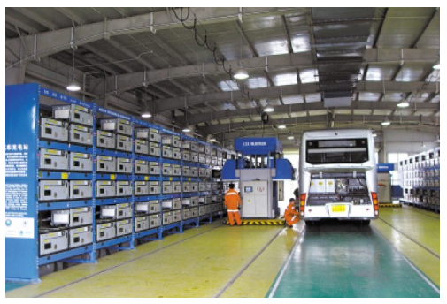
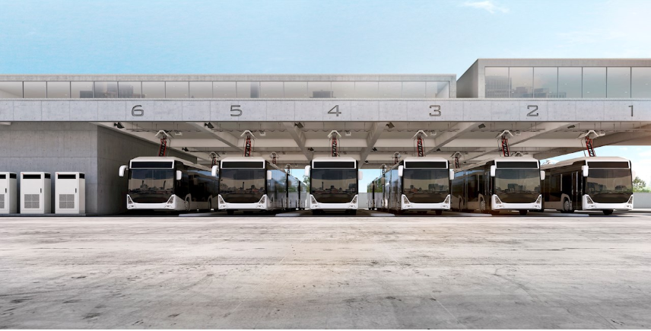
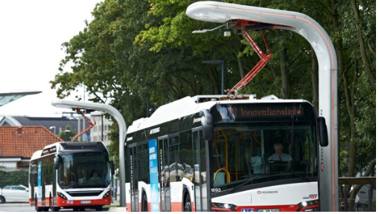
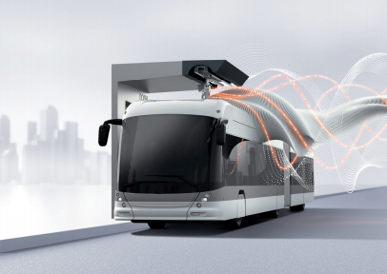
We have alternate fuels, don’t have alternate future
BATTERY MODEL CHARGING E-BUS
BATTERY SWAPPING
UP PANTOGRAPH
DOWN PANTOGRAPH
FLASH CHARGING

Slide 29
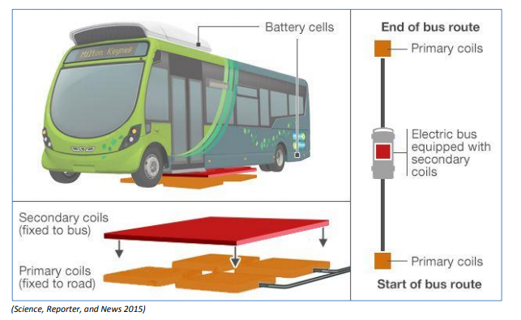
We have alternate fuels, don’t have alternate future
INDUCTING MODEL CHARGING E-BUS

Slide 30
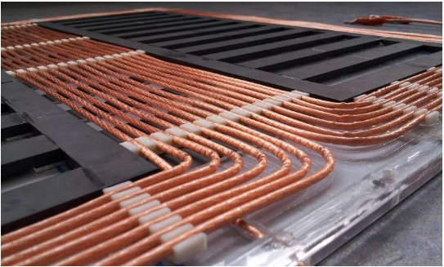
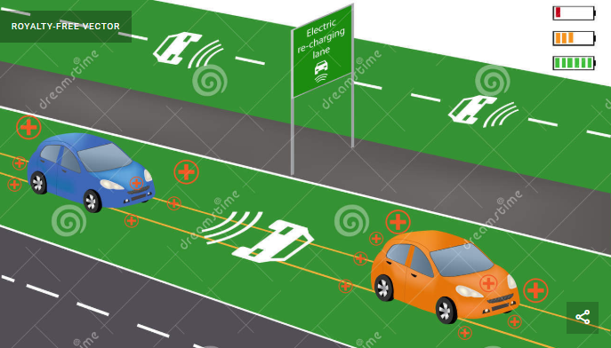
We have alternate fuels, don’t have alternate future
INDUCTING MODEL CHARGING E-BUS

Slide 31
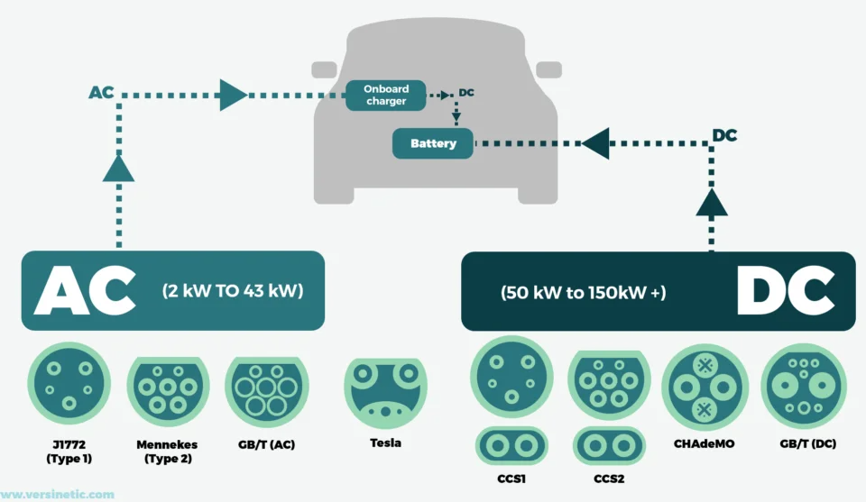
We have alternate fuels, don’t have alternate future
EV CHARGING CONNECTORS

Slide 32
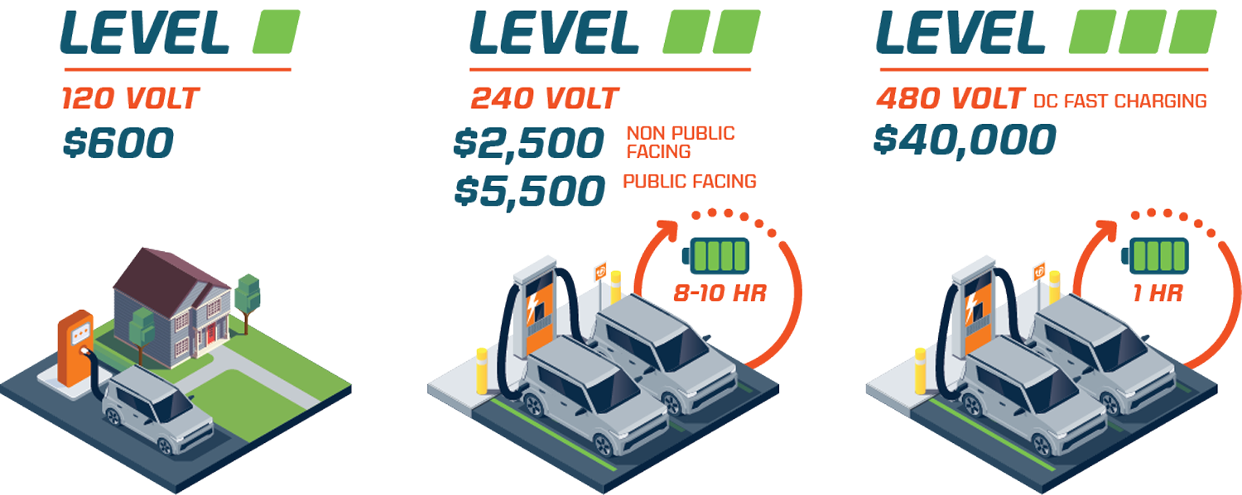
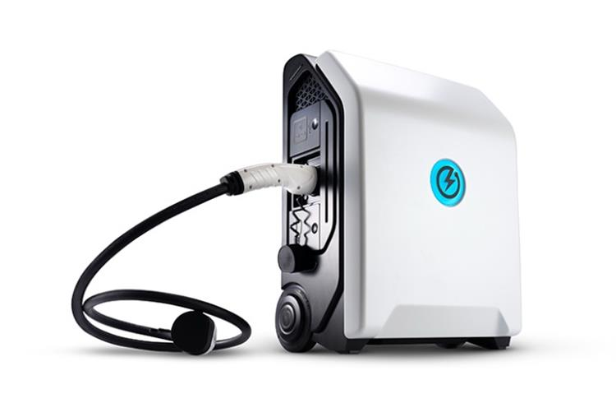
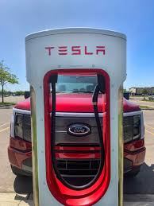
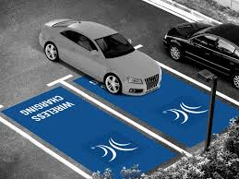
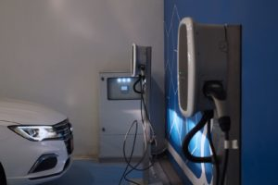
We have alternate fuels, don’t have alternate future
BATTERY CHARGING METHODS
1. Level 1 Charging (120V AC)
2. Level 2 Charging (240V AC)
3. DC FAST CHARGING
4. PORTABLE CHARGERS
5. TESLA SUPER CHARGERS
6. WIRELESS CHARGING
7. RESIDENTIAL COMMERCIAL CHARGERS

Slide 33


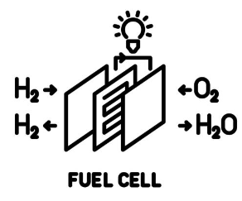
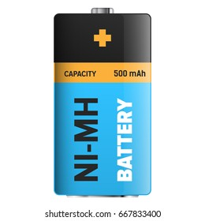
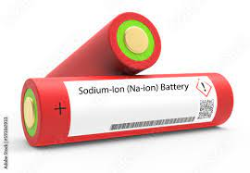
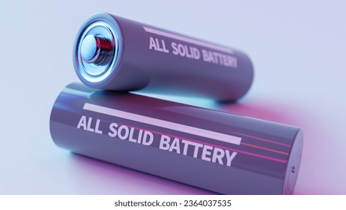






We have alternate fuels, don’t have alternate future
BATTERY TYPES
Lead-Acid
Lithium-ion
Fuel Cell
Nickel-Metal Hydride
Sodium-Ion
Solid-State
GEL LEAD ACID
ABSORBENT GLASS MAT
Super Capacitors
Ultra Capacitors
Smart Battery
Redox Battery

Slide 34



We have alternate fuels, don’t have alternate future
BATTERY TYPES (Lithium, Nickel based etc)
NICKEL BASED BATTERIES
LITHIUM ION BATTERIES
NICKEL BASED BATTERIES
Nickel-cadmium (NiCd)
Nickel-metal-hydride (NiMH)
Nickel-iron (NiFe)
Nickel-zinc (NiZn)
Nickel-hydrogen (NiH)
LITHIUM ION BASED BATTERIES
Lithium Cobalt Oxide(LiCoO₂) — LCO
Lithium Manganese Oxide (LiMn₂O₄) — LMO
Lithium Nickel Manganese Cobalt Oxide (LiNiMnCoO₂)—NMC
Lithium Iron Phosphate(LiFePO₄) — LFP
Lithium Nickel Cobalt Aluminum Oxide (LiNiCoAlO₂) — NCA
FUTURE BATTERIES
Lithium-air (Li-air)
Lithium-metal (Li-metal)
Solid-state Lithium
Lithium-Sulfur (Li-S)
Sodium-ion (Na-ion)
Sodium-Nickel Chloride (Na-NiCl2)
SMART BATTERY
SINGLE WIRE BUS
SM BUS
REDOX BATTERY
Hydrogen bromine
Iron-chrome
Vanadium/Polyhalide
Vanadium/Vanadium
Bromine polysulphide
Zinc-Bromine

Slide 35

We have alternate fuels, don’t have alternate future
BATTERY TYPE COMPARISON
Note : Typical specific energy of lead-, nickel- and lithium-based batteries. NCA enjoys the highest specific energy; however, manganese and phosphate are superior in terms of specific power and thermal stability. Li-titanate has the best life span. Source : Cadex

Slide 36

We have alternate fuels, don’t have alternate future
BATTERY TYPE COMPARISON
Note :
1. Driving range as a function of energy storage ^{[1] .}
2. 35MPa hydrogen tank refers to 5,000psi pressure; 70MPa is 10,000psi.
3. ^{[1]} Source: International Journal of Hydrogen Energy, 34, 6005-6020 (2009)+

Slide 37


We have alternate fuels, don’t have alternate future
4.ALTERNATE FUELS

Slide 38





We have alternate fuels, don’t have alternate future
BIO-DIESEL,CNG/LNG, CBG/RNG
BIO- DIESEL
CNG
LNG
DME
RNG

Slide 39











We have alternate fuels, don’t have alternate future
BIO DIESEL RAW MATERIALS
Sunflower
Seed oil
Cottonseed Oil
Rapeseed Oil
Olive Oil
Palm Oil
Soy bean Oil
Animal Fat
(Lard – Pork)
(Tallow – Beef)
(Schmaltz- Chicken)
Peanut Oil
Linseed Oil
Safflower Oil
Used Cooking Oil
Notes:
Hello everyone,
This is Amudhan, and I am delighted to present to you today on the fascinating topic of "Mobility of the Future: Trends and Developments in Public Transport." As our world continues to evolve, so does the way we move around our cities and communities.

Slide 40


We have alternate fuels, don’t have alternate future
COMPRESSED NATURAL GAS
DI METHYL ETHER

Slide 41

We have alternate fuels, don’t have alternate future
2.HYDROGEN AS A FUEL & TECHNOLOGIES

Slide 42

We have alternate fuels, don’t have alternate future
HYDROGEN GENERATION TYPES

Slide 43




We have alternate fuels, don’t have alternate future
HYDROGEN COMPONENTS & SYSTEMS
HYDROGEN CHECK VALVE
FILLING RECEPTABLE
TUBE & FITTINGS & MANUAL BALL VALVE
HYDROGEN TANK SYSTEM
Note :The hydrogen buses save an estimated one kilogram of CO₂ per kilometre

Slide 44

We have alternate fuels, don’t have alternate future
HYDROGEN GENERATION TYPES
HOW A DIRECT HYDROGEN FUELCELL WORKS

Slide 45


We have alternate fuels, don’t have alternate future
HYDROGEN + CNG FUEL BUS RUNNING IN DELHI
HYDROGEN FUEL CELL BUS
SOURCE: https://www.businessworld.in/article/CNG-To-HCNG-Model-Capital-Intensive-Delhi-Govt-Unlikely-To-Scale-Up-Pilot-Project/30-09-2021-406749/

Slide 46

We have alternate fuels, don’t have alternate future
COMPARISONS OF ALTERNATIVE FUEL DRIVE
Notes:
Hello everyone,
This is Amudhan, and I am delighted to present to you today on the fascinating topic of "Mobility of the Future: Trends and Developments in Public Transport." As our world continues to evolve, so does the way we move around our cities and communities.

Slide 47

We have alternate fuels, don’t have alternate future
TECHNOLOGIES & ALTERNATIVE FUEL FEASIBILITIES
SOURCE : SAE INDIA
Notes:
Hello everyone,
This is Amudhan, and I am delighted to present to you today on the fascinating topic of "Mobility of the Future: Trends and Developments in Public Transport." As our world continues to evolve, so does the way we move around our cities and communities.

Slide 48

We have alternate fuels, don’t have alternate future
CLEAN FUEL TECHNOLOGIES
NOTE:
1. High: Strong potential of achieving this benefit
2. Medium: Possibility of achieving this benefit, according to local context, operational conditions and limits of the energy source
3. Low: The benefit is not applicable or does not work well for this technology
SOURCE : UITP
Notes:
Hello everyone,
This is Amudhan, and I am delighted to present to you today on the fascinating topic of "Mobility of the Future: Trends and Developments in Public Transport." As our world continues to evolve, so does the way we move around our cities and communities.

Slide 49
We have alternate fuels, don’t have alternate future
FUEL TECHNOLOGY COMPARISON
DESCRIPTION | DIESEL | BIO DIESEL | ELECTRIC | CNG | LNG | DME | H₂ | H₂ FUEL CELLS
COST | NO | YES | YES | YES | YES | YES | YES | YES
DRIVING RANGE | YES | YES | YES | YES | YES | YES | YES | YES
FUEL AVAILABILITY | YES | YES | YES | YES | YES | NO | NO | NO
PAY LOAD | YES | YES | YES | YES | YES | YES | YES | YES
RELIABILITY | YES | YES | YES | YES | YES | YES | YES | YES
SERVICE LIFE | YES | YES | YES | YES | YES | YES | YES | YES
CLIMATE PROTECTION | NO | YES | NO | YES* | YES* | YES | YES | YES
POLLUTION CONTROL | NO | YES | YES | YES* | YES* | YES | YES | YES
SOURCE : SAE INDIA
Notes:
Hello everyone,
This is Amudhan, and I am delighted to present to you today on the fascinating topic of "Mobility of the Future: Trends and Developments in Public Transport." As our world continues to evolve, so does the way we move around our cities and communities.

Slide 50

We have alternate fuels, don’t have alternate future

