Slide 1
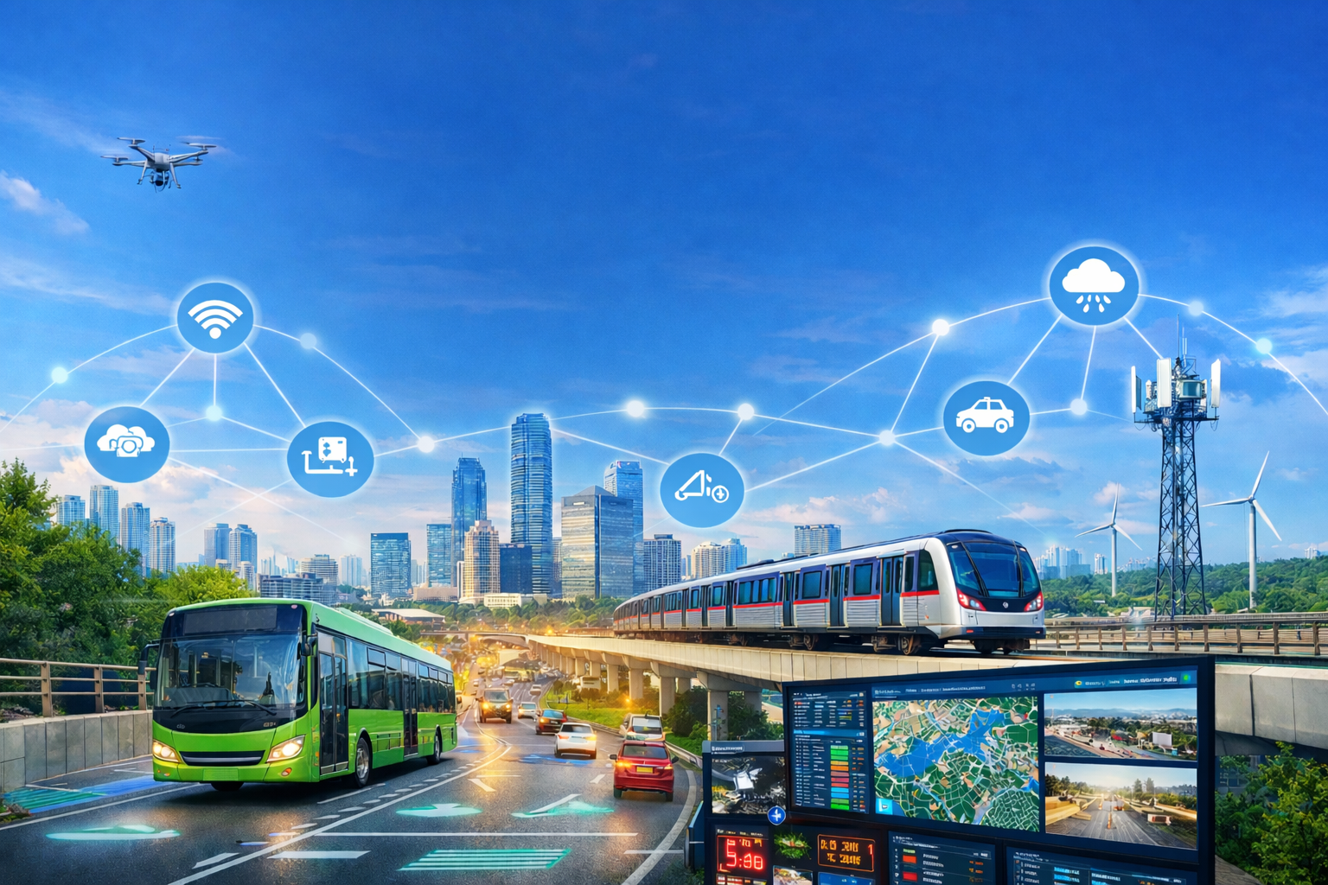

IoT-Driven Solutions for Disaster-Resilient Urban Mobility and Smart Infrastructure
ATAL Online 6 Days Faculty Development Program
SRM Madurai College for Engineering and Technology
Dr. V. Amudhan
BE,MS,Ph.D,MITE(USA),MISQM(USA),FIE(India),C.EnG(IEI)
Independent Director to MTC Chennai ,
TNSTC (Coimbatore ) & TNSTC (Salem)

Slide 2

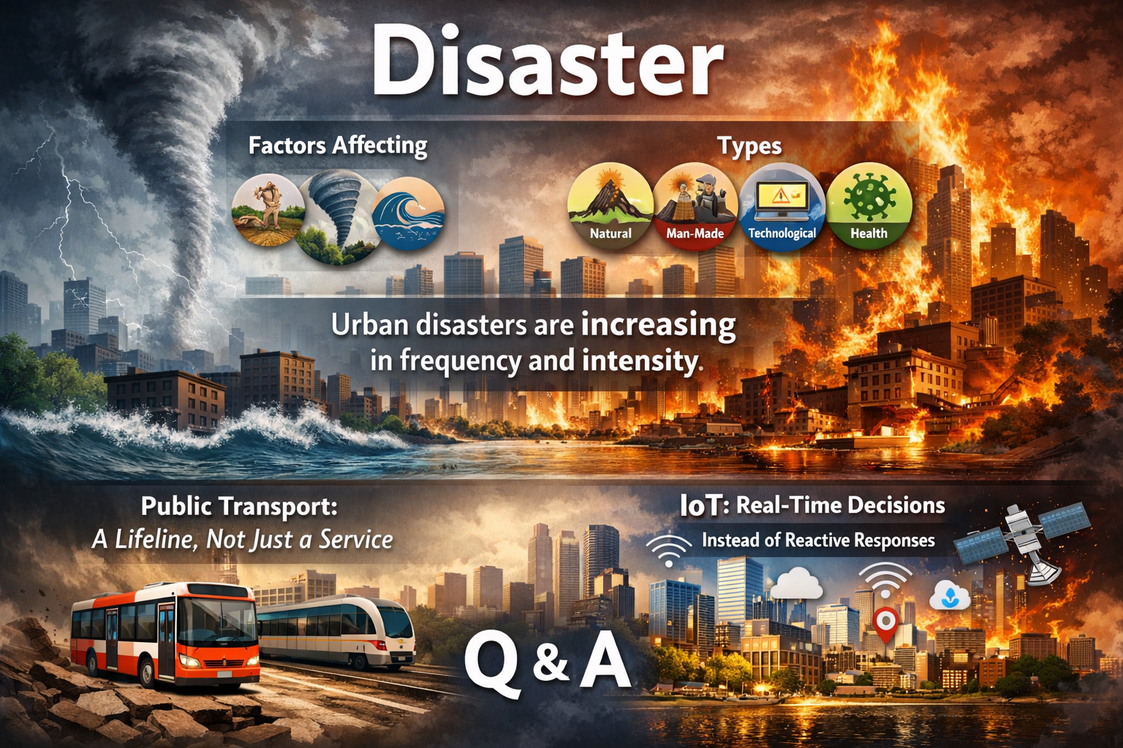
IoT-Driven Solutions for Disaster-Resilient Urban Mobility and Smart Infrastructure
Contents

Slide 3
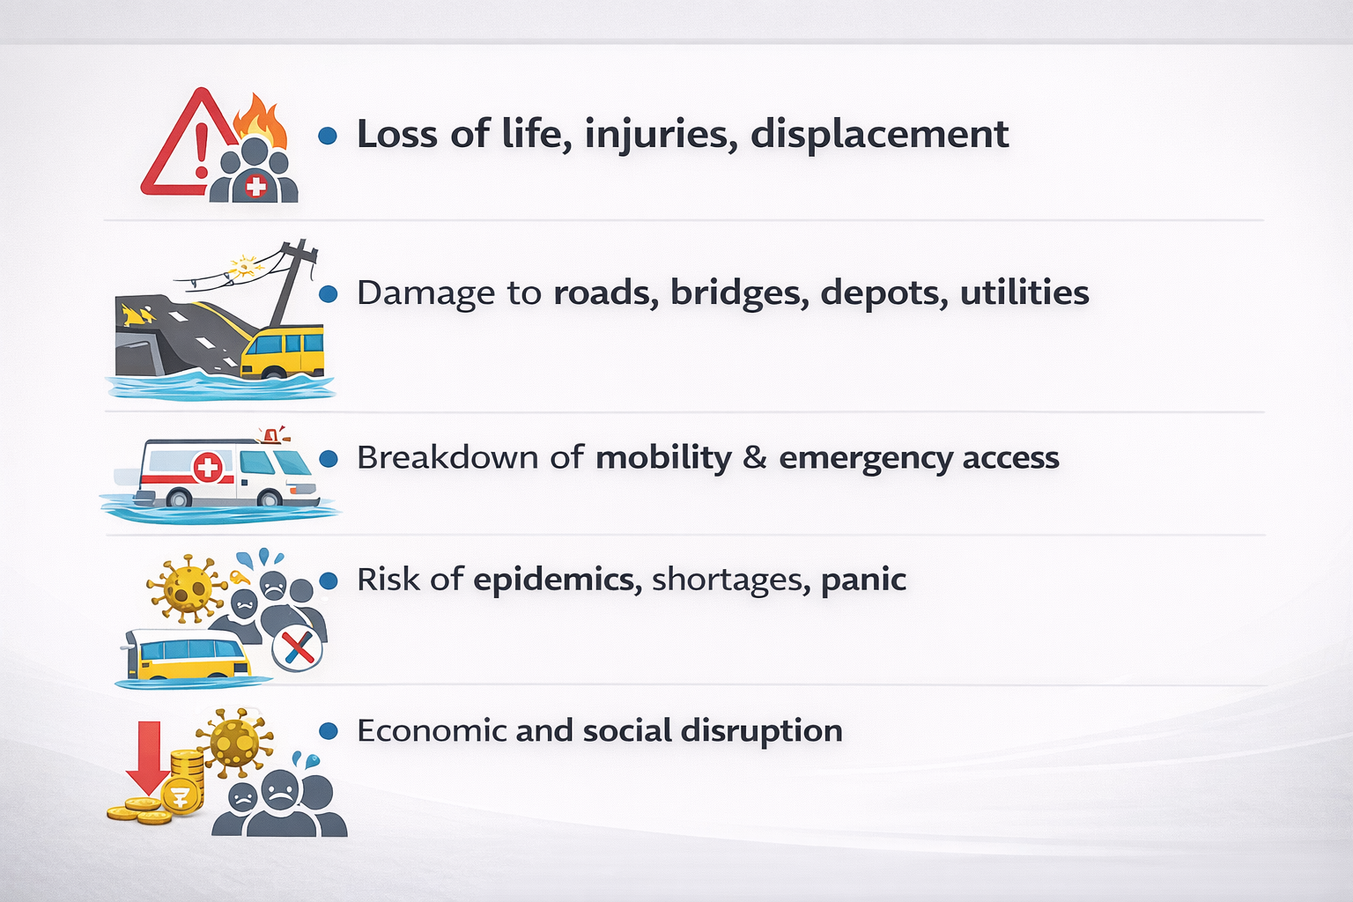
IoT-Driven Solutions for Disaster-Resilient Urban Mobility and Smart Infrastructure
Disaster Impacts on Cities & Transport Systems

Slide 4
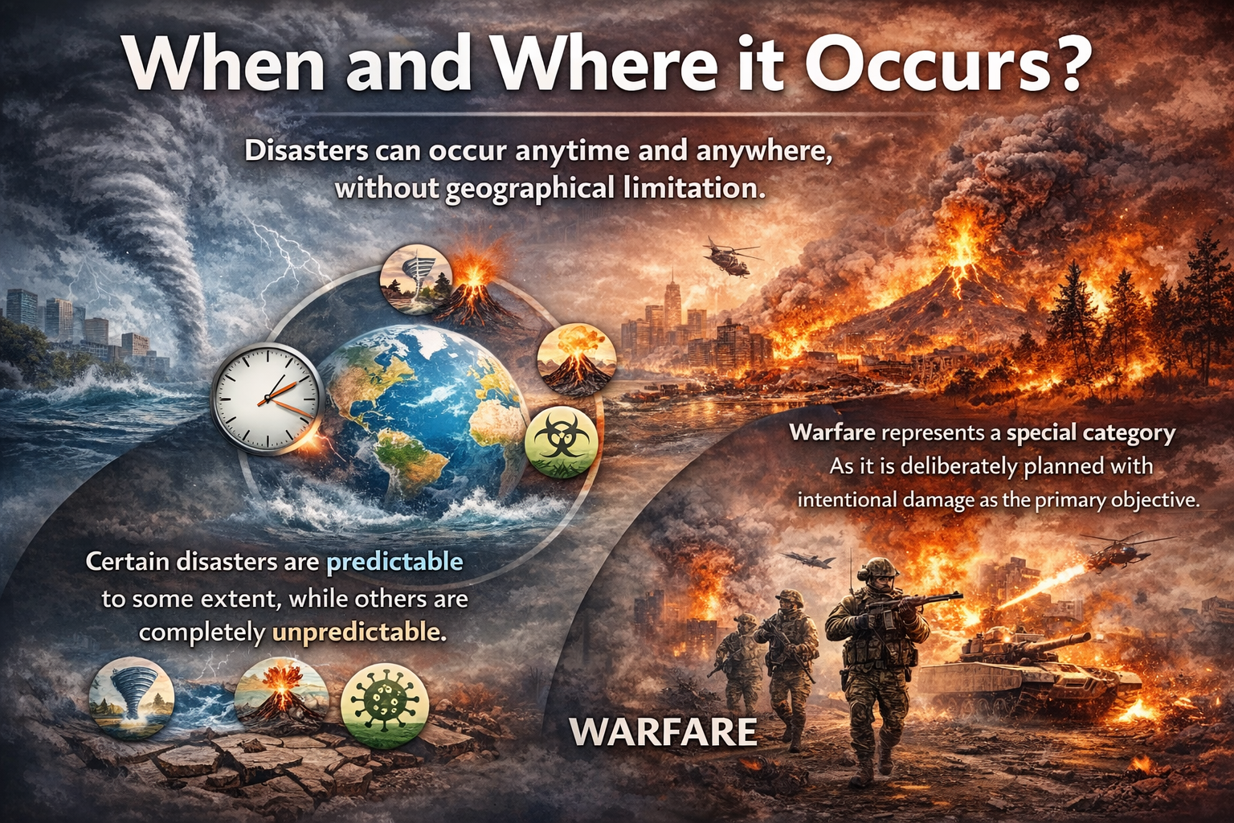
IoT-Driven Solutions for Disaster-Resilient Urban Mobility and Smart Infrastructure
Disasters : Unpredictable and Global Impacts

Slide 5
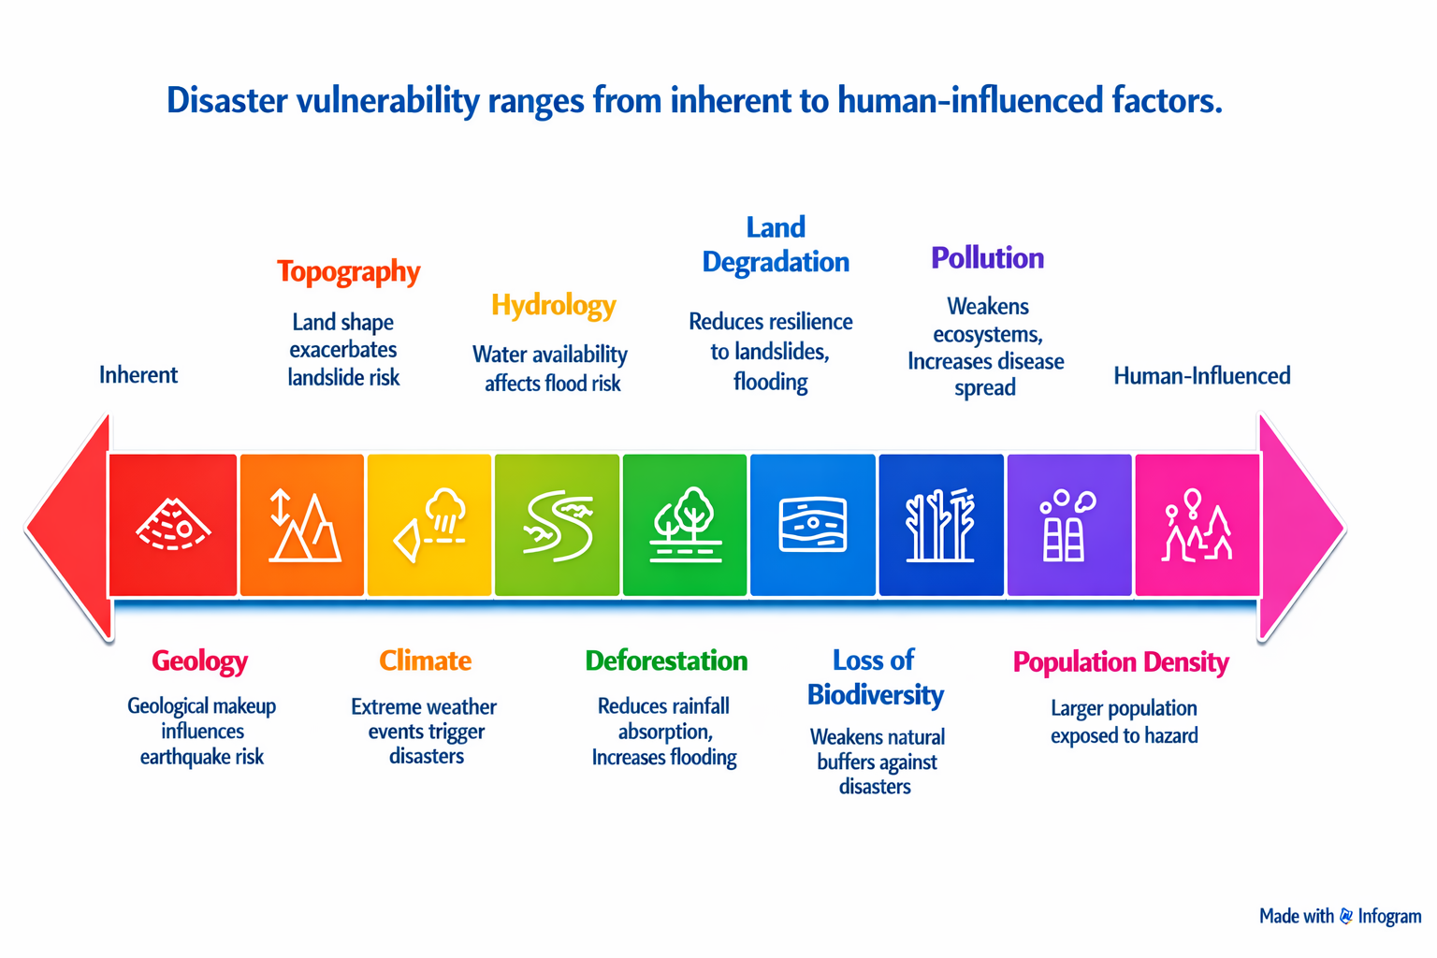
IoT-Driven Solutions for Disaster-Resilient Urban Mobility and Smart Infrastructure
Factors Affecting Disaster

Slide 6
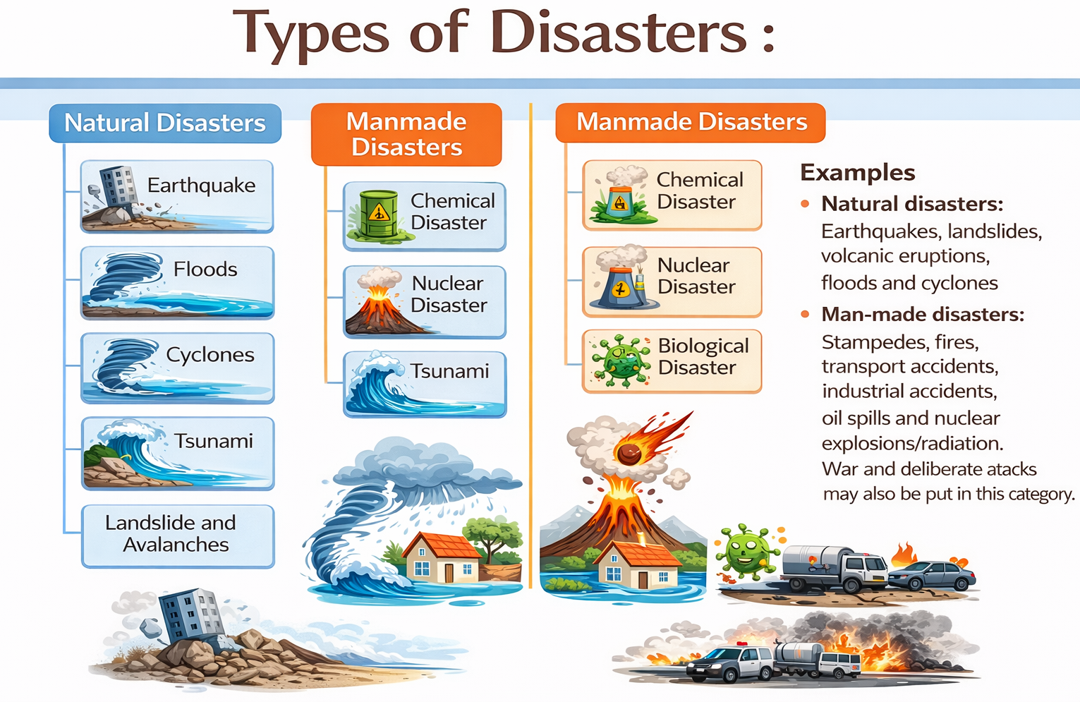
IoT-Driven Solutions for Disaster-Resilient Urban Mobility and Smart Infrastructure

Slide 7

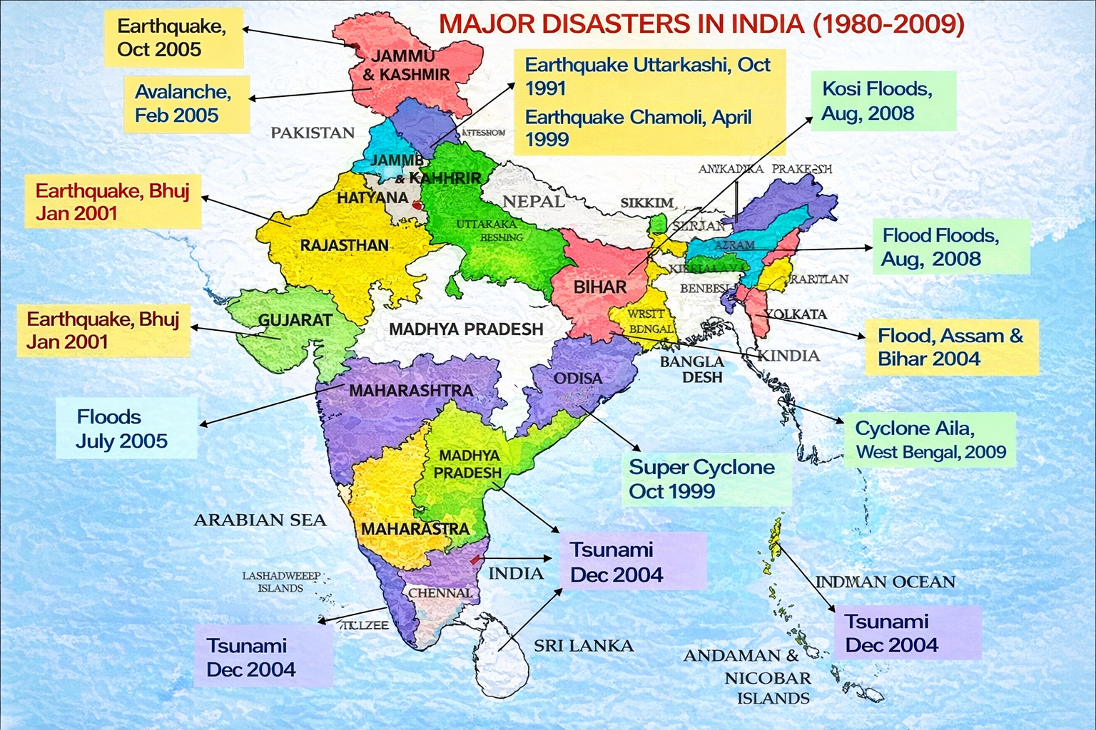
IoT-Driven Solutions for Disaster-Resilient Urban Mobility and Smart Infrastructure

Slide 8
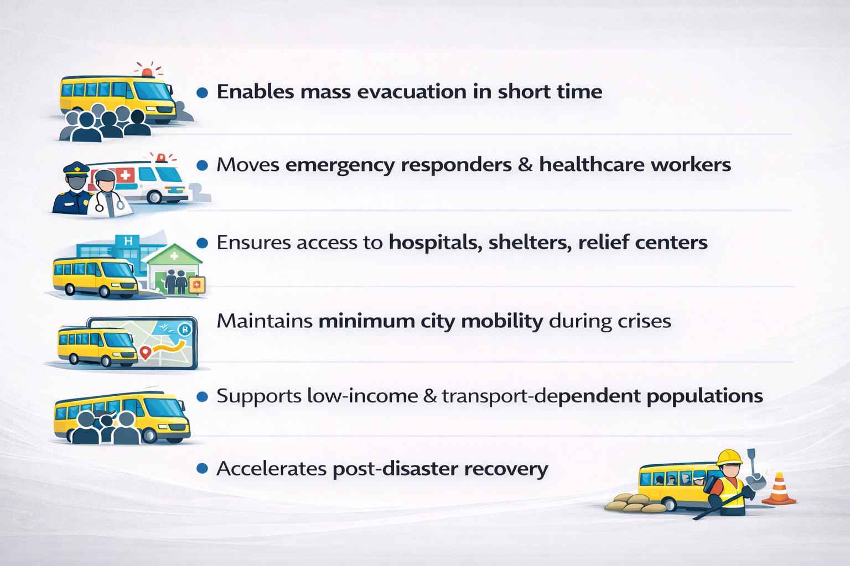
IoT-Driven Solutions for Disaster-Resilient Urban Mobility and Smart Infrastructure
Public Transport as Disaster Response Infrastructure

Slide 9
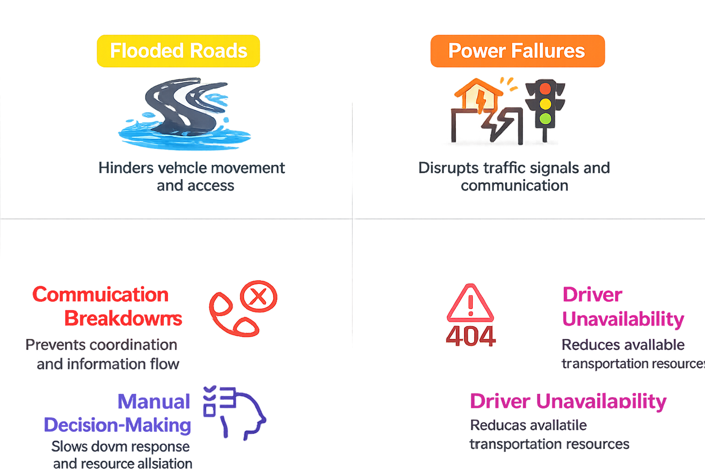

IoT-Driven Solutions for Disaster-Resilient Urban Mobility and Smart Infrastructure
Urban Mobility Challenges During Disasters

Slide 10
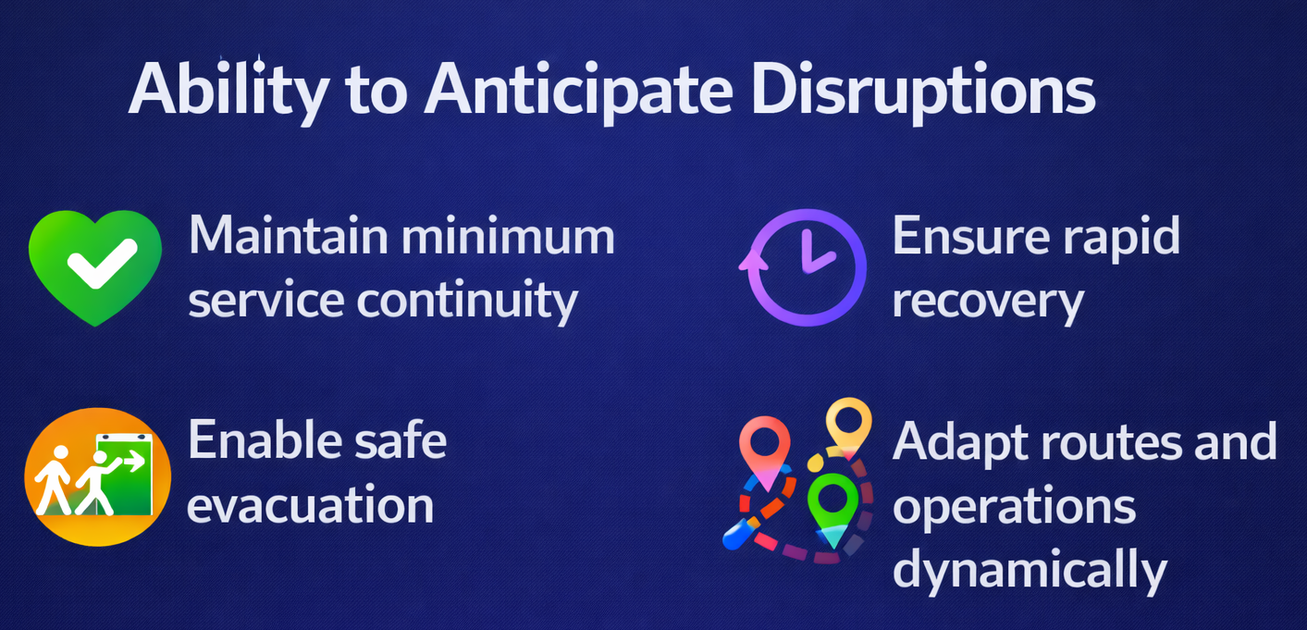
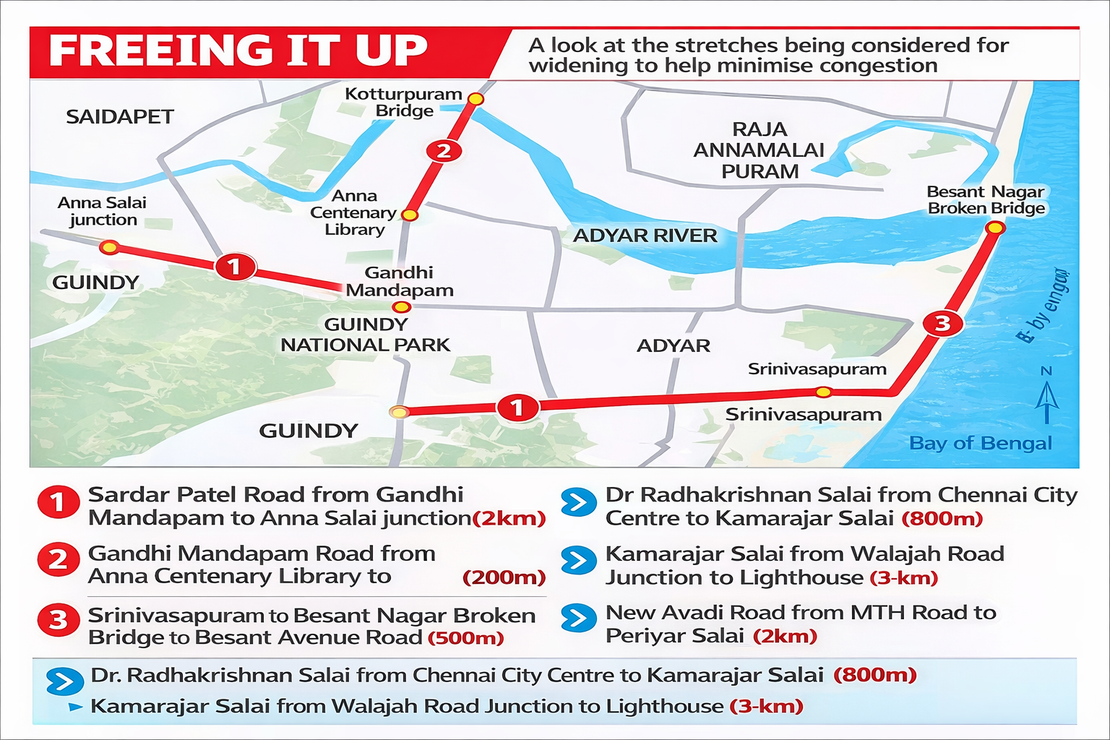
IoT-Driven Solutions for Disaster-Resilient Urban Mobility and Smart Infrastructure
What is Disaster-Resilient Urban Mobility

Slide 11
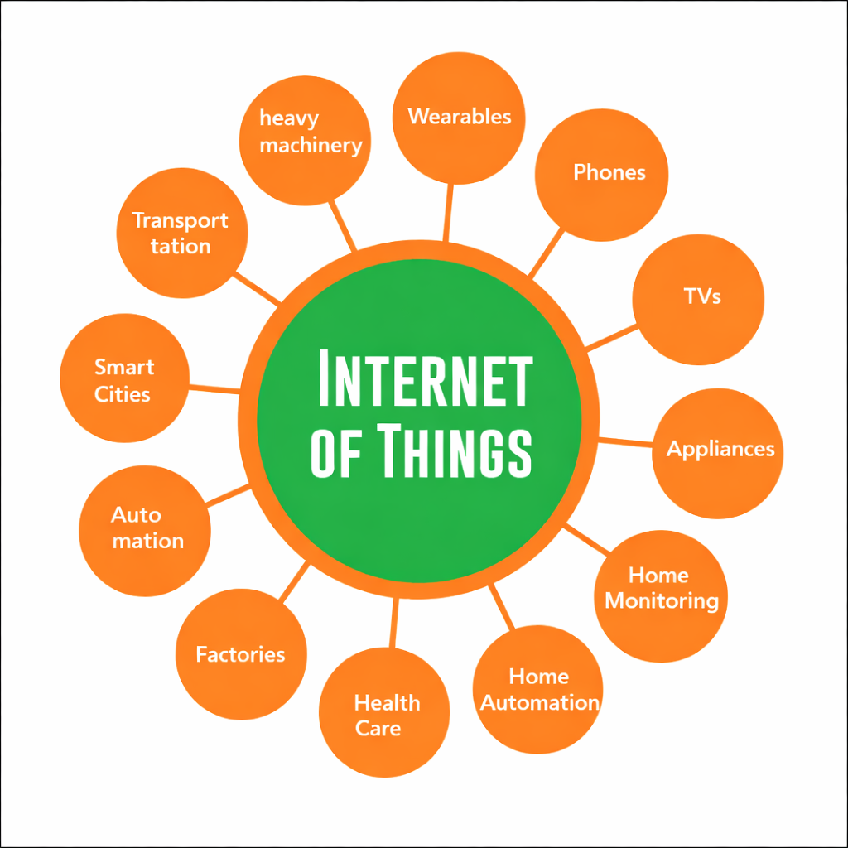
IoT-Driven Solutions for Disaster-Resilient Urban Mobility and Smart Infrastructure
What is IoT (Internet of Things)?
Network of connected physical devices
Sensors, software, and communication networks
Collects and exchanges real-time data
Enables monitoring, control, and automation
Foundation of smart cities and smart transport

Slide 12

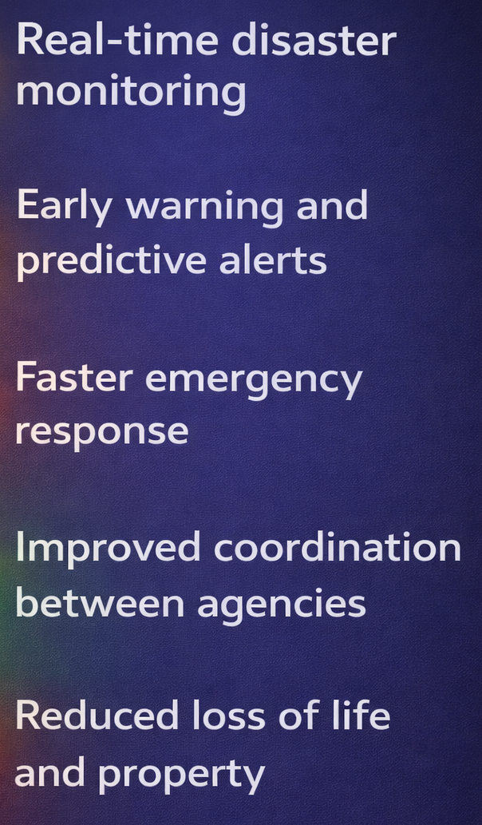
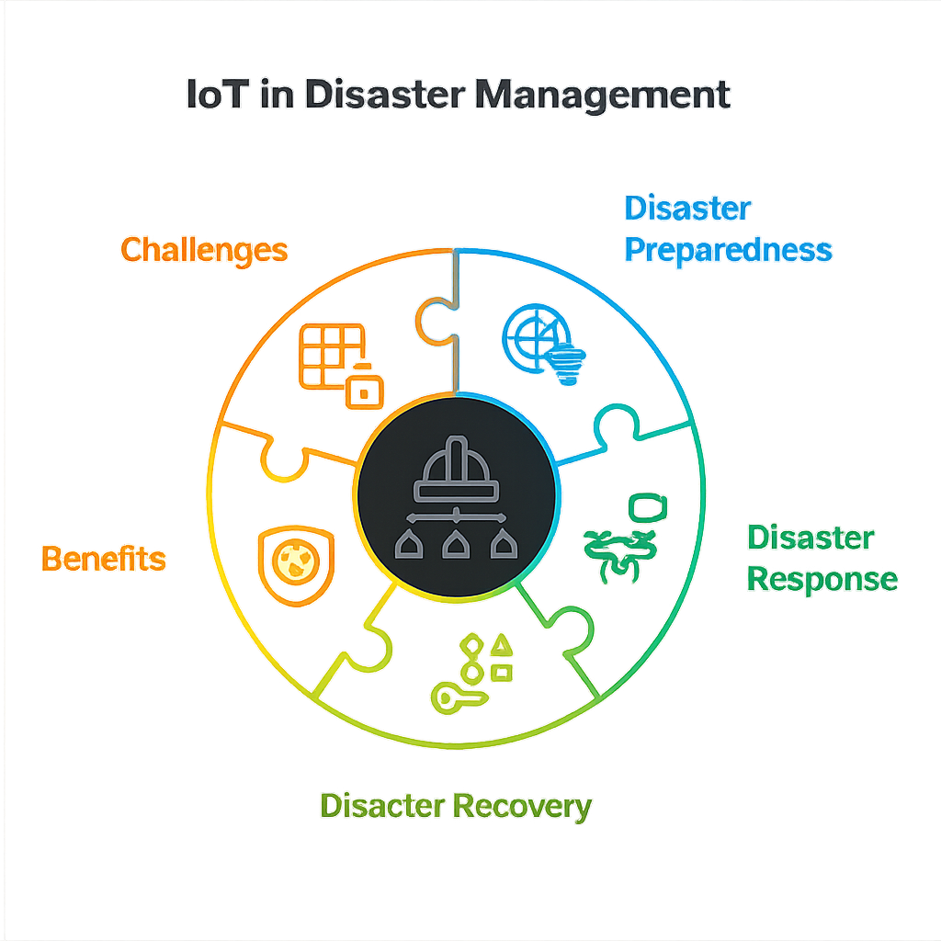
IoT-Driven Solutions for Disaster-Resilient Urban Mobility and Smart Infrastructure
Before technology, disaster response was reactive.
IoT makes it predictive.

Slide 13
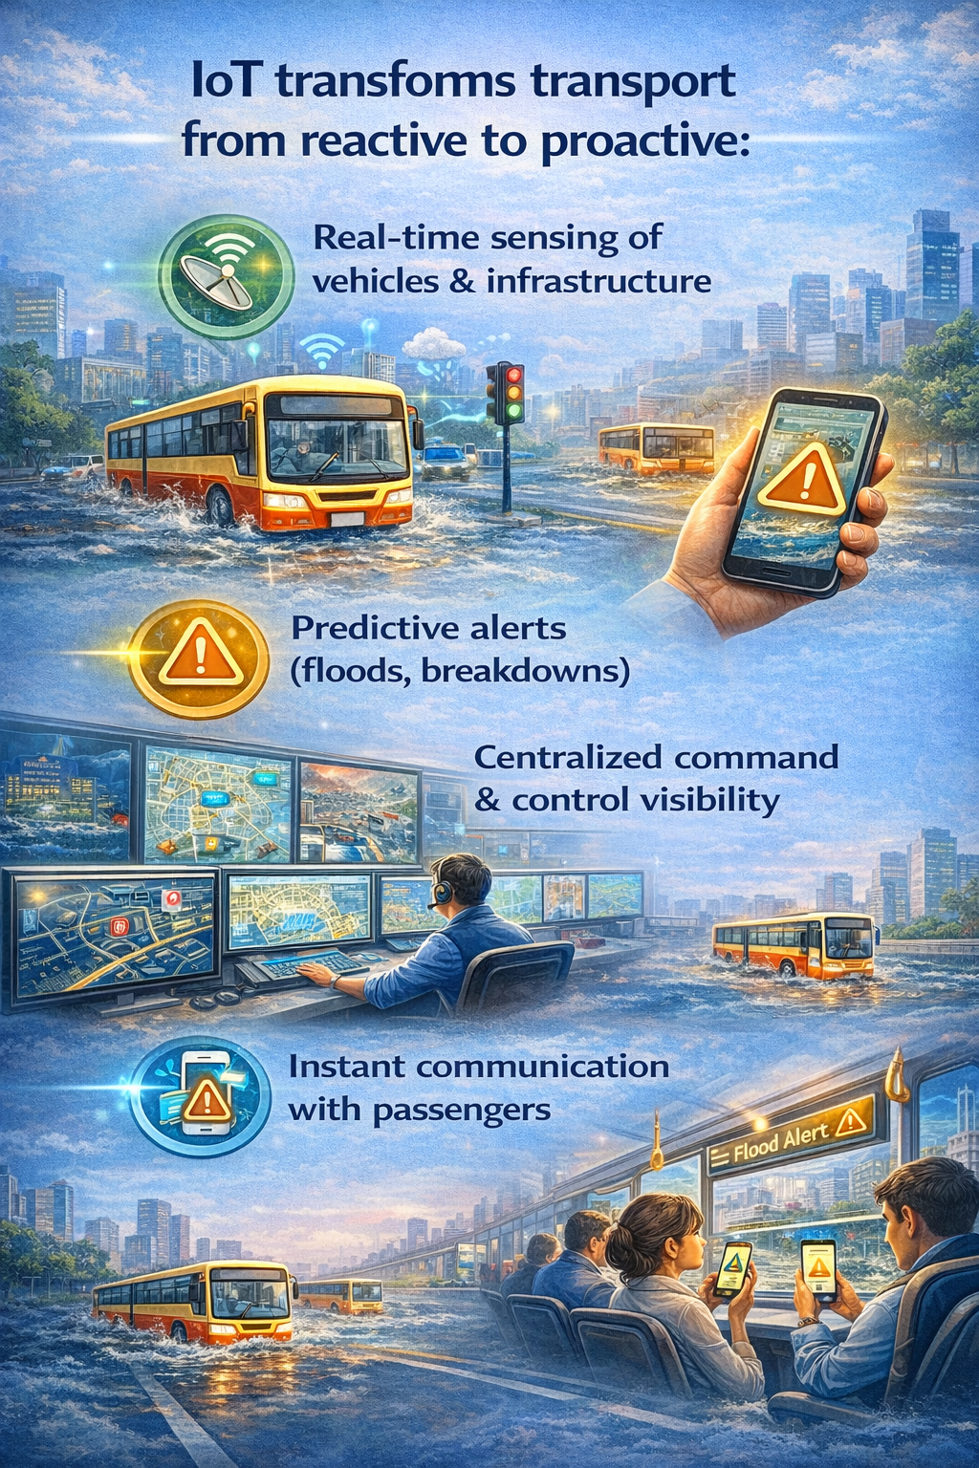
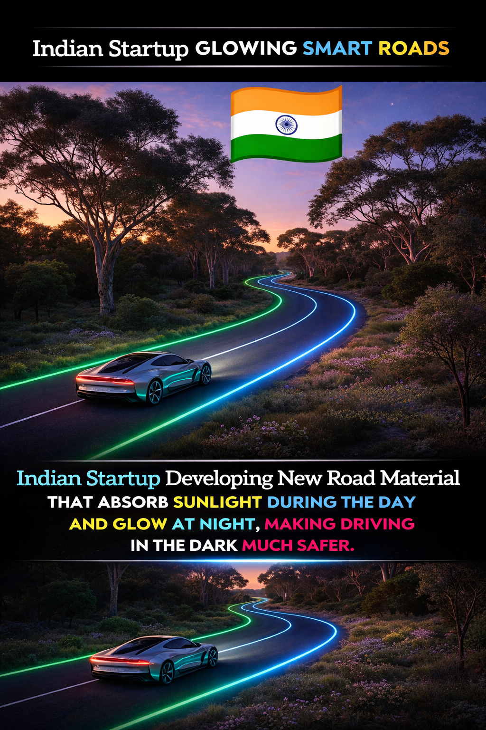
IoT-Driven Solutions for Disaster-Resilient Urban Mobility and Smart Infrastructure
Now that we know why IoT matters, let’s see where it operates in transport

Slide 14
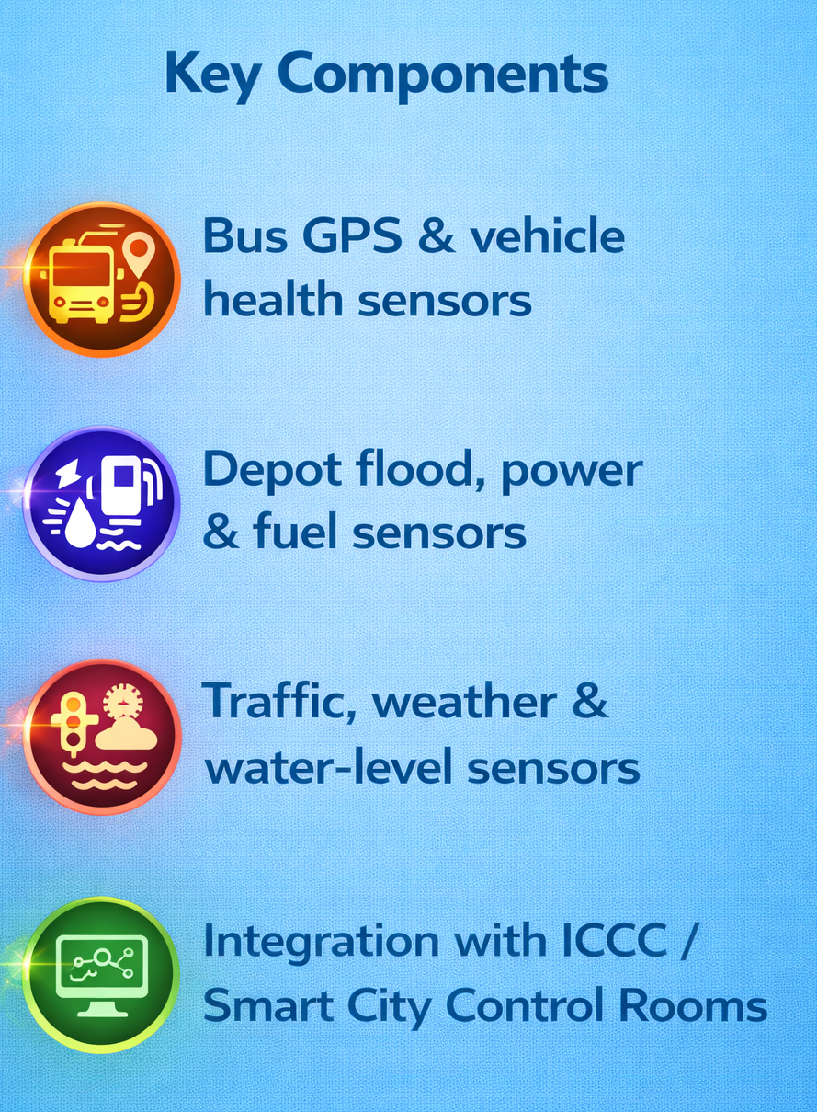
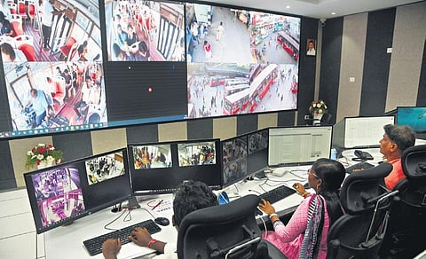
IoT-Driven Solutions for Disaster-Resilient Urban Mobility and Smart Infrastructure
IoT Architecture: Transport Perspective

Slide 15
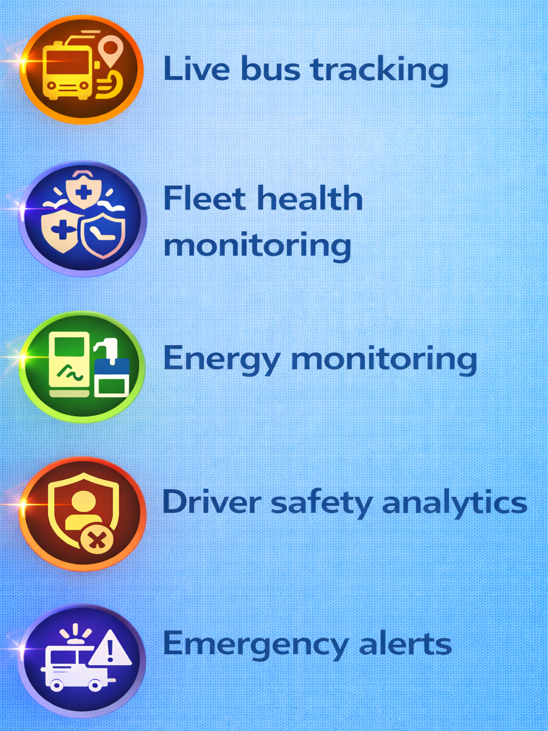
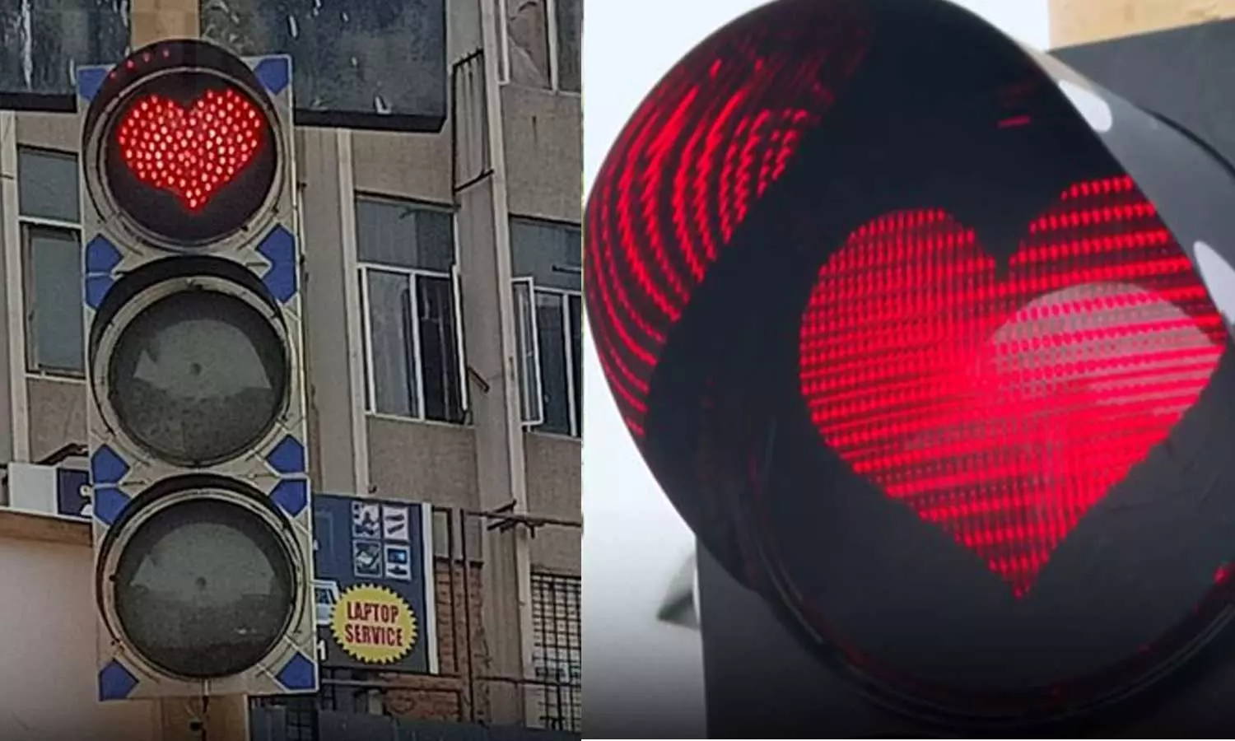
IoT-Driven Solutions for Disaster-Resilient Urban Mobility and Smart Infrastructure
IoT in Public Bus Operations

Slide 16
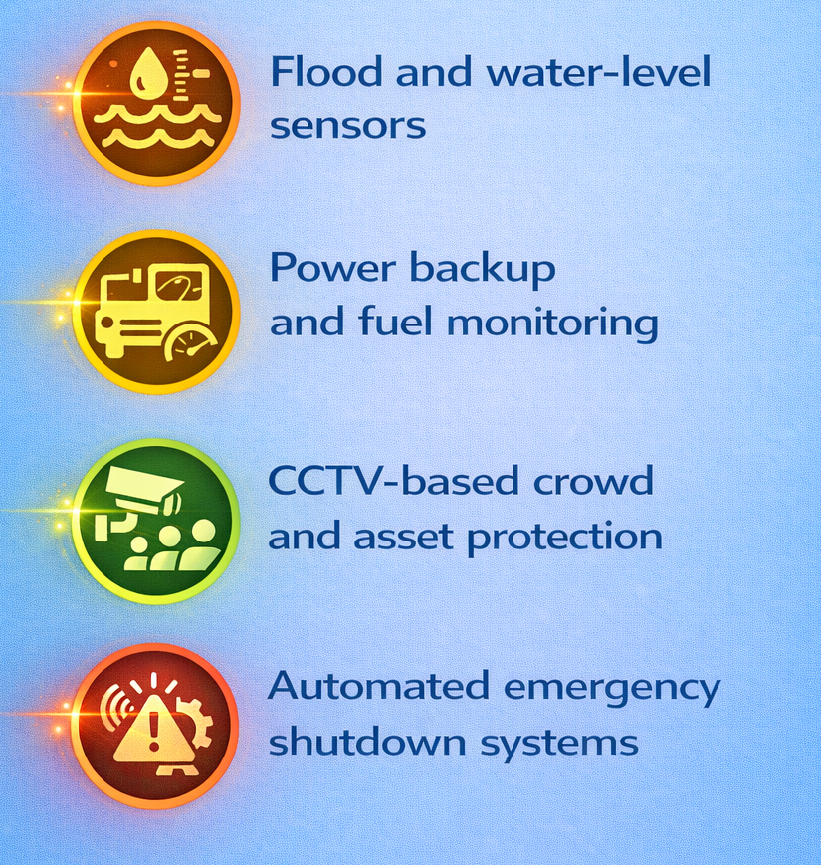
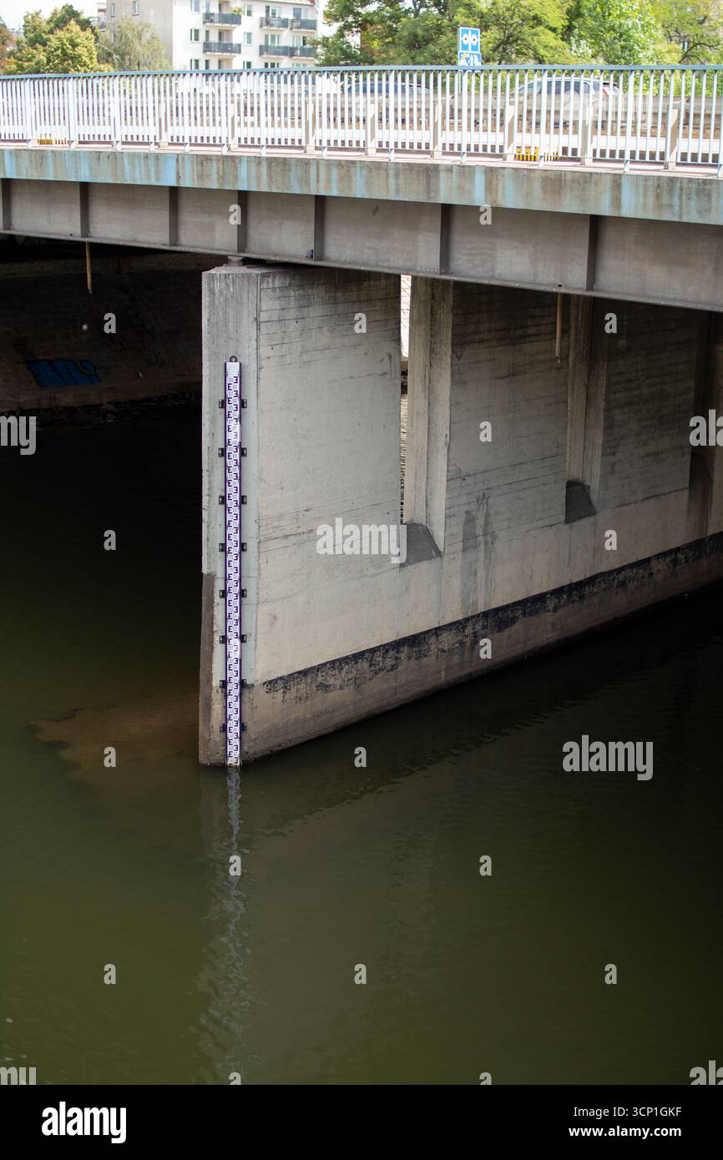
IoT-Driven Solutions for Disaster-Resilient Urban Mobility and Smart Infrastructure
Smart Bus Depots – Disaster Ready Depots

Slide 17
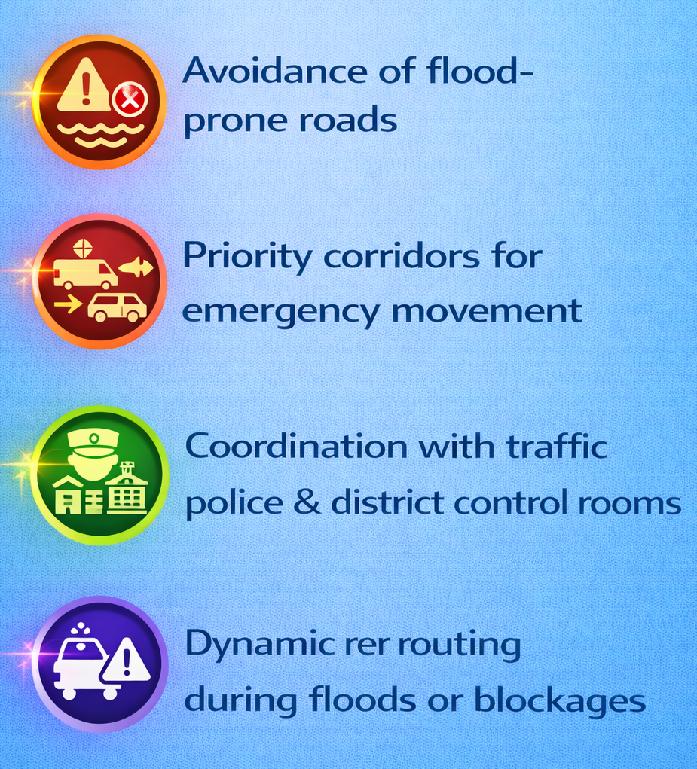
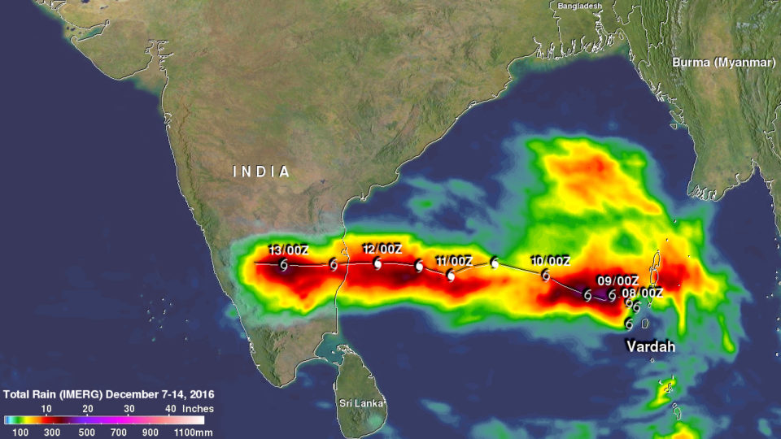
IoT-Driven Solutions for Disaster-Resilient Urban Mobility and Smart Infrastructure
Disaster-Aware Route Management

Slide 18
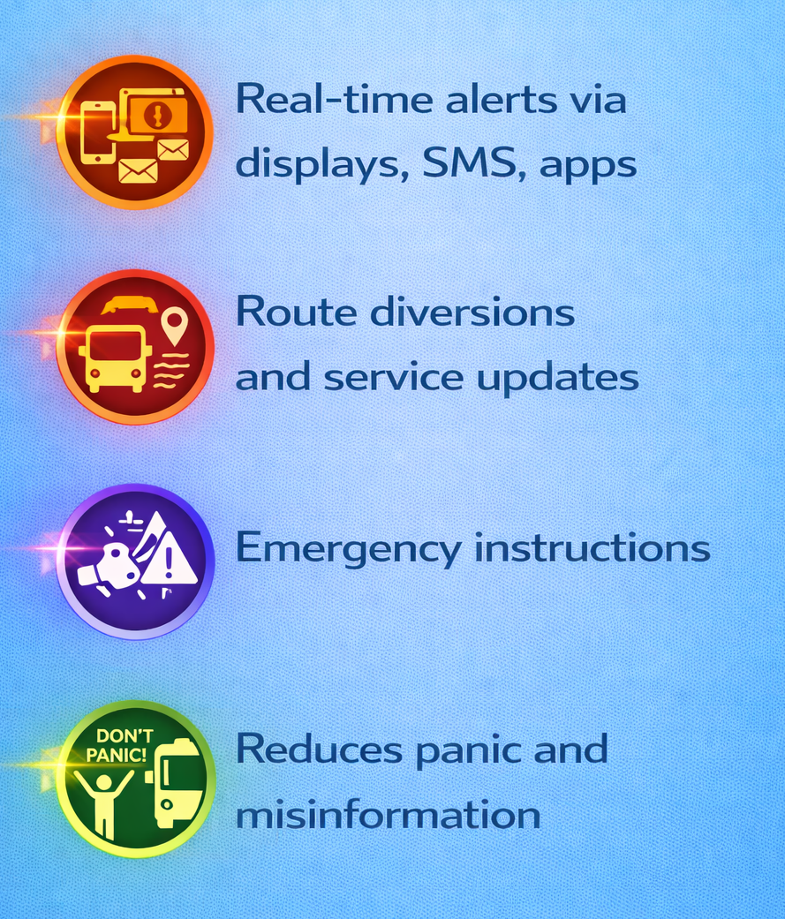
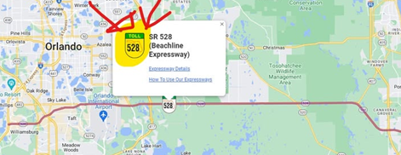
IoT-Driven Solutions for Disaster-Resilient Urban Mobility and Smart Infrastructure
Passenger Information Systems

Slide 19
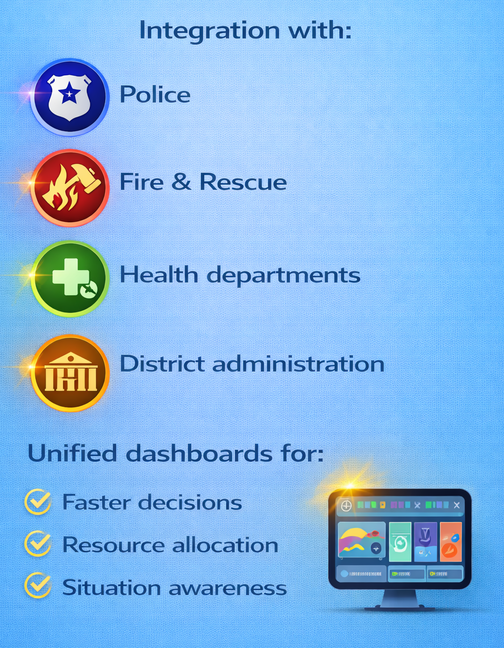
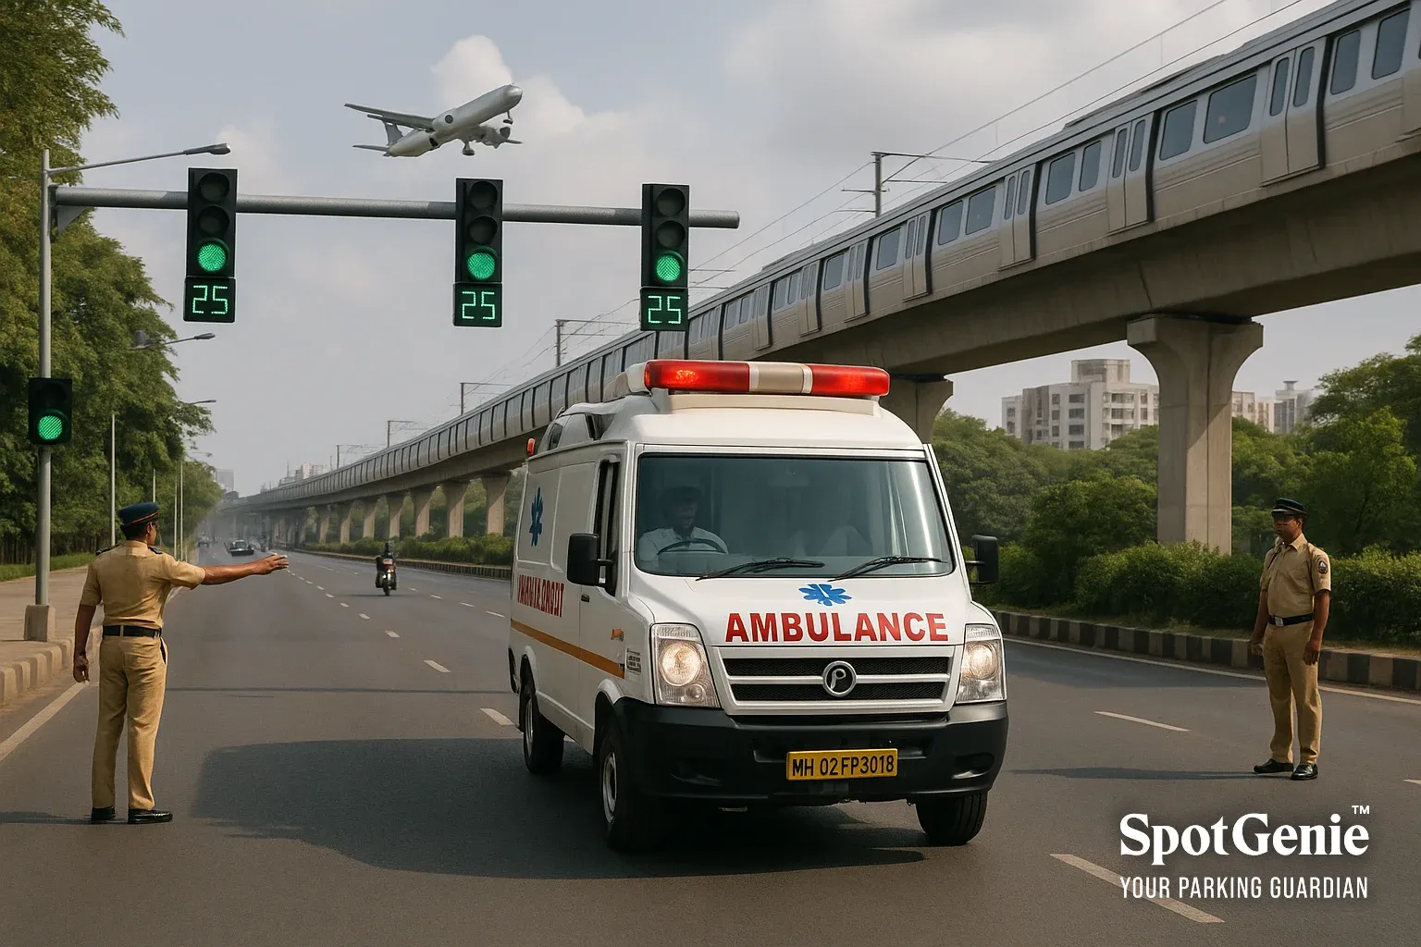
IoT-Driven Solutions for Disaster-Resilient Urban Mobility and Smart Infrastructure
Emergency Coordination Using IoT

Slide 20
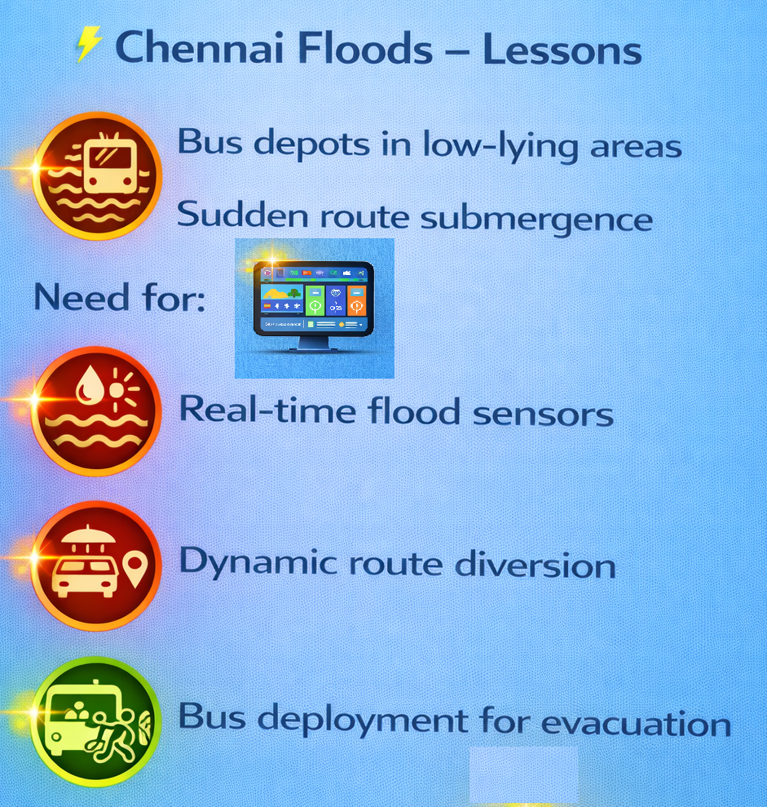
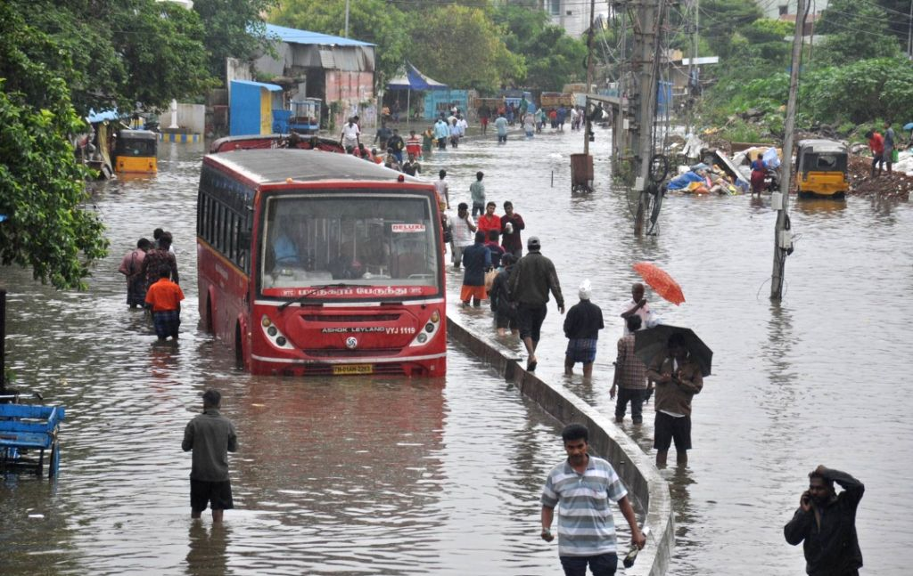
IoT-Driven Solutions for Disaster-Resilient Urban Mobility and Smart Infrastructure
Tamil Nadu Case: Flood Scenario

Slide 21
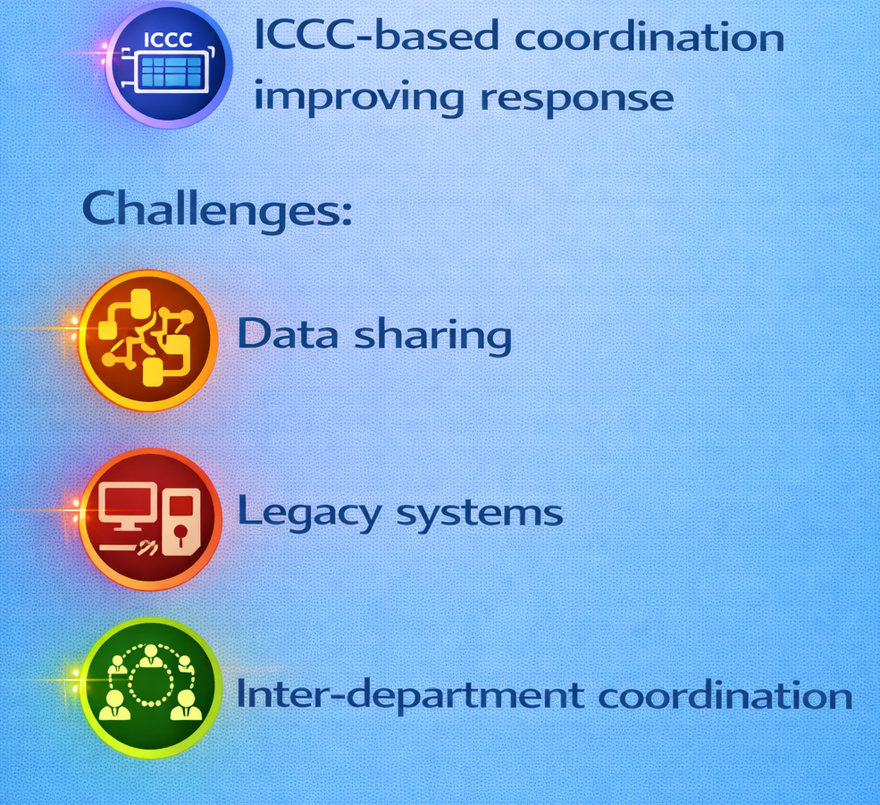
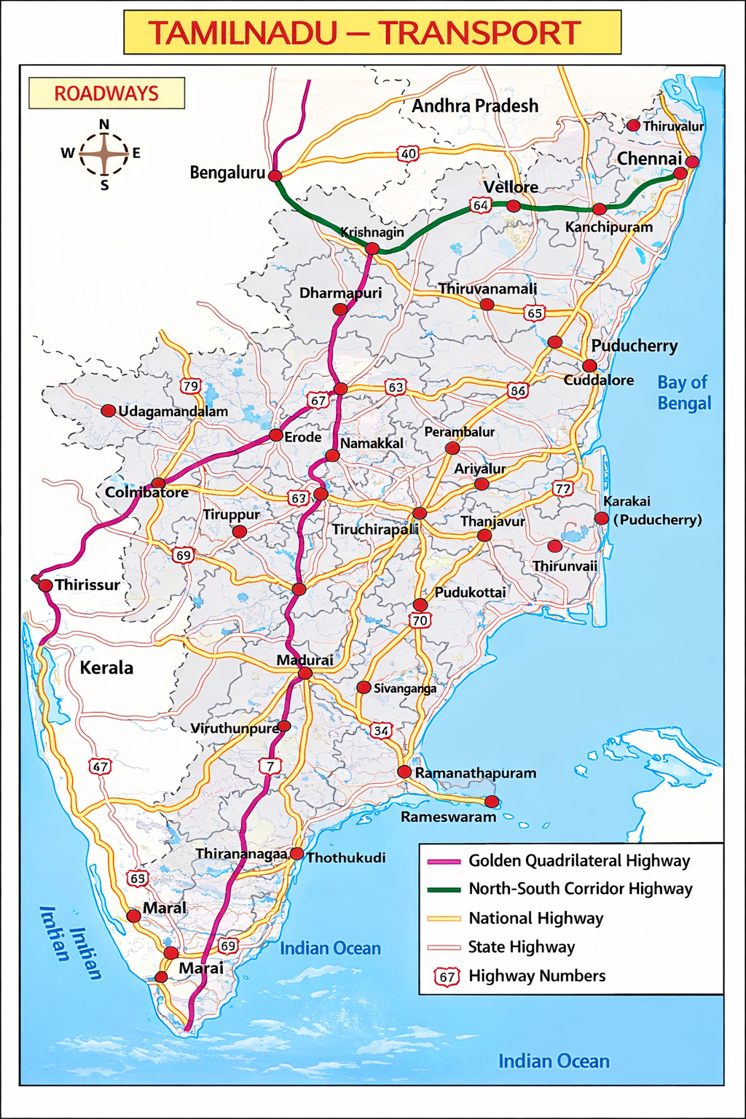
IoT-Driven Solutions for Disaster-Resilient Urban Mobility and Smart Infrastructure
Tamil Nadu: Operational Insights
MTC & TNSTC act as first responders

Slide 22
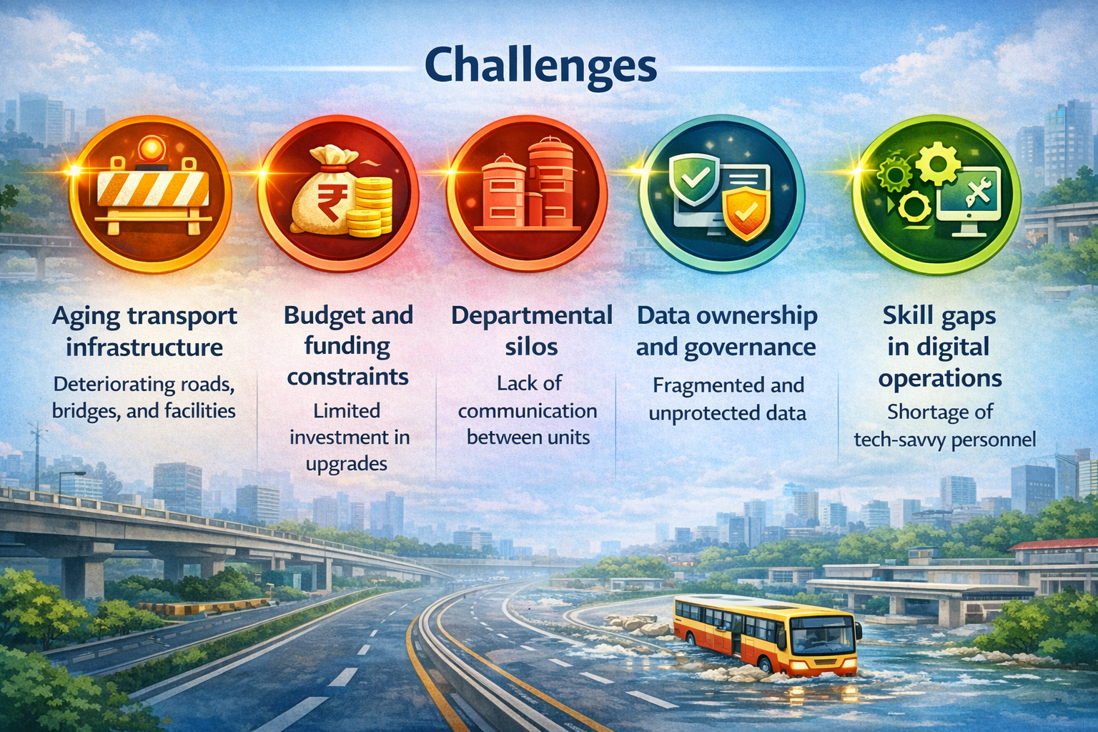
IoT-Driven Solutions for Disaster-Resilient Urban Mobility and Smart Infrastructure
Policy & Operational Challenges

Slide 23
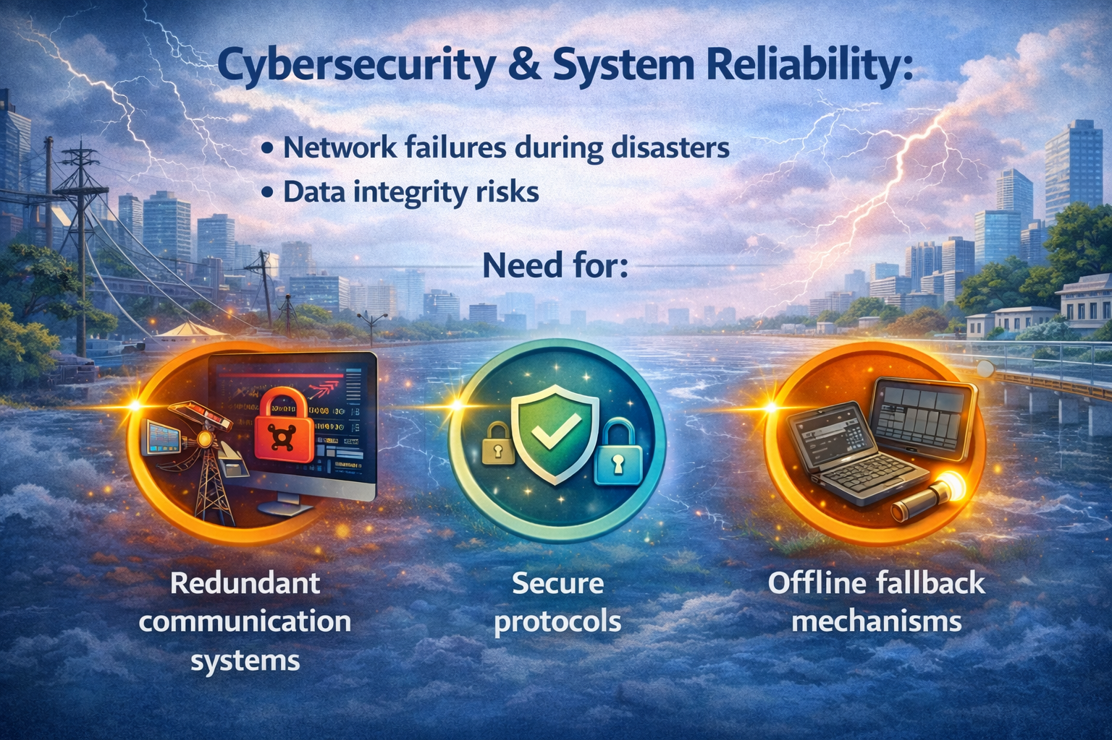
IoT-Driven Solutions for Disaster-Resilient Urban Mobility and Smart Infrastructure

Slide 24
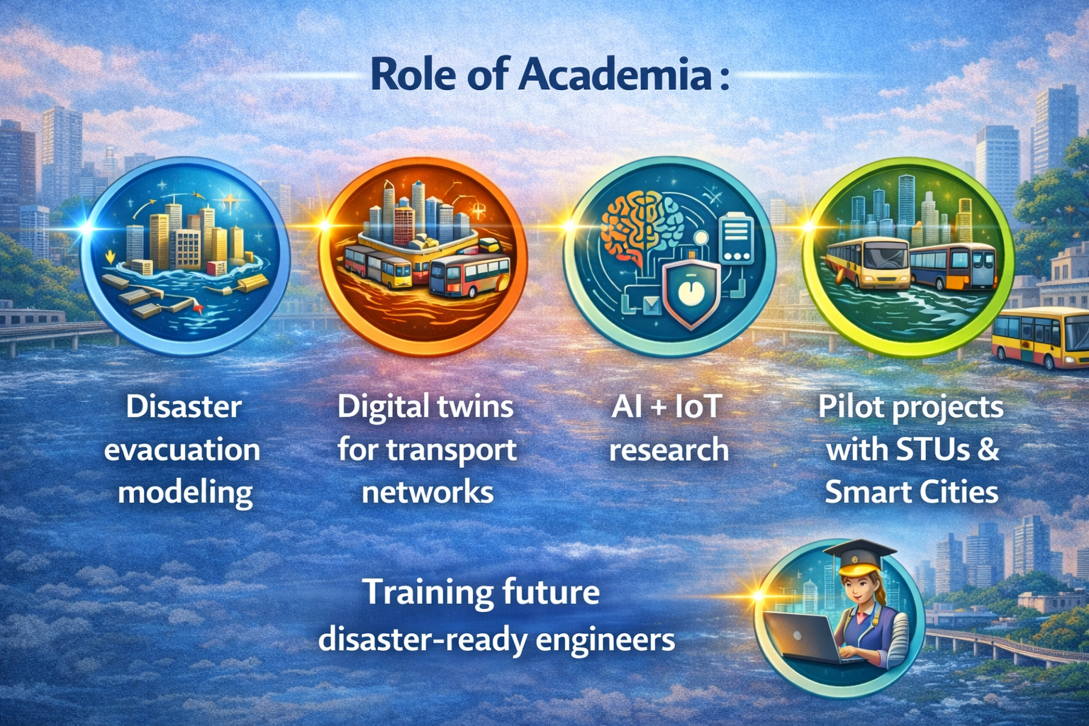
IoT-Driven Solutions for Disaster-Resilient Urban Mobility and Smart Infrastructure
Role of Academia in Evolving Cities

Slide 25
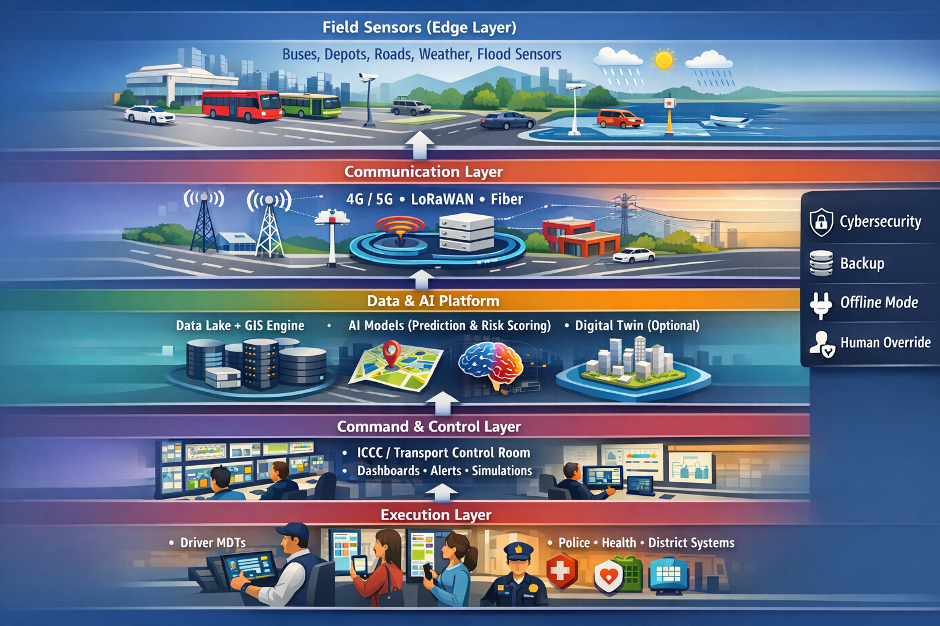
IoT-Driven Solutions for Disaster-Resilient Urban Mobility and Smart Infrastructure
A.I. Work Flow

Slide 26
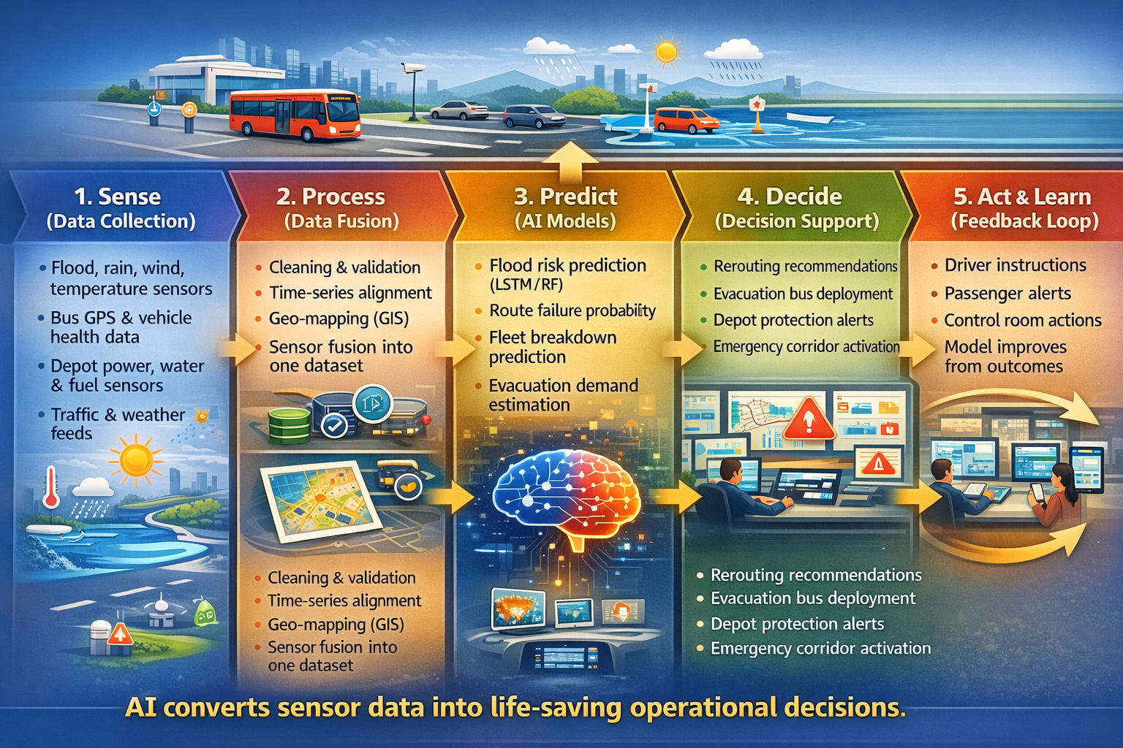
IoT-Driven Solutions for Disaster-Resilient Urban Mobility and Smart Infrastructure
A.I. – IoT Technical Architecture

Slide 27
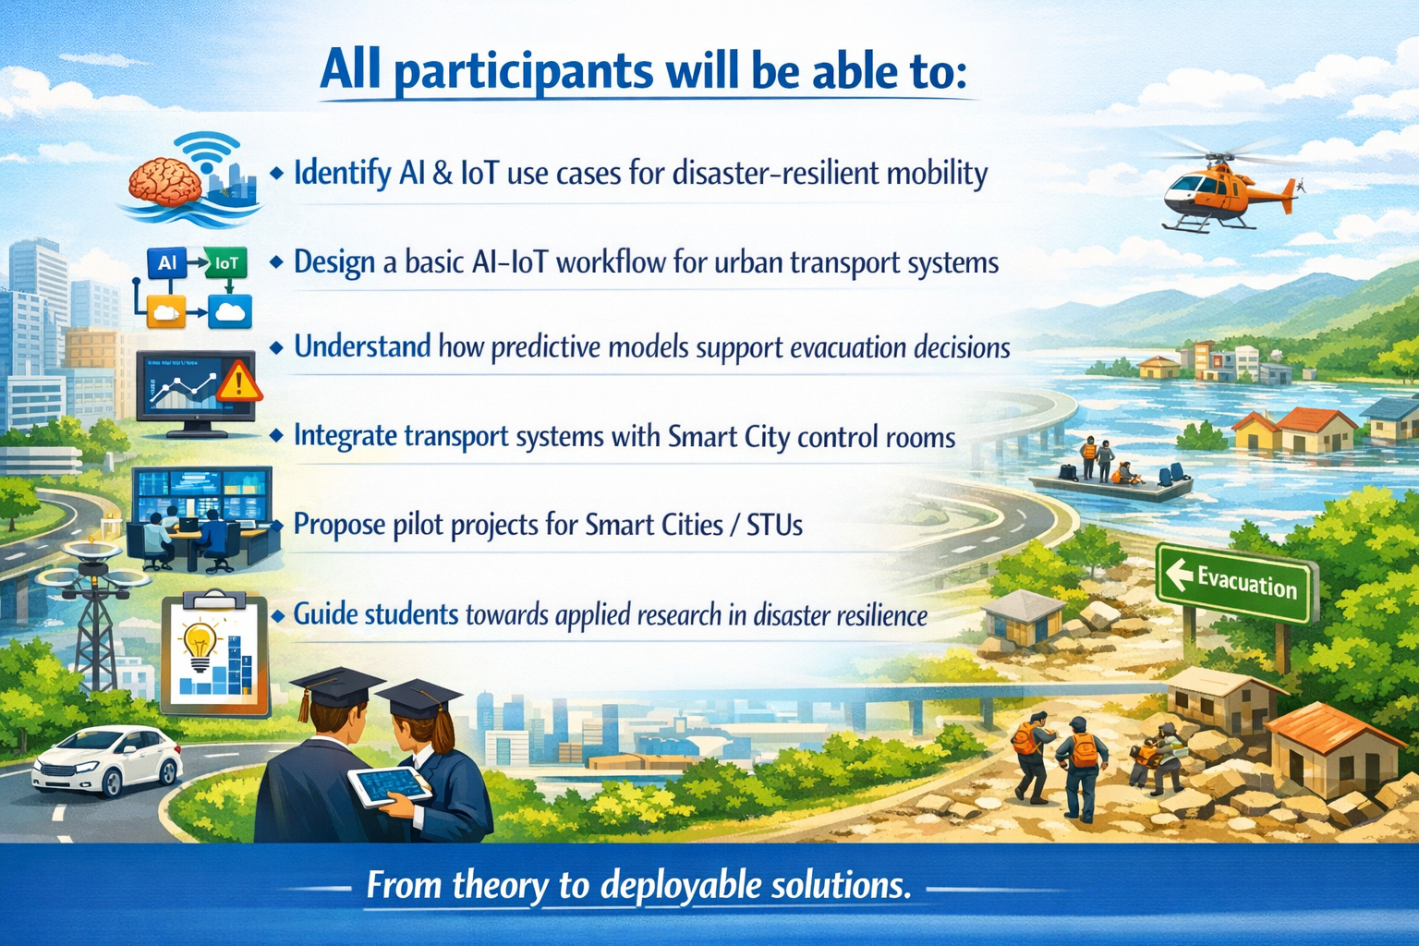
IoT-Driven Solutions for Disaster-Resilient Urban Mobility and Smart Infrastructure
Learning Outcomes of this Session

Slide 28
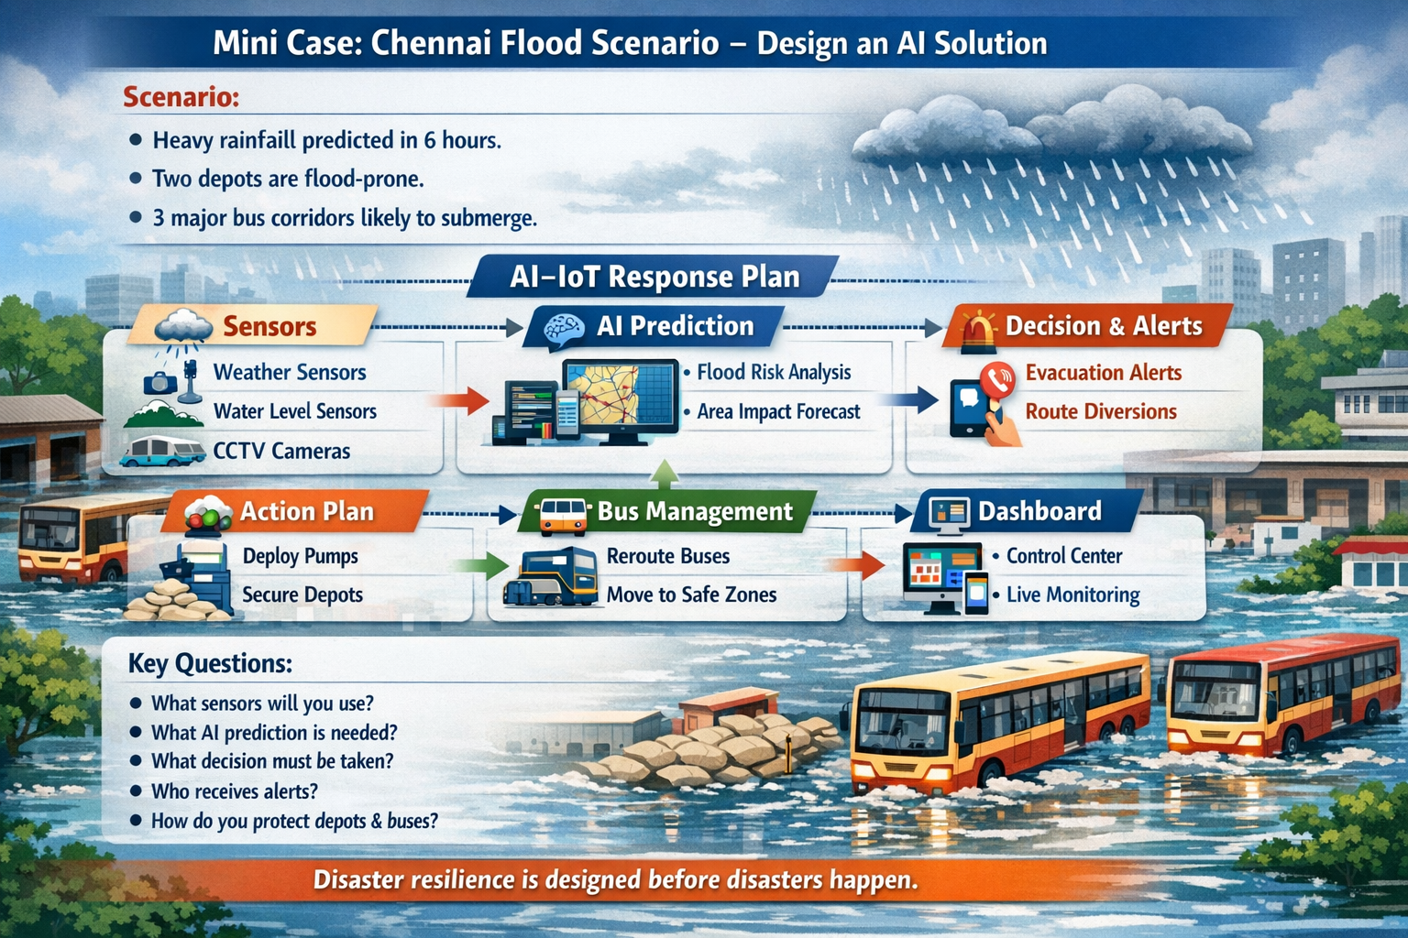
IoT-Driven Solutions for Disaster-Resilient Urban Mobility and Smart Infrastructure
Mini Case : Chennai Flood Scenario – Design an A.I.Solution

Slide 29
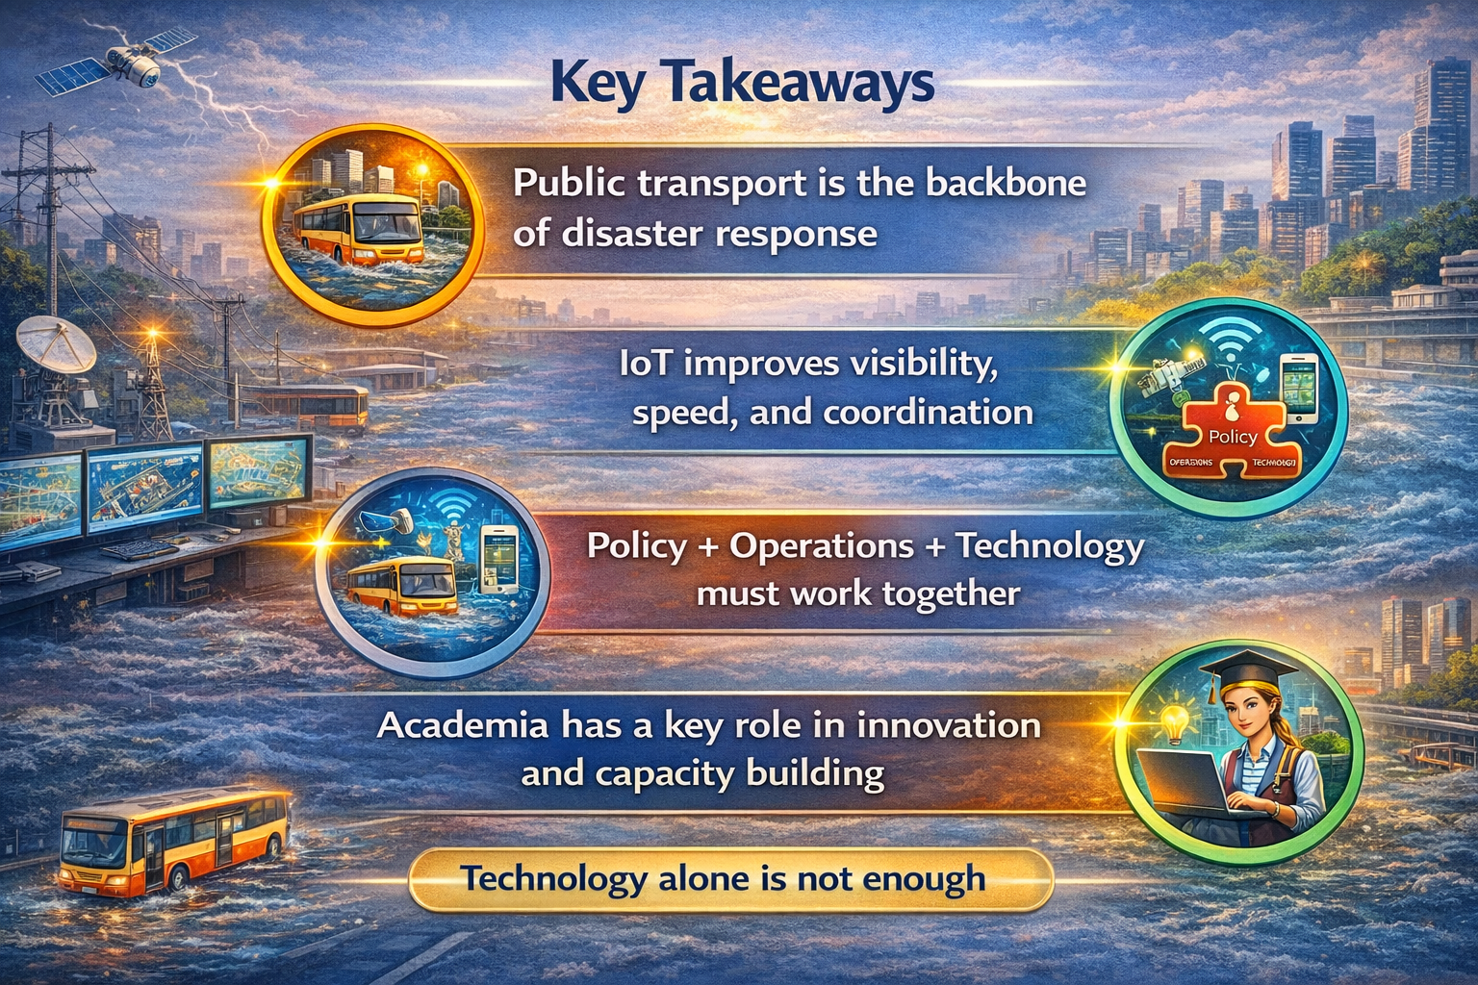
IoT-Driven Solutions for Disaster-Resilient Urban Mobility and Smart Infrastructure

Slide 30
Thank You
IoT-Driven Solutions for Disaster-Resilient Urban Mobility and Smart Infrastructure
Discussion & Interaction

